Slide 1



FGFOA
Annual Conference
2026
June 13-17, 2026
Loews Sapphire Falls Resort at Universal

Slide 2
FGFOA 2026
Annual Conference
June 13-17, 2026
Loews Sapphire Resort at Universal Orlando

Slide 3
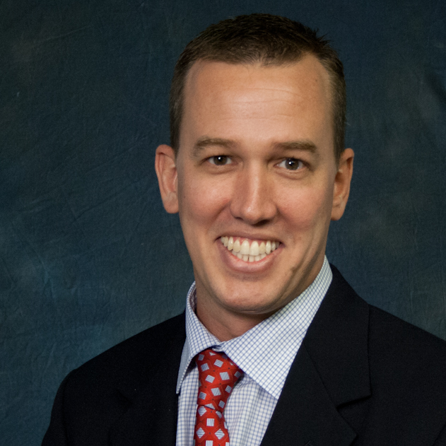
Keynote Speaker
John Smith
Title

Slide 4
Add Title Here
Add Text Here

Slide 5
Add Title Here
Add Text Here

