Slide 1
Clean Energy Tax Credits
Utilizing Direct Pay

Slide 2
Direct Pay Overview

Slide 3
Direct Pay
IRA introduced the concept of Direct Pay (also referred to as Elective Pay)
Section 6417 allows the following tax- exempt organizations to utilize Direct Pay for clean energy incentives:
State, local, and Tribal governments
Non-profit organizations
U.S. territories
Other entities
The IRS launched its Inflation Reduction Act (IRA) Pre-Filing Registration Tool in late 2023 for elective (direct) payments under Section 6417 and tax credit transfers under Section 6418 of the Internal Revenue Code.
Contemporaneous with the launch of the online tool, the IRS released a user guide and an instructional video that should be carefully reviewed before accessing the online pre-filing registration tool.
On March 5, 2024, the U.S. Department of the Treasury and the Internal Revenue Service (“IRS”) released the final rules on direct payment.
The final rules (RIN 1545-BQ63) provide that applicable entities generally include: tax-exempt organizations, state and local governments, Indian tribal governments, Alaska Native Corporations, the Tennessee Valley Authority and rural electric cooperatives.
Most importantly, the final rules include as applicable entities agencies or instrumentalities of state, local, tribal, or territorial government, which means that public universities and public-school districts are eligible for direct pay.
This is an opportunity for public universities and public-school districts to monetize tax credits and create additional revenue.

Slide 4
Energy Tax Credits & Incentives
Section 48 – Investment Tax Credit
Provides a tax credit for investment in renewable energy projects
The base credit is 6% of the basis of the qualified energy property
Credit may be increased to 30% if project meets prevailing wage and apprenticeship requirements
In addition to the respective 6% and 30% base credit rates there are several stackable bonuses potentially available to increase the credit rate (domestically sourced materials and geography)
Subject to a recapture period of five years from when the property is placed into service

Slide 5
Energy Tax Credits & Incentives
Section 45 - Production Tax Credit
Provides a tax credit for production of electricity from renewable resources
The PTC provides a base credit amount of $0.30 cents per kilowatt hour adjusted for inflation
Credit may be increased by 5x if project meets prevailing wage and apprenticeship requirements
In addition to the respective base credit rate there are several stackable bonuses potentially available to increase the credit rate
Unlike the investment tax credit, the production tax credit is recognized over a 10-year period beginning on the date the facility is originally placed into service
Adjusted for inflation annually
Cannot combine both ITC & PTC for a single facility generating clean electricity, must choose one or the other

Slide 6
Energy Tax Credits & Incentives
Section 48E – Clean Electricity Investment Tax Credit
Provides a technology-neutral tax credit for investment in facilities that generate clean electricity
Replaces the investment tax credit for energy property (Section 48) for property placed in service in 2025 and later
The base credit is 6% of the basis of the qualified energy property & credit may be increased to 30% if project meets prevailing wage and apprenticeship requirements

Slide 7
Energy Tax Credits & Incentives
Section 45Y – Clean Electrcity Production Tax Credit
Provides a transferable technology-neutral tax credit for production of clean electricity.
Replaces the production tax credit for electricity generated from renewable sources (§45) for facilities placed in service in 2025 and later
The PTC provides a base credit amount of $0.30 cents per kilowatt hour adjusted for inflation
Credit may be increased by 5x if project meets prevailing wage and apprenticeship requirements

Slide 8
Project Types Eligible for Direct Pay
Technology | ITC Eligible | PTC Eligible
Solar | X | X
Wind | X | X
Geothermal Electricity | X | X
Landfill Gas | X | X
Biomass | X | X
Hydropower | X | X
Municipal Solid Waste | X | X
Standalone Energy Storage | X | X
Combined Heat & Power | X | -
Biogas | X | -
Geothermal Heat Pump | X | -
EV Charger Installation | X | -

Slide 9
Relevant Project Types Eligible for Direct Pay
Technology | ITC Eligible
Solar | X
Standalone Energy Storage | X
Geothermal Heat Pump | X
EV Charger Installation | X

Slide 10
IRA Credit and Deduction Enhancers

Slide 11
Credit Rate Increase
IRA implemented provisions that can increase base credit rate
Credit Increases | Requirements
5 times the base credit | Projects meeting prevailing wage and registered apprenticeship requirements
10% | Facility meets domestic content requirements
10% | Placed in service in an energy community
10% | Solar and wind facilities with a maximum net output of less than five megawatt (a/c) if located in a low-income community
20% | Project is part of a qualified low-income residential building project or a qualified low-income economic benefit project

Slide 12
Prevailing Wage and Apprenticeship Requirements
To achieve the maximum credit rate of 5x the base credit rate projects must meet prevailing wage & apprenticeship
Prevailing Wage Requirements
Any laborers or mechanics employed on a project must be paid prevailing wages for the location of the project
The prevailing wage rate is determined by the Department of Labor
Notice 2022-61 offers initial guidance to taxpayers on how to satisfy wage and apprenticeship requirements
Exception for certain projects with a maximum net output of less than one megawatt
Apprenticeship Requirements
Percentage of total labor hours for construction, repair or alteration of an energy facility performed by apprentices Participating in a registered apprenticeship program
Taxpayers satisfy the apprenticeship program requirement when hours worked by qualified apprentices make up a set percentage of the total hours worked on a construction project
The percentage of qualified apprentice hours to total hours vary based on the date construction begins:
Before January 1, 2023: 10%
After 2022 and before January 1, 2024: 12.5%
On or after January 1, 2024: 15%
Apply to both 179D and ITC/PTC Benefits

Slide 13
Prevailing Wage
Prevailing wage is the combination of the hourly wage rate and any bona fide fringe benefits
Prevailing wage rates vary based on:
Geographical location
The classification of the laborers completing the work
The type of construction being performed
The Department of Labor (DOL) provides prevailing wage rates on their website

Slide 14
Apprenticeship
Percentage of total labor hours for construction, repair or alteration of an energy facility performed by apprentices Participating in a registered apprenticeship program
Taxpayers satisfy the apprenticeship program requirement when hours worked by qualified apprentices make up a set percentage of the total hours worked on a construction project
The percentage of qualified apprentice hours to total hours vary based on the date construction begins:
Before January 1, 2023: 10%
After 2022 and before January 1, 2024: 12.5%
On or after January 1, 2024: 15%

Slide 15
Domestic Content Requirements
Entities eligible to claim direct pay for projects that begin construction after 12/31/2023 must meet domestic content requirements to achieve maximum tax credit
The table below is a high-level example of how it would impact the credit amount for a direct pay perspective

Slide 16
Direct Pay Process

Slide 17
How Direct Pay Works
A tax-exempt organization makes an investment in certain clean energy technologies eligible for Direct Pay
The entity files an annual tax return to claim Direct Pay (typically form 990-T for entities that don’t normally file a tax return)
The entity notifies the IRS of their intent to claim Direct Pay
IRS then pays the NFP entity the value of the credit

Slide 18
Direct Pay Timeline
A college intending to file for Direct Pay must complete the pre-registration form in the IRS portal
The pre-registration should be completed:
No earlier than the beginning of the tax period when you earn the credit
After placing an investment in service, electricity is produced, or the electric charger is installed and ready to charge vehicles.
Once the pre-registration is complete you will obtain a registration number which is used to file for direct pay which may take up to 120 days to receive
For a project placed in service in 2023 the form would be filed in 2024
Upon receipt of the registration number, you can file the appropriate form (typically 990-T) for the tax year in which the asset is placed in service

Slide 19
Direct Pay Timeline / Continued
To file for Direct Pay, tax-exempt entities will use form 990-T : Exempt Organization Business Income Tax Return
It will also file Form 3800, General Business Credit
For most tax-exempt and government entities is generally the 15th day of the fifth month after the end of the entity’s tax year
Recently IRS has confirmed fiscal year governmental filer that has not established a tax year (those who don’t file 990-T) can elect to file elective pay 990-T on a calendar year basis
Entities without an annual filing requirement can receive a 6-month extension to file their return and make a Direct Pay election

Slide 20
Qualifying Costs Examples
Solar |  | Geothermal |  | Energy Storage |  | EV Chargers/Vehicles
Qualified | Ineligible | Qualified | Ineligible | Qualified | Ineligible | Eligible
Panels | Roofing | Pumps | Duct vents | Electrochemical batteries | Property primarily used for transportation | EV charger hardware
Some wiring | Non-structural additions | Well system | Existing HVAC equipment | Ultracapacitors |  | EV charger installation costs
Racking | Electrical changes not necessary for solar function | Some wiring |  | Reversible fuel cells |  | For a vehicle to qualify it must: Have capacity of at least 7kwh Weigh less then 14,000 pounds Made by qualified manufacturer Final assembly in North America Meet critical mineral and battery component requirements
Structural necessity | Existing electrical | Some piping
Inverter
* The list of costs above is not exhaustive but meant to represent those costs that are generally qualified and those that are not. Each specific asset will need to be reviewed to determine which costs are eligible.

Slide 21
Additional Considerations
The IRS released Final Regulations which clarify several other important elements of direct pay. The became effective in March of 2024.
Chaining of credits is not allowed. Taxpayers will not be permitted to purchase credits and then receive direct payment under the 6417 rules.
An excessive payment will be repaid with an addition of 20% if the entity receives a larger direct payment than it is due and there was no reasonable cause. Important to document and substantiate credit eligibility and the credit amount when electing direct payment.
Direct pay applies to the entire credit amount and cannot apply to only a portion of the credit as can be done under the transferability rules.
There are no restrictions on how direct pay proceeds may be utilized.
Going forward, direct pay amounts will be phased down based on meeting the domestic content requirements also found in the enhancement rules. E.g., if domestic content requirements are not met for construction started in 2024, only 90% of an earned credit will be eligible for direct pay.

Slide 22
Example
College Installs Solar
Scenario
Credit Validation
Result
A County is considering investing $1M in solar panels on top of their buildings to reduce electric costs
It wants to ensure that it receives the maximum credit possible for this investment
Review that the technology is eligible for Direct Pay
Track that prevailing wage & apprenticeships requirements are met
Complete pre-registration form
The County met prevailing wage and apprenticeship requirements and are eligible to receive a credit of 30%
They file form 990-T on May 15th, 2025
Receive a refund of $300K within 45 days
Title

Slide 23
Real Estate & Construction Section 179D

Slide 24
Direct Pay vs 179D Deduction Allocation
Direct pay allows a tax-exempt entity to receive a refund from the IRS for their investment in an eligible clean energy technology
Tax-exempt entities eligible for a 179D deduction can allocate their deduction to the contractor/developer who performed upgrades
The decision to allocate their 179D deduction to the designer of the upgrades may result in monetary benefits to the tax-exempt entity

Slide 25
IRC Section 179D
What is it:
Constructing, improving, or designing buildings to be energy efficient may help you meet sustainability goals and could also increase your cash flow and reduce federal income tax liability.
Claiming the Internal Revenue Code (IRC) Section 179D tax deduction requires compliance with various tax code and industry standards, rigorous energy modeling, and third-party certification by a qualified individual.
Commercial buildings qualify for the Section 179D deduction if the building receives energy-efficient improvements to the interior lighting, HVAC, and hot water or envelope systems.
How much is the Deduction:
For property placed into service after December 31, 2022, the maximum available deduction is more than $5 per square foot for the building affected.
What is Required to Calculate the Deduction:
An energy model of the building, using DOE-approved software
An inspection and certification of the property, completed by a qualified third party
Organizations that worked on the design aspect of energy efficient buildings will need a statement of allocation signed by the NFP building owner and the taxpayer to qualify for the 179D deduction.

Slide 26
Updates to 179D in the IRA
Increase in Maximum Available Deduction: Eligible buildings may now qualify for $5.65/SQFT, up from $1.88 as adjusted for inflation.
Reduction in Energy Consumption Requirement: Building energy consumption will only need to be reduced by 25% instead of 50% for maximum deduction.
Expansion Of Eligible Buildings: Any tax-exempt entity may now allocate a section 179D deduction to a designer
Churches, Charity Hospitals, Private Schools, Public Schools, Tribal Lands, etc.
Why would a tax-exempt entity do this? – What do they get in Exchange?
Triennial Reset Of Deduction: A new 179D deduction may be calculated and taken for a commercial building every 3-4 years.
Relevant upgrades to the building must have been made in that time period.
New Prevailing Wage and Apprentice Program Requirements: To qualify for the maximum $5/SQFT, the construction project must pay prevailing wages and conduct an apprentice program.

Slide 27
Project Types: Direct Pay vs 179D Deduction

Slide 28
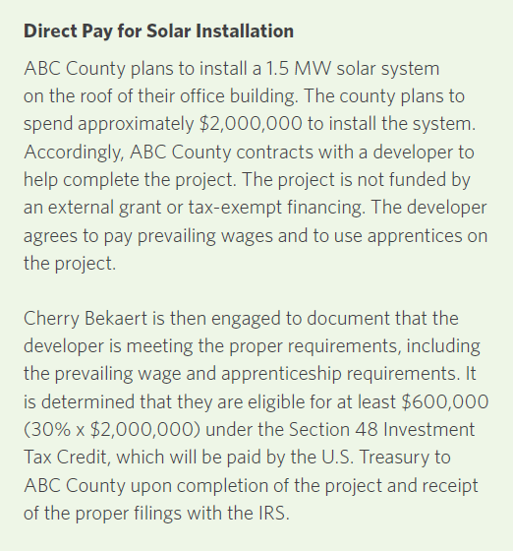
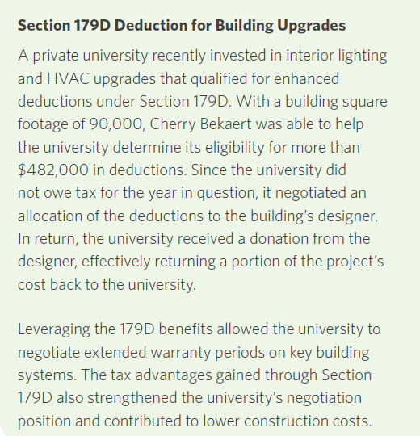
Monetization of Energy Tax Credit Examples

Slide 29
Information Requests to Scope Project Benefits
Direct Pay
Which clean energy technology are you utilizing or considering utilizing?
Project address for each project?
Estimated construction start date for each project?
The estimated placed in-service date or substantial completion of each project?
The funding source (internal, grants, debt, etc.)?
The estimated total capital cost of equipment type per eligible project (geothermal system, solar panels, wind turbines, etc.)?
The estimated energy capacity of the projects, if applicable (Nameplate MW, etc.)
Are the materials being used for the construction of the asset being sourced domestically?
At what stage is the project (Planning, design, partial completion, etc.)?
IRC Section 179D
List of projects completed after June 1, 2023 (Spreadsheet)
List of future projects to be completed through 2025 (Spreadsheet)
Name of building
Address of building
Cost of project
Brief description of project

Slide 30
Contact Us
Martin Karamon Partner | Tax Credits & Incentives Advisory Practice Leader
martin.karamon@cbh.com
Timothy Doran
Director | Tax Credits & Incentives Advisory
timothy.doran@cbh.com
David Mohimani
Senior Manager | Tax Credits & Incentives Advisory
david.mohimani@cbh.com

