Slide 1
Lean Today to Change Tomorrow Successfully Implementing Lean Six Sigma
Mike Sibley, CPA, LSS Black Belt December 11, 2015
……………………………………………………………………………………………………………………………………………………………………………………………………………………………..…..
Providing Tax, Auditing, Accounting & Controllership, Technology Solutions, Consulting, and Wealth Management Services Since 1964.
Notes:
BBP/Mike

Slide 2
Agenda
Introduction to Lean Six Sigma
Simulation
5 Principles of Lean
9 Categories of Waste
Lean Practices in Action
Success Stories
Notes:
Mike

Slide 3
What is the Goal?
Notes:
Mike
Decrease costs
Taxpayer dollars can go to more services

Slide 4
Benefits of Implementation
Increased throughput and capacity
Better quality from the start
Less management time in “the mud”
Allows time for high level activities and identifying value-adding solutions
Increased citizen service and satisfaction!
Decreased costs
Reduced turnaround time
Improved employee morale
Decreased overtime
Better inventory management
Improved communication
Better utilization of people’s talents
Notes:
Mike

Slide 5
Benefits of Implementation
Erie County, New York:
The first large county in the United States to implement Lean Six Sigma
Saved $2.2 million in 2008
County of McHenry, Illinois:
Used Lean for its development regulation processing
Lean reduced internal processing time by 75% without requiring an investment in new technology
City of Conroe, Texas:
Wanted to imbed a Lean culture into the organization. Selected staff members were trained in Lean concepts.
$2 million in combined real-dollar savings in their $42 million general fund budget and $14.7 million enterprise fund budget
Notes:
BBP
We’ll share more success stories later.
“The University at Buffalo's Center for Industrial Effectiveness (the Center) is the prime agent making Erie County of Western New York the first large county in the United States to implement Lean Six Sigma … The first round of improvement projects alone – which included improving fleet management, decreasing overtime and more - saved $2.2 million in 2008…” – Center for Industrial Effectiveness, University at Buffalo
The County of McHenry, Illinois used Lean for its development regulation processing. Lean reduced internal processing time by 75% without requiring an investment in new technology.
The City of Conroe, Texas had a goal of imbedding a Lean culture into the organization. Selected staff members were trained in Lean concepts, and several Lean events were held. These efforts have resulted in a $2 million in combined real-dollar savings in their $42 million general fund budget and $14.7 million enterprise fund budget.

Slide 6
What is Lean?
Velocity!
Efficiency
Capacity
Value
“Moving fast is not the same as going somewhere.”

Slide 7
What is Six Sigma?
Quality!
Consistency
Capacity
Value
“There’s never time to do a job right, but always time to do it over.”

Slide 8
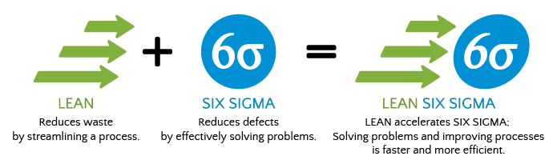
What is Lean Six Sigma?
Notes:
Mike

Slide 9
What Lean Six Sigma Is
Notes:
Katie
Eliminate waste and non-value added activities to maximize efficiency
Improves consistency and quality of work performed
Improves communication among staff and across departments
Improves employee morale and accountability
Understanding what is valuable to customers (talk later about who those customers are)
Continuous improvement

Slide 10
What Lean Six Sigma Is Not
Notes:
Katie
Not about employee layoffs – new capacity can be redirected to take on new responsibilities
Not instant improvement – inefficiency didn’t happen overnight, and improvements won’t happen overnight either
Not flavor of the month – must have top management support

Slide 11
Powerful Model for Process Improvement
Define
“Begin with the End in Mind”
Measure
Analyze
Put the process under the microscope and beat it up!
Collect data to confirm/deny opinions
Determine the “Current State” process
Improve
Manipulate process to improve
Control
Develop procedures and controls
Organize project scope and develop project charter.
Opinion of the experts
Create desired “Future State”
Sustain the gains
Notes:
Katie

Slide 12
Cross-Functional Team
TOPS Model Lean Companies Use:
Team-Oriented Problem Solving
Champion
Team leader
Facilitators
Cross-Functional Subject Experts
“No one knows the work like the people doing the work.” – Henry Ford
Notes:
Katie
Champion = executive
Team leader = key stakeholder of a process/department
Facilitators = certified in lean six sigma, can be internal or external
Subject experts = cross-functional team of employees, all levels, all departments

Slide 13
Securing Buy-In
Management understanding & commitment is essential!
“Any fool can criticize, condemn and complain –
and most fools do.” - Dale Carnegie
Notes:
Katie
First comes understanding, then commitment. Not the other way around. You must understand what you are committing to.
If you aren’t part of the solution, you are part of the problem.
Management buy-in is critical. W/O this, the process will fail.

Slide 14
Lean Simulation
Notes:
Mike

Slide 15
Lean Simulation Instructions
Follow instructions for each of the three exercises.
Be creative within instruction limits.
Ask questions immediately if not clear.
Observe what is going on around you.
Be prepared to discuss each of the exercises at the end of the demonstration.
Notes:
Mike

Slide 16
Exercise 1
Produce batch of 5 planes prior to transporting to next step. Keep on producing, do not stop.
You can not fix assembly mistakes from another operator.
Flip airplane upside down if you receive a reject.
Keep producing batches of 5 until we have completed our first defect free airplane.
Blocks need to be pushed tightly together.
Notes:
Mike

Slide 17
Exercise 2
Produce batch of 5 planes prior to transporting to next step. Keep on producing, do not stop.
You can not fix assembly mistakes from another operator.
Flip airplane upside down if you receive a reject.
We will stop production after 6 minutes.
Blocks need to be pushed tightly together.
Notes:
Mike

Slide 18
Exercise 3
We will reassign the QC job duties so they are adding more value to the process.
Produce 1 airplane and stage in WIP area and then you can not start assembling your next plane until the WIP is empty.
You can not fix assembly mistakes from another operator.
Flip airplane upside down if you receive a reject.
We will stop production after 6 minutes.
Notes:
Mike

Slide 19
Lean Simulation
Notes:
Mike
Discussion of airplane exercises

Slide 20
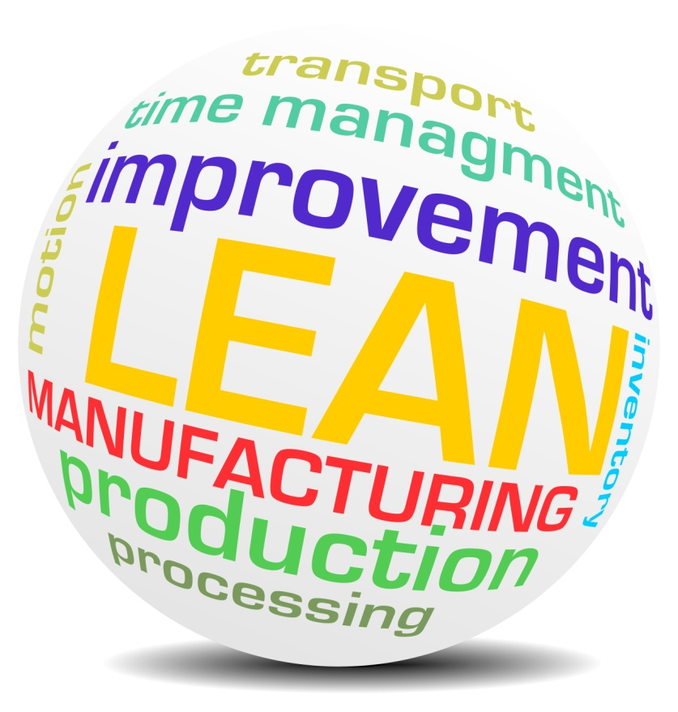
5 Principles of Lean
Customers define value
Identify the value stream – what is value added and what is “waste”?
Make the process flow
Implement “pull” to the process
Continuous Improvement
Notes:
Katie
Do only what the customer wants or is willing to pay for. Make sure you know what the customer values.
VS is the flow of information or production. Want to minimize non-value added steps.
Eliminate/reduce loops, rework and bottlenecks. Attempt to get to a point where no one is waiting on an upline or downline process.
Today’s solution is not the end all, beat all of solutions. Constantly need to analyze the process. (iPhone analogy)

Slide 21
The Voice of the Customer
Internal Customer:
The next step and/or person in the process
Any downstream process
External Customer:
The end customer who is paying for the service
Outside compliance agencies and readers of data
Notes:
Katie

Slide 22
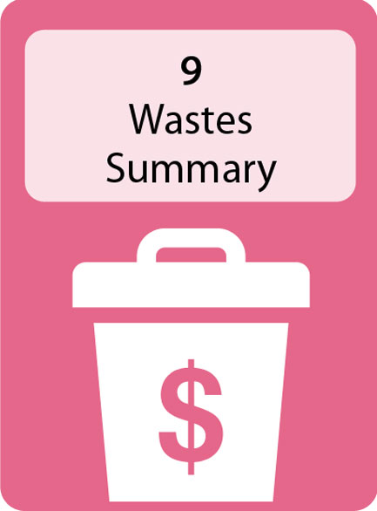
9 Categories of Waste in Processes
D
O
W
N
T
I
M
E
+
A
efects
verproduction
aiting
ot utilizing people’s talent
ransporting
nventory
otion
xcess Processing
ttitude
Notes:
Katie
Relate to toast

Slide 23
DEFECTS
Examples | Creates | Tools/Solutions
Errors Not following procedures and quality guidelines | Re-work Lost opportunity Poor Service Non-compliance Bottlenecks Creates frustration/ stress | Pareto Charts Proper Feedback Develop Consistency Quick Checks Poke Yoke Training
Notes:
Mike

Slide 24
OVERPRODUCTION
Examples | Creates | Tools/Solutions
Significant time on tasks that do not take precedence Prioritizing the wrong projects | WIP Lost capacity Bottlenecks Strained employees | Triage “Managing the front Door”
Notes:
Mike

Slide 25
WAITING
Examples | Creates | Tools/Solutions
Non-value added time Productive output is not being performed | Increased costs Lost capacity Bottlenecks “Learning Curve” | Analyze process steps Level-loading work responsibilities Cross-training
Notes:
Mike

Slide 26
NOT UTILIZING PEOPLE’S TALENTS
Examples | Creates | Tools/Solutions
Higher skilled people performing lower skilled work Not maximizing staff strengths Failing to cultivate staff ideas for improvement | Job dissatisfaction Employee turnover Increased costs Limited value to citizens Bottlenecks | Understanding the VOC and your people Staff A-B-C matrix Training & Development Creating team culture
Notes:
Mike

Slide 27
TRANSPORTING
Examples | Creates | Tools/Solutions
Poor office design - not accounting for work teams and flow Not properly leveraging technology (e.g. electronic documents) | Longer cycle time Increased costs Lost capacity | Value stream maps Creating work cells/ teams for high volume service areas Properly leveraged technology Spaghetti Diagram
Notes:
Mike
T – How many hands does a process go through. Anything more than one will tend to increase time required to complete a process.

Slide 28
INVENTORY
Examples | Creates | Tools/Solutions
Filled inboxes Backlog in email inbox WIP Supply storage | Stress Low throughput Poor service Bottlenecks | 5S and Visual Management Triage workflow Performance goals
Notes:
Mike
I – Email buildup, work backlog, etc.

Slide 29
MOTION
Examples | Creates | Tools/Solutions
“Search parties” in the office Forms/Supplies centrally located Trips to printer/copiers | Longer cycle time Increased costs Chaos | Evaluating workflow Properly set up work centers
Notes:
Mike
5S
M – How is the office set up? Is it efficient? Do people waste motion by making extra, unnecessary trips to the copier, etc. Is the work station messy requiring moving of paper from one place to the next?

Slide 30
EXCESS PROCESSING
Examples | Creates | Tools/Solutions
Performing more work than necessary Over-documentation Creating “works of art” | Non-value added project time Increased costs Lost capacity Bottlenecks | Understanding the VOC Use 80-20 rule for getting work done Training/Development
Notes:
Mike
effort
80% of the problems are caused by 20% of the issues.
E – Striving for perfection when less than perfection is acceptable. Unnecessary w/p documentation, w/p preparation, etc.

Slide 31
ATTITUDE
Examples | Creates | Tools/Solutions
Whether you think you can or can’t, you’re right Not respecting needs of the citizens | Redundant discussions Inaction to pressing issues Inefficient, low quality work | Performance metrics that promote the right behaviors
Notes:
Mike

Slide 32
Symptoms of Inefficiency
Variation in process cycle times to customers
Waiting for customer information to filter in
Variation in processes between employees
Numerous and repeatable mistakes
Complex filing structure or inconsistent filing system
Excessive management time in the minute details – not enough time spent for high-level activities
Working ever harder, not smarter
“Develop success from failures.” – Dale Carnegie
Notes:
Mike

Slide 33
Where is Waste in Your Processes?
Notes:
Mike
Breakout sessions to discuss wastes in their processes

Slide 34
Where Do You Start?
SUPPLIERS
Providers of required resources
Who supplies each input? List all of the people/ organizations who provide input to the process.
INPUTS
Resources required by the process | Numerical requirements on inputs
 | Requirements:
What inputs are required to enable this process? List the inputs from the suppliers which are needed by the process. | What are the requirements for the input to be acceptable to the process?
PROCESS
Top level description of the activity.
OUTPUTS
Resources required by the process | Numerical requirements on inputs
 | Requirements:
What inputs are required to enable this process? List the inputs from the suppliers which are needed by the process. | What are the requirements for the Input to be acceptable to the process?
CUSTOMERS
Stakeholders who place the requirements
Who is the customer of each output? List all of the customers, both internal and external, who receive the outputs.
……………………………………………………………………………………………………………………………………………………………………………………………………………………………..…..
Providing Tax, Auditing, Accounting & Controllership, Technology Solutions, Consulting, and Wealth Management Services Since 1964.
Notes:
Katie
SIPOC helps you decide where to begin. 35,000 foot level

Slide 35
Where Do You Start?
INPUTS
PROCESS
INPUTS
 | Requirements:
PROCESS
OUTPUTS
CUSTOMERS
SUPPLIERS
OUTPUTS
 | Requirements:
CUSTOMERS
Meet new client
Car Buyer
Dealership
Service Department
US DMV
Bank or Credit Union
Car Manufacturer
Detail Shop
Service Garage
Bank of Credit Union
Credit Agency
Sales and Printing
New Car
Option Packages
Wash / Fuel
Credit Check Forms
Financing Forms
Options Guide
Pricing Guide
Car has low mileage to qualify as new
Option packages are installed and functional
Car is clean and full tank of gas
Forms are current and acceptable by credit check agency
Finance forms are current and apply to correct finance agency
Options guide is clear to the customer and sales person
Pricing guide for the sale person is up to date and accurate
New Client Account
Dealer Sales Paperwork
State Paperwork
Financing Paperwork
Service Contract
Client Payment
Rapid transactions, no excess waiting (max 1 hour)
All options available and installed same day
Car clean and fueled
Paperwork correct
Best financing terms
All manuals and service contract available and accurate
Understand client’s needs in new car
Present options to client, test drive
Co-agreement on
options, price & delivery
Complete credit check & financing
Sign paperwork & hand over keys
……………………………………………………………………………………………………………………………………………………………………………………………………………………………..…..
Providing Tax, Auditing, Accounting & Controllership, Technology Solutions, Consulting, and Wealth Management Services Since 1964.
Notes:
Katie
SIPOC example – process of buying a new car

Slide 36
Value Stream Map
Manual Process
Manual Process
Waiting / Queue
Manual Process
Decision
Waiting / Queue
Manual Process
Customer
Manual Process
* Indicates inefficiency
……………………………………………………………………………………………………………………………………………………………………………………………………………………………..…..
Providing Tax, Auditing, Accounting & Controllership, Technology Solutions, Consulting, and Wealth Management Services Since 1964.
Notes:
Katie
Measure phase. Value stream map. More at the 10,000 foot level.

Slide 37
Cause & Effect
Problem: The stone on the Jefferson Memorial is deteriorating.
Cause: Frequent washing of the stone
The rest of the story ...
Notes:
Katie
Problem: The stone on the Jefferson Memorial is deteriorating
Cause: Frequent washing of the stone
The rest of the story . . .
The stone has to be washed frequently to clean off the bird dropping which pose a health hazard to tourists.
Why all of the bird droppings – the birds are attracted to the abundance of spiders which inhabit the memorial
Why all of the spiders? The spiders feed on tiny insects called biting midges (winged insect similar to a mosquito which are very difficult to see with the naked eye).
Why the midges? They are attracted to the light where they mate. When the powerful spotlights that illuminate the memorial are turned on the midges go into a mating frenzy (spiders don’t sound so bad after all!)
Solution – turn the lights on one hour after sunset. Midge population is down considerably, thus braking the food chain.

Slide 38
Lean Practices in Action
Managing the front door
Setting consistent expectations and expecting consistent performance
Bust the bottlenecks
Level loading
Implement “pull” and reduce WIP
Utilizing lead time goals to help with project management
Notes:
Katie
Proper project management requires managing the external customer and the process. A failure in either will cause problems.

Slide 39
What is “Managing the Front Door”?
Everything that is done prior to starting the job.
Being proactive can go a long way toward dictating how effective the job will be.
The more hours that can be moved out of higher capacity periods and into time periods of less constraint will alleviate bottlenecks.
Purposeful planning with clients up-front to set expectations in order to meet stated deadlines.
Preventing confusion and communication loops.
Notes:
Katie

Slide 40
Quick Checks - Summary
Document expectations and responsibilities at each level in the process.
If used properly, each team member will be working towards the “Gold Standard” and will know exactly what to expect in their work product.
This includes technical and non-technical items.
Consider including metrics that help outline the success of each stage of the process.
Notes:
Katie
Every person involved in the process must know what is expected of them. This is why communication and management buy-in are so important.
People involved in the process should be striving to provide the customer (internal and external) with highest quality (GOLD).
Consider doing collaborative review. Also, consider setting a time limit for just fixing someone’s work rather than writing a review point.
Quick checks increase consistency and quality.

Slide 41
Quick Checks - Summary
Quick Checks help build consistency into the process at the various levels.
Quick Checks help build quality into the process at all levels.
Avoid the “hot potato syndrome” and get personnel at all levels to focus on providing only quality work to the next step.
Set the expectations and watch personnel strive to meet it. Too often we just fail to set expectations.
Notes:
Katie
Every person involved in the process must know what is expected of them. This is why communication and management buy-in are so important.
People involved in the process should be striving to provide the customer (internal and external) with highest quality (GOLD).
Consider doing collaborative review. Also, consider setting a time limit for just fixing someone’s work rather than writing a review point.
Quick checks increase consistency and quality.
Elaborate that lack of expectations leads to individuals setting their own standards that are not “gold”.
How often do individuals just play hot potato to get it off their desk and then let the reviewer make comments? Is this effective?

Slide 42
Ways to Bust the Bottlenecks
Eliminate non-value add activities
Level-load work responsibilities
Develop consistent work practices
Quality control before the bottleneck
Minimize re-work and loops
Avoid batch processing
Triage
Add resources
Notes:
Katie

Slide 43
Level Loading
3R’s – Right people, right roles, right time.
Without this you will most likely end up with bottlenecks because you will have higher level people performing way too much lower level work (and possibly vice versa).
It is important to shift workload to the level and expertise it’s most practically done at.
Match capabilities to the job.
Notes:
Katie

Slide 44
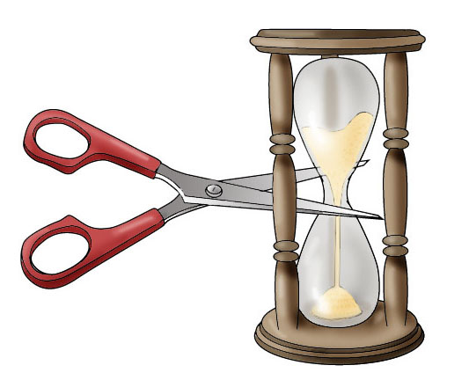
Lead Time Goals
While “managing the front door”, expectations are extremely effective in helping employees manage work load.
Without setting these expectations, work tends to drag out. We begin to lose discipline. We think we still have plenty of time available until the deadline and it is easier to pick something else up.
Setting time goals gives us an internal deadline to strive for – since it is human nature to procrastinate to a deadline.
It builds discipline.
Notes:
Katie
Most humans live under the guise of “never do today what can be put off until tomorrow.”
Time goals help new and experienced staff be more cognizant of getting projects through the system.
Must create new habits.
Time expands to the work allotted.

Slide 45
Time Goals Help With Project Management
Time goals help with project management because they break up our steps and processes into bite sized chunks.
Each step has to hit their target for the project to be completed on time.
Effectively managing each project means we should be seeing more completed projects with less chaos.
To make this happen each step needs to hit their time goal target.
Notes:
Katie
Also, need to keep one disaster from creating additional ones.

Slide 46
Individual Project Management Techniques
Quickly respond to external and internal customer phone calls and emails, even if it is to set expectations for a later date.
Start off each day tackling the most complex task or task you are dreading (try doing this before you even open email). You are the most efficient first thing; get that done and watch your productivity that day soar!
Utilize the “3 Minute Rule” to answer emails. When you are checking emails, if you can take care of the question/issue in 3 minutes or less, do it. If not, file it away and schedule a time to come back to it.
Notes:
Katie

Slide 47
Questions
Mike Sibley, CPA
Partner
James Moore, CPAs
www.jmco.com
mike.sibley@jmco.com
386.257.4100
http://www.linkedin.com/in/mikesibleydaytonabeachcpa
Blog: http://www.jmco.com/category/lean-six-sigma/

