Slide 1
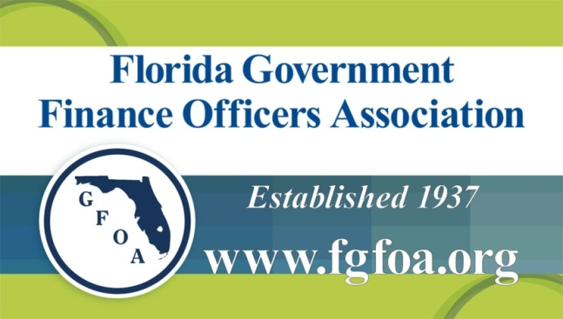
“Utilities are Big Business. Are you Operating Yours as a Business?”
Friday, March 9, 2018

Slide 2
What Are We Going to Talk About Today?
What is a Business?
Focus on Water and Sewer Industry
Business Component Evaluation
Questions and Answers
2

Slide 3
Definition of the Term “Business”
“Organization that provides goods and services to others that want or need them”
—University of Minnesota
“Entity that brings together time, effort, and capital in order to produce a profit”
—Joseph Kenny
“Objective is receipt of a financial return in exchange for work and acceptance of risk”
—Wikipedia
Activity formed for profit”
—Legal Website
3

Slide 4
Governmental Accounting Standards Board
“Enterprise funds should be used to account for operations that are financed and operated in a manner similar to private business—where the intent of the governing body is that costs of providing services to the general public on a continuing basis be financed or recovered primarily through user charges.”
4

Slide 5
What Does it Mean to “Operate like a Business?”
“A Enterprise Fund brings together time, effort, and capital in order to benefit the Public”
Lowest Sustainable Cost
High Level of Service
Uninterrupted Service
Meets all Regulatory Requirements
No Environmental Impact
Meets Financial Objectives
Satisfies Customers
Cannot Produce a “Profit” — Can Produce a “Benefit”
5

Slide 6
How Can a Public Utility be a “Business” in Today’s Market?
Decision-Makers Reluctant to Raise Rates to Match Cost
Lack of Political Will
Consumers Skeptical of Need
Water Management Districts Imposing Restrictions to Sell Product
Must Price to Conserve Water
Must Build New Facilities — Alternative Water Supply
May Result in “Double Debt Service”
Regulations Increasing Cost of Operations
6

Slide 7
Business Components
Must Understand the Link Between the System Needs and Finance
Business Component Puzzle:
Utility Assets and Capacity
Cost of Operations
Rates and Revenue Generation
Management and Financial Planning and Reporting
Financial Policies and Rate Covenants
Public Understanding and Support
7

Slide 8
The Utility Business Component Puzzle
Utility Assets
and Condition
Rates and
Revenue
Generation
Cost of Operations
Management and
Financial Planning
and Reporting
Financial
Policies / Rate
Covenants
Public
Understanding
and Support
8

Slide 9
Utility Assets and Condition
Utility Assets
and Condition
Rates and
Revenue
Generation
Cost of Operations
Management and
Financial Planning
and Reporting
Financial
Policies / Rate
Covenants
Public
Understanding
and Support
9

Slide 10
Utility Assets and Condition (cont’d.)
Capital Plan → Major Driver in Finance Plan and Level of Rates Charged for Service
Problem → Engineering and Finance May Have Different Goals and Objectives
Engineers Can Always Identify Projects —Need Always Seems Immediate
May Result in “Unintended Consequences”
Appropriated Funds that are Not Spent
Competition for Funds may Result in Unneeded Outside Financing
“Lumpy” Capital Spending Plan
High Cash Balances / may be Viewed Negatively
Rates Artificially Increased
10

Slide 11
Utility Assets and Condition (cont’d.)
Funding is Limited — Must Establish Priorities in Capital Planning to Match Funds
Capital Planning Strategy Manual Developed by Water Research Foundation
Capital Project Prioritization is the Most Critical in Planning Process
Develop Systematic Approach to Capital Planning
Provides Flexibility in Capital Planning Efforts
Assists in Making Sound Business Decisions
Identifies which Projects to Defer / Advance
Based on Market Conditions and Available Funds
11

Slide 12
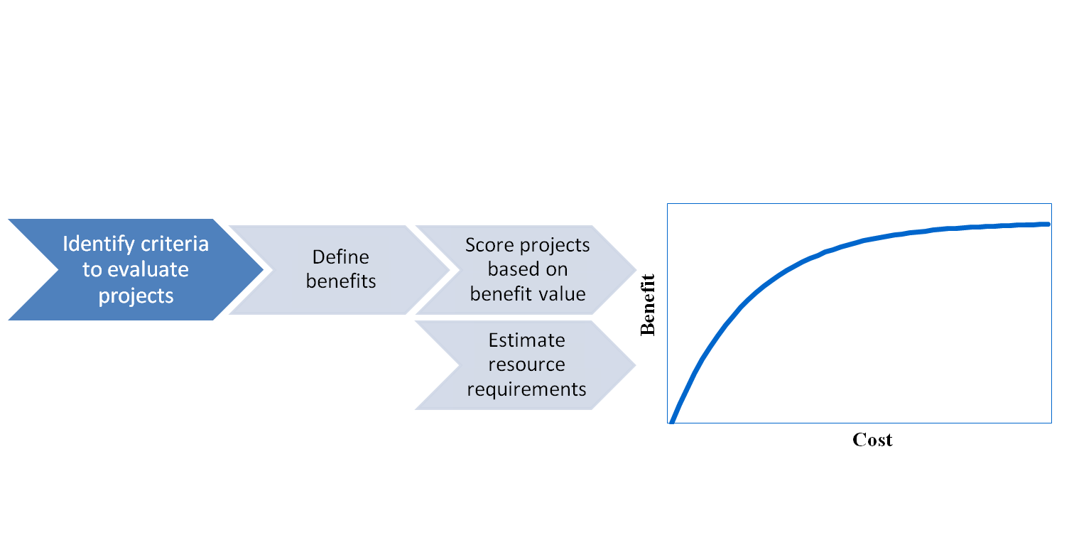
Capital Planning — Prioritization Process
Identify the Criteria and Weights for Ranking of Projects
Develop Performance Scales / Benefits for Each Criteria
Develop Prioritization Model
Economic Evaluation (Highest Return for Investment)
12

Slide 13
Prioritization Process Example
Example of Criteria for Prioritization (Aurora, Colorado):
13

Slide 14
Prioritization Process Example (cont’d.)
14

Slide 15
Renewals and Replacements
Capital Reinvestment — One of Biggest Issues in Utility Planning
Utility Asset Considerations Affecting Capital Reinvestment
Criticality
Value
Service Life
Maintenance Effectiveness
Regulatory
Planned Obsolescence
Planning Process Moving from “Growth” to “Replacement” Mode
15

Slide 16
Renewals and Replacements (cont’d.)
Has been Overlooked for Years in Business Planning Process
Out of Sight, Out of Mind
No Structured Funding Plan
Generally Funded as Follows:
Based on Bond Covenants (e.g., 5% of Previous Year’s Gross Revenue)
Surplus Funds Derived from Operations
16

Slide 17
Renewals and Replacements (cont’d.)
Many Instances Not Even in Capital Plan
Utilities have been in “Growth Mode”
Infrastructure is Forgiving for a Long Time
As Assets Reach Useful Life (Begin to Break) — Watch Out
For Older Utilities, Assets are Beginning to Reach Useful Life
Cost of Replacement Greatly Exceeds Original Cost
Condition of Underground Facilities (Pipes) Not Readily Apparent
17

Slide 18
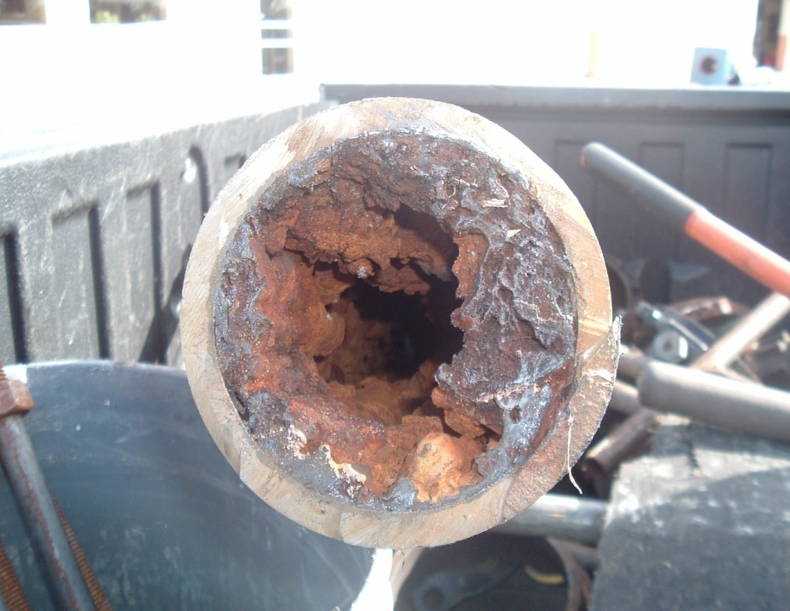
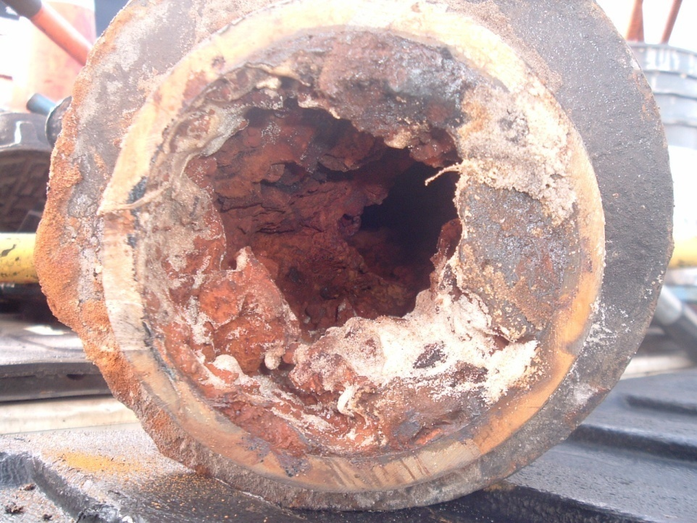
Why Fund Renewals and Replacements?
Severely Tuberculated Mains
Water Main
Sewer Force Main
18

Slide 19
Why Fund Renewals and Replacements? (cont’d.)
Hydrogen Sulfide Damaged Pipe
Deteriorating Manholes
19

Slide 20
Requires Dedicated Utility Plant Replacement Funding Program
Replacement Program Tied to Fixed Assets/ Condition
Based on Average Service Life and Replacement Cost
Link Cost Recovery (Funding) to Benefit Received by Existing Customer
Assets with Short Service Life (e.g., 10 Years)
Recommend 100% Funding Plan Over Average Service Life
Meters, Membranes, and Filters
20

Slide 21
Requires Dedicated Utility Plant Replacement Funding Program (cont’d.)
Assets with Long Service Life
Recommend Combined Debt and Cash Funding Program
Minor Units of Property Cash Funded
Must Understand Functional Assets Components
How Do You Book Your Investment?
Needs to be in Separate Dedicated Account for Control / Identification
Address Funding Plan Periodically
Do not Want to Over-Recover
Long-Term Benefit = Stable Rates and Ability to Fund Capital Needs
21

Slide 22
Capacity Availability and Use
Component of Capital Planning Cycle
Must Understand What Capacity Is
Cost of Expansion Generally Highest Capital Cost
Immediate Expenditure that Benefits Future Customers
Must Allow for Redundancy / Dependability
Interconnected Facilities vs. Separate Facilities
Level of Service (New Connections)
22

Slide 23
Capacity Availability and Use (cont’d.)
Stranded or Unused Capacity is “Most Expensive” Capacity
Results in Higher Financing Costs
Affects Availability of Funds
Results in Higher Rates
Who Bears Risk of Unused Capacity?
Existing Rate Payers
Considered by Rating Agencies in Review of Credits
23

Slide 24
Operations and Maintenance
Utility Assets
and Condition
Rates and
Revenue
Generation
Cost of Operations
Management and
Financial Planning
and Reporting
Financial
Policies / Rate
Covenants
Public
Understanding
and Support
24

Slide 25
Cost of Operations and Maintenance
May Account for 50% - 75% of Annual Funding Requirements
Primary Components:
Salaries and Benefits
Power and Chemicals
Sludge Disposal
Repairs and Maintenance
Links to Asset Management Program
Should Review Cost Relationships / Benchmark
Inflation Adjusted Trend Analysis
Compare to the Industry
Identify Improvements
25

Slide 26
Rates and Revenue Generation
Utility Assets
and Condition
Rates and
Revenue
Generation
Cost of Operations
Management and
Financial Planning
and Reporting
Financial
Policies / Rate
Covenants
Public
Understanding
and Support
26

Slide 27
Rates and Revenue Generation (cont’d.)
Need to Stabilize Revenues / Fully Recover Cost
Identify Cost of Service
Match Cost to User Responsibility
Consistent with Utility Policies
27

Slide 28
Rates and Revenue Generation (cont’d.)
To Improve Revenue Stability
Increase Fixed Cost Recovery through Base Charges
“Readiness to-Serve” Principle
Large Meter Sizes are Issue
Owner vs. Tenant
Adopt Price Index / Pass-Through Adjustment Charges
Smaller Incremental Increases
Maintain Operating Margins
Must Understand Customer Demographics
Bill Frequency — Where is Water Used?
28

Slide 29
Rates and Revenue Generation (cont’d.)
Charges to New Development
Recover Cost of Carry of Holding Capacity
In Addition to Impact Fee
Interest Cost / Fixed Operating Cost
Can be Linked to Developer Agreement
Line Maintenance Fees / Other Specific Cost Recovery Mechanisms
Goal = Make Unconnected Customers Responsible for Economic Impacts
Consider Partnering Opportunities
Use of Stranded / Unused Capacity
29

Slide 30
Rates and Revenue Generation (cont’d.)
Reclaimed Water
Still an Emerging Utility
Need to Understand the Business Model
Water Resource vs. Effluent Disposal
Pricing Considerations — Must Consider the Following:
Finite Resource — Plan and Price it Right
Understand Type of Customer Served and Cost to Provide
Large Users — Enter into Service Agreement
Capacity Reservation vs. Demand
Special Conditions (Storage, Interruption of Service)
Prioritization of Service (If Supply Not Available)
Understand Rate Impacts (Reduced Water Sales)
30

Slide 31
Financial Policies and Bond Resolution Provisions
Utility Assets
and Condition
Rates and
Revenue
Generation
Cost of Operations
Management and
Financial Planning
and Reporting
Financial
Policies / Rate
Covenants
Public
Understanding
and Support
31

Slide 32
Financial Policies and Bond Resolution Provisions / Rate Covenant
Primary Doctrine for Utility Business Process
Policies and Covenants should Promote Stability / Creditworthiness
Establishes Minimum Financial Margins
Liquidity (Operating / Capital Reserves)
Debt Service Coverage and Debt Affordability
Cash Flow and Rate Covenants
Provide Management Guidance to Meet Business Objectives
Higher-Rated Utilities Set Goals that Exceed Minimum Financial Margins
32

Slide 33
Financial Policies and Bond Resolution Provisions / Rate Covenant (cont’d.)
Links to Utility Revenue Guidelines Established by Fitch Ratings:
“For utilities in the most stable operating environments with a suitably diverse and healthy service area economy, 1.5x annual coverage, with consistently maintained unrestricted financial liquidity of at least 90 days of operating revenues, could be sufficient for ‘AA-’ or higher ratings. For utilities with substantial growth, compliance demands, or significant annual volatility in revenues or expenditures, greater financial flexibility may be necessary.”
33

Slide 34
Unrestricted Financial Liquidity
Utilities Considered as Good Credit have Strong Reserve Balances and Policies
Operating Reserves
Repair and Replacement (Capital) Reserves
Rate Stabilization Reserves
Purpose — Reduce Volatility during Any Particular Fiscal Year
Reserve Balances are Cumulative — Funds Limited for Specific Purposes
34

Slide 35
Utility Reserves
Operating Reserves
Purpose — Provide Funds for Short-Term Variability
Minimum Balance Generally Required by Bond Resolution
Average Balance Depends on:
Availability of Other Reserves
Size of Utility (Revenues)
Rate Covenants per Bond Resolution
Generally 60 Days of Revenue / 90 Days of Operating Expenses
35

Slide 36
Utility Reserves (cont’d.)
Repair and Replacement Reserves
Purpose — Provide Funds for Capital Reinvestment
Allowance for Emergencies / Changes in Capital Priority
Average Balance Depends on:
Capital Investment Requirements and Remaining Service Life of Plant
Magnitude of Periodic Expenditures (e.g., Membrane Replacement)
36

Slide 37
Utility Reserves (cont’d.)
Repair and Replacement Reserves (cont’d.)
One Year Average Renewal and Replacement Expenditures
Primary Emphasis is Funding the Program
General Provision of Bond Resolution (Minimum Level)
Helps Stabilize Rates Over Time
37

Slide 38
Utility Reserves (cont’d.)
Rate Stabilization
Purpose — Provide Contingency Funds for Material Changes in Cash Flow
Allows Utility to React to Events and Adjust Business Parameters
Recommended to be Defined in Bond Resolution
Provides Enhanced Ability to Meet Rate Covenants (Recognized Carry-Forward)
38

Slide 39
Utility Reserves (cont’d.)
Rate Stabilization (cont’d.)
Average Balance Depends on:
Recognized Fund in Bond Resolution
Stability of Revenue Stream
Overall Operating Margins
Level of Working Capital Maintained
Rate Level and Competitiveness
Minimum of 90 Days of Rate Revenues
Allows Utility to Adequately Plan Rate Adjustments in Future Periods
39

Slide 40
Bond Resolution Provisions / Rate Covenants
Absent Reserve Policy, Bond Resolution the Primary Financial Document
Flow of Funds
Minimum Deposit Requirements
Rate Covenant
Other Provisions
Sale of System Assets
Planning and Oversight
40

Slide 41
Bond Resolution Provisions / Rate Covenants (cont’d.)
Must Understand Provisions
Can be Very Restrictive and Not Up-to-Date
Lack of Guidance Regarding Interpretation
Must be Involved in Development / Update
Key = Follow Budget Process / Cash Flow
Goal is to Maximize Coverage / Availability of Funds
Do Not be “Cash Rich and Coverage Poor”
41

Slide 42
Primary Resolution Components to Review
Definitions
Gross Revenues
Earned vs. Received — e.g., Assessments/ Impact Fees
Priority of Use of Impact Fees
Investment Income — FMV Adjustments/ Arbitrage / Restricted Earnings
42

Slide 43
Primary Resolution Components to Review (cont’d.)
Definitions (cont’d.)
Operating Expenses
Follows Generally Accepted Accounting Principles
Excludes Depreciation and Amortization
Other Items may Want to Consider/ Subordinate
Cash Payments vs. GAAP
PILOT / PILOFF
Administrative Cost Allocation
Amounts Budgeted and Paid from R&R Fund
43

Slide 44
Primary Resolution Components to Review (cont’d.)
Flow of Funds
Rate Stabilization
System “Open” or “Closed”
Closed = All Funds Stay within System
Open = Funds can be Transferred
Should be Established by Formal Policy
Reason for Designation of Capital Reserves
Rate Covenant (Debt Service Coverage)
Maximum Annual Debt / Annual Debt
Multiple Tests
Additional Bonds Test
44

Slide 45
Management and Financial Planning and Reporting
Utility Assets
and Condition
Rates and
Revenue
Generation
Cost of Operations
Management and
Financial Planning
and Reporting
Financial
Policies / Rate
Covenants
Public
Understanding
and Support
45

Slide 46
Management Practices
Highest-Rated Utilities:
Exhibit Practices that Maximize Stability by Planning
Anticipate Future Regulatory and Growth Demands
Reliably Implement Steady Rate Increases Over Time
Have Liquidity to Meet Unexpected Sales Shortfalls / Emergencies
46

Slide 47
Best Management Practices for a Strong Business Position
Sound Financial Management Key to Highly-Rated Utility Credit
Long-Term Financial Forecasting
Considers Growth in Demand
Changes in Rates / Revenues
Infrastructure Renovation and Needs
Policies Ensure Appropriate Financial Margins
Financial Monitoring Systems
Limited Exposure to Financial Operations of General Government
Policies Adopted to Limit Scope and Growth
47

Slide 48
Financial Forecast Model Example
Key Financial Indicators to Evaluate
Net Revenue (Operating) Margin — Measures Ability to Pay Operating Expenses and Contribution
“All-In” Debt Coverage — Measures True Ability to Pay Debt Obligations (Net Revenues)
Days Cash-on-Hand (Reserves) — Measures Financial Flexibility (All Funds)
Free Cash as % of Depreciation — Measures Financial Capacity to Maintain Facilities
Debt Outstanding per Customer — Measures Debt Burden on Ratepayer
Principal to Net Plant — Measures Leveraging of Plant Investment
48

Slide 49
Financial Forecast Model Example (cont’d.)
Key is to Set Targets and Follow Plan
Prepare 5-Year to 10-Year Financial Plan
Addresses All Aspects of Business Model
Make Adjustments as Conditions Change
49

Slide 50
Public Understanding and Support
Utility Assets
and Condition
Rates and
Revenue
Generation
Cost of Operations
Management and
Financial Planning
and Reporting
Financial
Policies / Rate
Covenants
Public
Understanding
and Support
50

Slide 51
Public Understanding and Support
Must Communicate with Stakeholders
Decision-Makers
State of the Utility Report Prior to Budget Process
Show Decision Makers Facilities — Tour or “Bring it to Them”
Involve the Public in Community Programs Where Possible
Rating Agencies and Financial Community
Provide Annual Update (Rating Agency Package)
Illustrate the Plan
51

Slide 52
What Do Rating Agencies Consider Good Business Performance?
Fitch Rating’s “10 Cs” of Water / Sewer Revenue Bond Analysis
Community Characteristics
Customer Growth and Concentration
Capacity
Compliance with Environmental Laws and Regulations
Capital Demands and Debt Policies
Covenants
Charges and Rate Affordability
Crew (Management)
Coverage and Financial Performance
Cash and Balance Sheet Considerations
52

Slide 53
53

Slide 54
For additional information and questions regarding this presentation, please contact:
Ryan Smith
Public Resources Management Group, Inc.
341 North Maitland Avenue, Suite 300
Maitland, FL 32751
Phone: 407-628-2600
Email: RSmith@PRMGinc.com
Website: www.PRMGinc.com
54

