Slide 1

Presented by
Citrus County Property Appraiser
Chief Deputy
Tonya Caldwell, CFE
TRIM for 2016

Slide 2

What is TRIM?
This law is designed to inform taxpayers which governmental entity is responsible for the taxes levied and the amount of tax liability owed to each taxing entity. The Notice of Proposed Property Taxes is known as the TRIM Notice
TRIM establishes the statutory requirements that all taxing authorities levying a millage must follow, including all notices and budget hearing requirements. Taxing authorities establish the millage to be levied against the parcel of land shown on the TRIM notice at the budget hearings. The millage and budget hearings are the best opportunity for taxpayers to provide input into the budgets established by taxing authorities, and the procedures are monitored by the department to ensure compliance with the law.

Slide 3
TRIM con’t
The Notice of Proposed Property Taxes (TRIM Notice) enables the taxpayer to compare the prior year assessed value and taxes with the present year assessed value and proposed taxes, and the amount of taxes if there is no budget change for the upcoming year.
The notice lists the date, time, and location of all budget hearings at which the taxing authorities will hear from the public.
The notice also shows the deadline for filing a petition to protest the assessment and any denial of exemption.
Rolled back rate is defined as that millage rate which provides the same property tax revenue for each taxing authority as was levied during the previous year (exclusive of New Construction, Additions, Rehabilitative Improvements Increasing Assessed Value by at least 100%, Annexations, Deletions).
Non compliance by the taxing authority could result in the loss of revenue sharing funds.

Slide 4


TRIM Timetable
July 1, 2016
The first day of the TRIM process is July 1, or the date of certification of taxable value, whichever is LATER.
The property appraiser certifies the taxable value on form DR-420, Certification of Taxable Value, and delivers it to each taxing authority within his/her district.
DAY 1

Slide 5

TRIM Timetable
Day 35 = August 4
Within 35 days of certification of value, each taxing authority certifies the completed DR-420, DR-420MMP, and any additional forms and returns them to the property appraiser. The taxing authority informs the property appraiser of the following:
Prior year millage rate
Current year prosed millage rate
Current year rolled-back rate
The date, time and meeting place of the Tentative Budget Hearing
DAY 35

Slide 6


TRIM Timetable
If a taxing authority fails to provide the information to the property appraiser within 35 days:
The taxing authority will be prohibited from levying a millage rate greater than the rolled-back rate
The rolled-back rate will be computed by the Property Appraiser and used to prepare the Notice of Proposed Property Taxes

Slide 7
TRIM Timetable
Day 55 = Trim Notices
The property appraiser must mail the Notice of Proposed Property Taxes (TRIM Notice) within 55 days of certification.
DAY 55
If a review notice has been issued the TRIM Notice can not be mailed until DOR has approved the assessment roll.

Slide 8

TRIM Timetable
Day 65-80 Days - September 3 - 18
A public hearing on the tentative budget and proposed millage rate will be held.
This tentative hearing is published on the TRIM Notice mailed by the property appraiser.

Slide 9
TRIM Timetable
Day 95 = September 18 to Oct 3
Within 15 days after the meeting adopting the tentative budget, the taxing authority shall advertise its intent to finally adopt a millage rate and budget. A public hearing to finalize the budget and adopt a millage rate shall be held not less than 2 days nor more than 5 days after the day that the advertisement is first published.
October 1
2 | 3

Slide 10
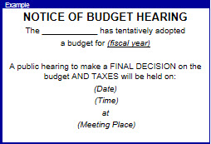
TRIM Timetable
Day 97 -100 FINAL Hearing
A public hearing on the final millage rates and budget will be held 97 to 100 days after certification of value.
This final hearing is held within 2 to 5 days after the hearing is advertised.

Slide 11



The FINAL Certification of Voted Millage
Within 3 days after the final hearing the taxing authority sends the resolution or ordinance adopting the final millage rate to the property appraiser, tax collector and the department of revenue.
The property appraiser submits the Certification of final voted debt millage form (DR422) to all taxing authorities.
Within 3 days after the taxing authority receives the DR422 the taxing authority completes and certifies final millages to the property appraiser.

Slide 12

TRIM Timetable
Within 30 days of FINAL Hearing
Each taxing authority has to certify compliance to the Florida Department of Revenue.

Slide 13

Value Adjustment
Board
The purpose of the Value Adjustment Board (VAB) is to rule on objections related to the following: Petitions relating to assessments Complaints relating to homestead exemptions Appeals from exemptions denied or disputes arising from exemptions granted Appeals concerning ad valorem tax deferrals and classifications Each year the Clerk of the Circuit Court acts as Clerk to the VAB.

Slide 14

eTRIM System
eTRIM, the Department of Revenue’s Internet-based system for completing and submitting documents for Florida’s Truth-in-Millage (TRIM) and maximum millage oversight process. By using this system we are able to electronically certify value data to principal authorities in our county. The principal authorities will then be able to complete and return their TRIM forms to us for inclusion in the Notice of Proposed Property Taxes (TRIM notice). Principal authorities will also be able to complete and certify their final TRIM and maximum millage forms to the department for review.

Slide 15




What is millage?
The property appraiser does not set the tax rate (millage). The tax rate is set by the various taxing authorities throughout Citrus County.
1 mill is equivalent to $1.00 in Taxes Due per $1,000 of Taxable Value.
Assessed Value - $200,000 Millage Rate – 16.4511 (000X/000CS) (Assessed ($ per 1 (millage rate) TAXES DUE Value) Mill) $200,000 ÷ $1,000 = $200.00 x $16.4511 = $3,290.22
Notes:
Board of County Commissioners
City of Inverness
City of Crystal River
Southwest Florida Water Management
Mosquito Control
Homosassa Special Water District
School Board

Slide 16




Ad Valorem
Non-Ad Valorem
Ad Valorem
Non-Ad Valorem
Based upon the assessed value of property.
These assessments are calculated on a unit basis, rather than on value. They are based on an improvement or service to the property such as drainage, lighting, or paving.

Slide 17
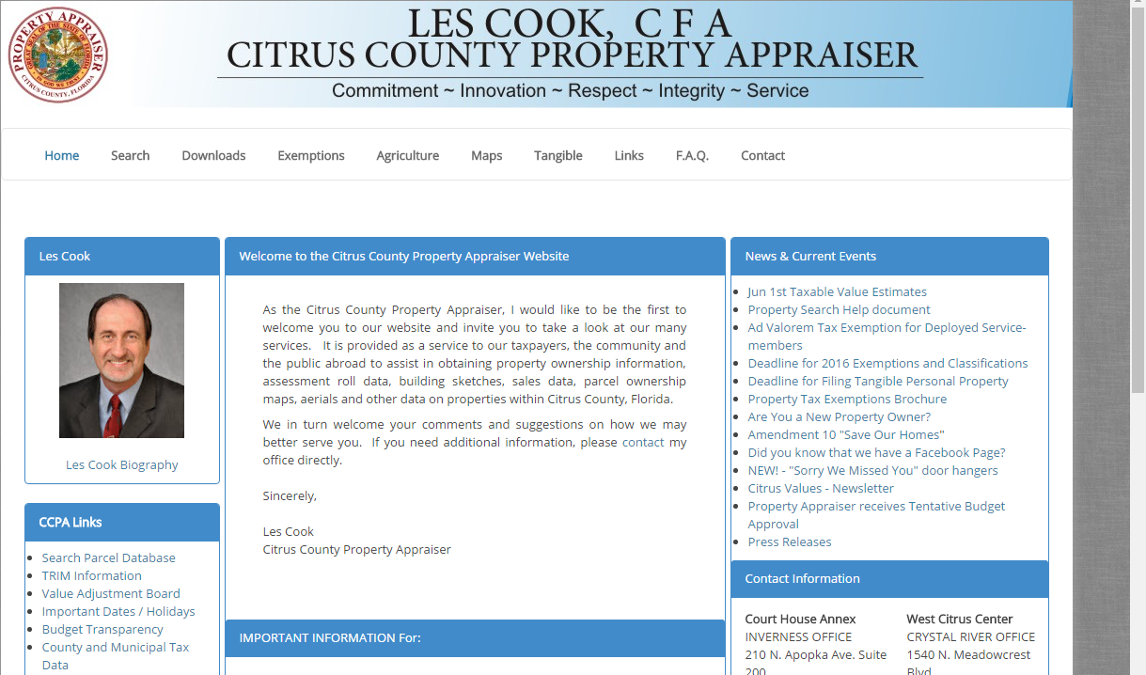

Thank You
It has been my pleasure to speak to you today.
Please visit our website or our Facebook page.
Both contain valuable information that should help you concerning the property appraiser’s office.
You may also contact our Customer Service Staff at either office location:
Inverness – 352-341-6600
Crystal River – 352-564-7130
www.citruspa.org
www.facebook.com/2015ccpa/

