Slide 1
Florida Municipal Pension Trust Fund
Preparing for Retirement Using your 457(b) Deferred Compensation Plan

Slide 2

Agenda
What is the FMPTF?
How our program provides value
  Oversight of Investments
  Low Fees
Traditional vs Roth
Income Replacement

Slide 3


Slide 4
How much should we save, per paycheck, towards retirement?
A) 5%
B) 10%
C) 15%
D) 20%

Slide 5
At age 55, how much could you save per year in your 457(b) plan?
A) $24,000
B) $18,000
C) $17,500
D) $36,000

Slide 6
At what age do Required Minimum Distributions start?
A) 59 1/2
B) 62
C) 67
D) 70 1/2

Slide 7
Florida Municipal Pension Trust Fund
Established in 1983
Non-profit, tax-exempt entity
Collectively manages individually designed employee pension and OPEB plans of Florida municipalities
Provides professional and cost-effective retirement and other post employment benefit programs
Any agency or political subdivision in Florida may become a member

Slide 8
Current Membership
200 Plans
  136 Defined Contribution and Deferred Compensation
  13 OPEB
  49 Defined Benefit
Over 5,000 Participants
$580,000,000 in assets

Slide 9
Current 401 & 457 Membership
Avon Park | Estero Fire District General | Labelle | Sanibel
Belle Isle | Flagler County Sheriff | Live Oak | Sarasota Bay Est Program
Belleair Beach | Florida Atlantic Research | Longwood | SCR Wastewater
Belleair Bluffs | Fort White | Macclenny Housing | Sebring
Broward MPO | Green Cove Springs Police | Malone | South Indian WCD
Bushnell | Greenacres | Marianna General | South Pasadena
Callaway | Greenwood | Marianna Health & Rehab | South Seminole
Cape Canaveral | Gulf Breeze | Mcintosh | Southern Manatee Fire
Cedar Key | High Springs | Mexico Beach | Space Florida
Cedar Key Sewer & Water | Holly Hill | Micanopy | Springfield
Cinco Bayou | Cottondale | Mulberry | St. Leo
Clermont | County Line Drainage | Oakland Park | St. Marks
Cottondale | Daytona Beach | Oldsmar | Tampa
County Line Drainage | Daytona Beach Shores | Pahokee | Umatilla
Daytona Beach | Dunnellon | Panama City Port Authority | Valparaiso
Daytona Beach Shores | Eagle Lake | Penney Farms | Welaka
Dunnellon | Eatonville | Plant City | Wellington
Eagle Lake | Emerald Coast Utilities | Ponce Inlet | Wewahitchka
Eatonville | Jupiter Inlet District | Redington Beach | Winter Garden
Emerald Coast Utilities | Keys Energy Services | Redington Shores | Zolfo Springs

Slide 10
Advantages of the FMPTF
Administered by the Florida League of Cities, a not for profit corporation that is the official organization of municipal governments in Florida.
Multiple Layers of Oversight
Local Government Membership
Extensive Governmental Plan Knowledge
Economies of Scale
Enhanced Member Service
Lower Costs

Slide 11
Oversight – Board of Trustees
The FMPTF is governed and supervised by a five member Board of Trustees made up of elected officials from municipalities participating in the fund.
  Dominick Montanaro (Chair), Councilman, Satellite Beach
  Robert Margolis (Vice Chair), Mayor, Wellington
  Jack Nazario, Vice Mayor, Belleair Bluffs
  Peter Noble, Councilman, Greenacres
  Heyward H. Strong, Jr., Mayor Pro-Tem, Valparaiso

Slide 12
Oversight – Investment Advisory Committee
The Investment Advisory Committee is made of respected municipal officials, and advises the FMPTF Board of Trustees.
Chairman Robert “Bob” B. Inzer
  Clerk of the Courts, Leon County
Linda Davidson
  Finance Director, Boca Raton
William “Bill” Underwood
  Finance Director, Town of Loxahatchee Groves
Francine Ramalgia
  Assistant City Manager, City of Delray Beach
Joseph LoBello
  Town Manager, Town of Juno Beach
Christopher McCullion
  CFO, City of Orlando
Jane Struder
  Finance Director, City of Palm Beach
Bonnie Wise
  Finance Director, Hillsborough County
Darrel Thomas
  Treasurer, City of Weston

Slide 13
Oversight – Asset Consulting Group
Asset Consulting Group has over 40 years of investment consulting experience.
  Conflict-free oversight
  Quarterly monitoring reports posted on FLCretirement.com
  Detailed analysis of each fund’s performance

Slide 14
Plan Investments
Asset Class | Fund Name | Symbol | Expense Ratio
Cash | Vanguard Prime Money Market | VMRXX | 0.10%
Stable Value | Mellon Stable Value Fund | (no symbol) | 0.40%
Bonds | Vanguard Intermediate-Term Bond Index | VBILX | 0.10%
 | Vanguard Total Bond Market Index Adm | VBTLX | 0.07%
 | Vanguard Long-term Treasury Adm | VUSUX | 0.10%
 | Vanguard Inflation Protected Securities | VAIPX | 0.10%
Balanced | Vanguard Wellington Adm | VWENX | 0.18%
Stock | Vanguard Windsor II Adm | VWNAX | 0.28%
 | Vanguard Institutional Index Inst | VINIX | 0.04%
 | Vanguard PrimeCap Adm | VPMAX | 0.35%
 | Vanguard Small-cap Index Adm | VSMAX | 0.09%
 | EV Atlanta Capital SMID-Cap I | ERASX | 0.90%
Expense ratios as of 12/28/2009

Slide 15
Plan Investments
Asset Class | Fund Name | Symbol | Expense Ratio
International | Vanguard Total International Stock Index | VTIAX | 0.14%
 | Vanguard International Growth Adm | VWILX | 0.34%
 | Vanguard International Value | VTRIX | 0.44%
Real Estate | Vanguard REIT Adm | VGSLX | 0.12%
Target Retirement | Vanguard Target Retirement Income | VTINX | 0.16%
 | Vanguard Target Retirement 2010 | VTENX | 0.16%
 | Vanguard Target Retirement 2015 | VTXVX | 0.16%
 | Vanguard Target Retirement 2020 | VTWNX | 0.16%
 | Vanguard Target Retirement 2025 | VTTVX | 0.17%
 | Vanguard Target Retirement 2030 | VTHRX | 0.17%
 | Vanguard Target Retirement 2035 | VTTHX | 0.18%
 | Vanguard Target Retirement 2040 | VFORX | 0.18%
 | Vanguard Target Retirement 2045 | VTIVX | 0.18%
 | Vanguard Target Retirement 2050 | VFIFX | 0.18%
 | Vanguard Target Retirement 2055 | VFFVX | 0.18%
Expense ratios as of 12/28/2009

Slide 16
Plan Investments
If the investment choices sound scary, consider the Vanguard Target Retirement Funds.
  Designed to “set it and forget it”
  Rebalances, reallocates and diversifies on its own
  Invested appropriately for your age and becomes more conservative as you grow closer to retirement

Slide 17
Target Funds Vs
Other Options
Managed Account
Annuity or Guaranteed Account
Fees are higher
  40bps or more
  Plus investment expense of possibly higher actively managed funds
Have to provide information about yourself
Should be a “complex investor”
Internal fees known as “spreads” inside account
Takes 5-10 years to liquidate
Is 2.5%-4.5% return over a 15 to 30 year period really adequate to save for retirement?

Slide 18
Fees
Most plans have between one and three layers of fees. When reviewing providers, you should be looking at the overall cost of participation.
FMPTF Plan Fees Example Provider
Participant Fees $16 per year $0
Administration Fees 0.40% per year $0
Investment Expenses 0.20% on average 1.20% on average
The comparison of these two plans may not be clear until you assess the impact on an average participant account.

Slide 19
Fees
Now review the impact of the quarterly fees on various participant account balances:
FMPTF Plan Fees Example 1 Example 2
Participant Fees $16 per year $0 $0
Administration Fees 0.40% per year $0 0.0% per year
Investment Expenses 0.17% per year* 1.20% per year 2.00% per year
FMPTF Fees Example 1 Fees Example 2 Fees
$1,000 balance $22 $12 $20
$5,000 balance $45 $60 $100
$10,000 balance $73 $120 $200
$25,000 balance $159 $300 $500
$100,000 balance $586 $1,200 $2,000
$250,000 balance $1,441 $3,000 $5,000
* Vanguard Funds

Slide 20
Fees
$200 a month, 6% return before fees = $248,000 vs. $218,000 vs. $184,000

Slide 21
Traditional Vs Roth
  Traditional also known as Pre-tax or Tax Deferred
  Roth is After-tax or Post Tax
  Roth generally is better if:
    Contributions are larger
    Start Roth earlier in your career
    Know you are going to be in higher tax bracket in retirement (Most people are in the same or a lower income tax bracket in retirement)

Slide 22
  Traditional
  NOW: Pay no income taxes on contributions in working years
  LATER: Pay taxes when you withdraw in retirement
  Money going in (contributions): Pre-tax contributions are deducted from your salary before taxes are taken. That can reduce your taxable income.
  Earnings, if any: Are tax-deferred until withdrawn.
  Money coming out (distributions): Distributions are taxable as current income when withdrawn.
  Required minimum distributions (RMD): The IRS requires distributions to begin at the later of age 70½ or retirement.

Slide 23
  Roth
  NOW: Pay income taxes on contributions as you make them
  LATER: Withdraw Savings Tax Free
  Money going in (contributions): After-tax contributions are subject to federal income tax withholding.
  Earnings, if any: Are tax-free as long as certain qualifying conditions are met (see below)
  Money coming out (distributions): Tax-free distributions, as long as you’ve satisfied the five-year holding period and are age 59 1/2 or older (assuming you have separated from service), disabled or deceased.
  Required minimum distributions (RMD): The IRS requires distributions to begin at the later of age 70½ or retirement. However, you can roll over your Roth 457(b) to a Roth IRA, where minimum distributions are not required.

Slide 24
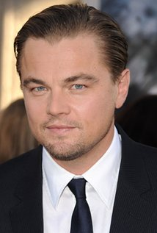
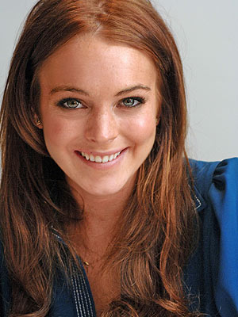
  Examples
Leo (Age 45)
Lindsay (Age 25)
 | Traditional | Roth
Gross Income | $50,000 | $50,000
Annual Salary able to save | $10,000 | $10,000
Taxes at 25% | -$0 | -$2,500
Net Yearly Contribution (total over 20 yrs) | $200,000 | $150,000
Value at end | $378,900 | $284,200
Taxes at 15% | -$56,800 | -$0
After Tax | $322,100 | $284,200
 | Traditional | Roth
Gross Income | $35,000 | $35,000
Annual Salary able to save | $3,000 | $3,000
Taxes at 25% | -$0 | -$750
Net Yearly Contribution (total over 40 yrs) | $120,000 | $90,000
Value at end | $478,200 | $358,700
Taxes at 33% | -$159,500 | -$0
After Tax | $318,700 | $358,700

Slide 25
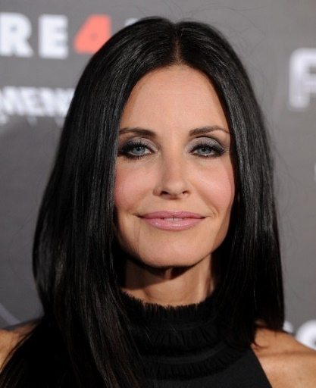
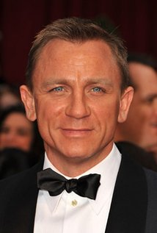
  Examples Continued
Daniel (Age 50)
Courtney (Age 55)
 | Traditional | Roth
Gross Income | $75,000 | $75,000
Annual Salary able to save | $24,000 | $30,000
Taxes at 25% | -$0 | -$6,000
Net Yearly Contribution (total over 15 yrs) | $360,000 | $360,000
Value at end | $576,617 | $576,617
Taxes at 25% | -$144,150 | -$0
After Tax | $432,457 | $576,617
 | Traditional | Roth
Gross Income | $60,000 | $60,000
Annual Salary able to save | $6,000 | $6,000
Taxes at 25% | -$0 | -$1,500
Net Yearly Contribution (total over 10 yrs) | $60,000 | $45,000
Value at end | $81,500 | $61,100
Taxes at 25% | -$20,400 | -$0
After Tax | $61,100 | $61,000

Slide 26
How much do I need to save?
Replacement of 80-100% of pre-retirement income?
Maybe. It depends on:
  Age - when will Social Security/Medicare kick in?
  Expenses – are the mortgage and cars paid off?
  Plans – travel, shopping, and adventure? Or a quieter retirement?
  Life expectancy – 30-40 years in retirement?

Slide 27

How much do I need to save?
Your Retirement Team
  Social security
  Employer
  - 401(a) or Florida Retirement System
  Home equity or Inheritance
  You!
  - IRAs and 457(b)
  - Savings in a bank

Slide 28
How much do I need to save?
  Social security
    - Average monthly benefit $1,335, but depends on many factors
  Employer (FRS)
    - Average final salary x years of service x 1.60% (for most)
    - Example $40,000 x 20 years x 1.6% = $12,800 annually ($1,067 per month)
  You!
  - $450 from your own investments

Slide 29
How much can I get?
  Assuming a 6% return
  $25/month = $22,000 $50/month = $45,000 $100/month = $90,000
  $250/month = $225,000 $500/month = $450,000

Slide 30
Is it worth it?
  Assuming a 6% return
  $25/month = $22,000 You put it $9,000
  $50/month = $45,000 You put in $18,000
  $100/month = $90,000 You put in $36,000
  $250/month = $225,000 You put in $90,000
  $500/month = $450,000 You put in $180,000

Slide 31
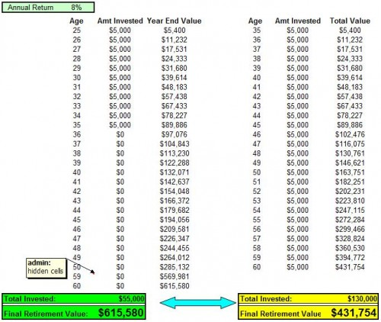
Start Early and Stop vs Starting Later

Slide 32
Contact
Rodney Walton
Account Representative
813-340-7545
rwalton@flcities.com
www.flcretirement.com

