Slide 1
WELCOME!!!
VP Card Program Officer:
Rick Lopez
SunTrust Bank

Slide 2
What is E-Payables?

Slide 3
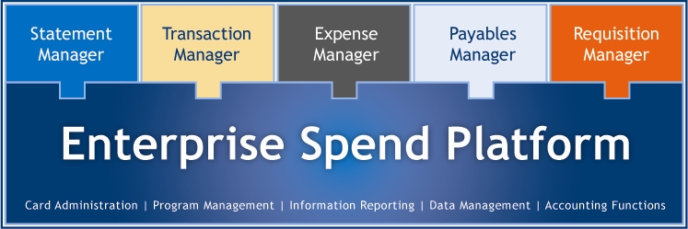
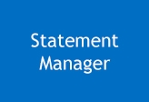
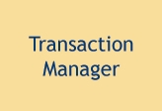

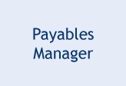
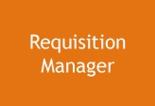
Technology to Maximize Performance
ESP Provides Oversight and Control
View detailed statements for SunTrust Purchasing Card and Corporate Card programs. Statement Manager also provides presentment of third party statements such as Cellular/Mobile providers and multinational commercial card partners – all from the same screen.
Manage outstanding transactions that require attention or actions, such as: GL coding, adding comments, transaction disputes, breaking out sales tax, checking against corporate policies, submitting for manager approval, and reviewing for approval status.
Perform end-to-end expense reporting and reimbursement for both card and out-of-pocket transactions. Reconcile against company spending policies, attach electronic receipts, claim mileage reimbursement and per diems, allocate to GLs, add comments to the transaction or manager approval, and streamline integration to your accounts payable system.
Integrate Purchasing Card into your A/P process and migrate invoice payments from check to Purchasing Card. Payables Manager increases visibility with invoice payments and helps reduce check fraud.
Create pre-purchase forms to fit any buying need. With the customizable business rules, approved requests dynamically fund specific cards, allowing for immediate spend capability
Single technology platform with modular architecture
Notes:
Main Point:
Enterprise Spend Platform (ESP) was developed using a modular architecture which provides you with the flexibility to use only the functionality you require.
ESP is a web-based application that users can access from any computer attached to the internet.
It offers robust reporting that provides oversight of transactions and spending as well as audit capabilities of program management
Provide a high level overview of the system
Enterprise Spend Platform is comprised of a base platform offering all the features necessary for managing your card programs, along with five separate application modules, which can be implemented as needed.
Modules
Statement Manager: This is the basic module that all clients get. Allows you to view a re-presentment of your Purchasing statements and code transactions. Advanced usage of this module includes presentment of third party statements such as Cellular/Mobile providers and multinational commercial card partners.
Transaction Manager: This module provides custom routing instructions to approve transactions. We offer “Single level” approval and “Multi-level” approval workflow.
Expense Manager: This is a full service expense reporting solution that integrates card & cash transactions, applies travel & expense policies, and leverages workflow approval, compliance monitoring, and streamlined export to A/P for allocation & reimbursement.
Payables Manager: ESP Payables integrates Card into the A/P payments mix.
Requisition Manager: This module provides for pre-purchase approval before a transaction is made. It can be configured to dynamically increase the card account credit limit based on the workflow approval. Clients can also customize the pre-purchase forms if needed.

Slide 4
Supplier Analytics
Supplier Vendor Match Analysis
  Conduct a thorough analysis and segmentation of all suppliers from AP file.
  Recommend & Prioritize Targets based on analysis
    STI Match
    Visa Match
    Non Acceptors
    Unlikely
  Extension of your AP / Procurement Department
  Implement Best Practice Approach
  Manage and track supplier recruiting campaign

Slide 5
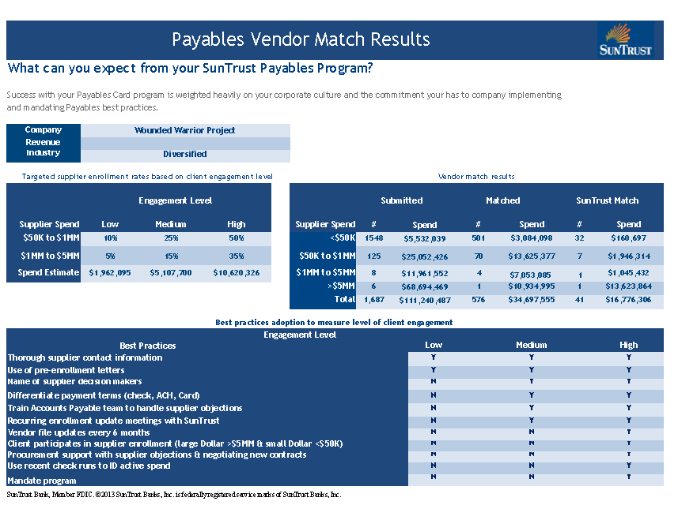
Payables Vendor Match
SAMPLE
5

Slide 6
Supplier Enablement Consultant Overview
Dedicated Liaison between Client and Supplier
Management of Supplier Enrollment Teams
Development & Administration
Dedicated Liaison between Client and Supplier
  Vendor Match Analytics
  Supplier Enrollment & Campaign Management
    Supplier target >$1MM
    Weekly updates
Management of Supplier Enrollment Team
    Targets Suppliers < $1MM
    Enrollment Documentation (Scripts, Letters, etc.)
    Internal Communication
Business Development Support
  Enrollment Optimization
  Enrollment Realization

Slide 7
Enrollment Campaign Management
Setting Goals & Expectations
  Thorough Review of Communication Materials
    Card Program Mandate?
    Pre Enrollment Letters
    Authorization Letters
    Email Confirmation
    Program Summary
  Inbound/Outbound Calling Efforts Tailored to each Client’s Needs
  Weekly On-boarding Tracking & Reporting
    New Enrolled Suppliers
    Declined Suppliers
    Client Action Items
  Flag Enrolled Suppliers from Check to Card – VITAL TO SUCCESS
  Internal Communication to Stakeholders
    Procurement
    Mandate on future construction projects

Slide 8
Business Development-Growth Opportunities
Annual AP File
Non Acceptors Opportunity
Enrollment Potential for Suppliers < 50K
Enrollment Tools
  Mail Inserts
  Enrollment Forms (Electronic)
Procurement Opportunity (New Relationships, Contracts, etc.)
Re-visit & Analyze Previous Campaigns by:
  Segmenting Declined Suppliers by Declined Reason
  Calling Effort Strategy

Slide 9
Quick Best Practices to Consider for Growth
What t should we Consider doing? |  | Why should we do this? |  | How do we do this? |  | How do we get help?
Set up ghost accounts |  | • Ghost cards offer a convenient payment method for individuals without card accounts while streamlining the payment process |  | • Examples of use include airfare purchases, recurring charges, payment of e-Procurement suppliers, and corporate event Expenses |  | • Use AP Analysis reporting to identify opportunities to use ghost cards • Work with your CPO to implement the ghost accounts
Target specific spend categories |  | • Choosing certain spend types to migrate allows a company to focus its efforts • A consistent view of spend across a category enhances the benefits of supplier management and spend visibility |  | • Choose spend categories to migrate to payment by card • Mandate or encourage commercial card payment of these categories • Update program policies and procedures accordingly |  | • Work with your CPO to analyze AP data to identify the best spend categories to target based on spend amount, transaction volume, and supplier acceptance of card
Evaluate slippage |  | • Sometimes only part of the total spend with a supplier is paid by Card • This inconsistency prevents both parties from capturing the full benefits of the card payment |  | • Determine which suppliers currently paid by card are also being paid by other payment methods • Mandate or encourage that all spend with these suppliers be by commercial card |  | • Your CPO can help review and compare AP data to ESP card spend reports to determine areas of Slippage
Use the commercial card in Accounts Payable |  | • Invoice processing and check payment are manual and require significant time and effort • Companies streamline their payment process and capture cost savings by transferring invoice payments to Card |  | • Provide AP with a card to use to pay invoices • Use this card for infrequent purchases with accepting suppliers or invoices that require immediate Payment |  | • Use AP data analysis reports to identify potential opportunities • The Vendor Match can assist with identifying accepting Suppliers

Slide 10
Strengthening Capabilities
Our goal is to offer you greater visibility and control over your working capital.
It is a SunTrust strategic priority to commit ongoing investment in technology
and other resources to ensure exceptional treasury solutions.
What This Means For You
  Consistent operational excellence in the core payment and treasury solutions you need.
Timely access to information and streamlined reporting
for better informed
cash management decisions.
  Opportunistic investment in
  emerging capabilities that target your
  future business needs.
Notes:
Purpose of Slide:
At SunTrust, we believe that delivering ongoing product enhancements and maintaining sustained investments in this space are important to help our clients succeed.
Talking Points:
SunTrust is committed to the treasury and payments business and has designated it as a strategic investment priority for our company. The bank is making a multi-year, multi-million-dollar investment to keep SunTrust offerings at the levels our clients need today and tomorrow.
Our goal is to offer greater visibility into and control over your working capital. SunTrust is continually making strategic commitments in technology and other resources to ensure ongoing enhancements to treasury solutions.
We know what clients are looking for; we stay in tune with the market through industry organizations and our own Client Advisory Council.
We have established the following strategies to drive our development priorities and investments in payment solutions:
SunTrust is strengthening our core processing platforms to maintain current services and enhance for the ever-evolving banking environment - providing high quality, reliable solutions to meet your needs.
SunTrust will simplify and enrich the interactions you have with the bank through improvements to critical online channels - helping to guide your company’s cash management decisions.
We are committed to understanding your business and your needs, and will partner with you to determine the best suite of products for your success.
So let’s look at what we are focused on right now for commercial card clients.

Slide 11

EMV - Chip & PIN Cards
Caroline Lord
Commercial Card Service Excellence Manager

Slide 12

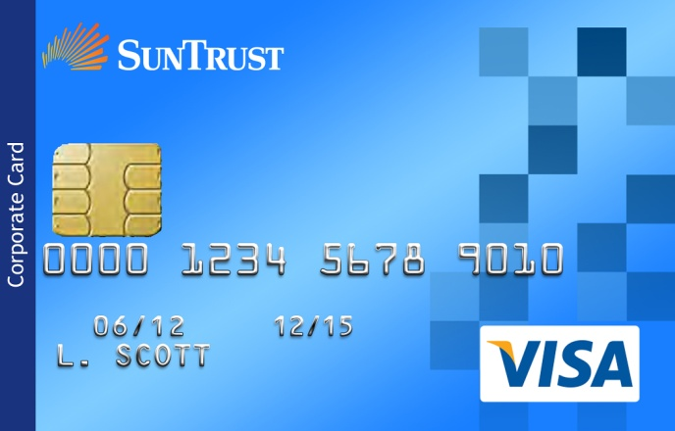
What is Chip Technology
  The chip card technology being adopted by SunTrust is known in the industry as EMV, which is an acronym for Europay/MasterCard/Visa. These three companies jointly developed the card authentication chip standards in use today in most parts of the world.
  SunTrust prefers the term “cards with chip technology,” but they are also known as chip & PIN cards, smart cards, smart chip cards and EMV cards.
  In addition to the familiar magnetic stripe on the back, chip cards include an embedded microchip on the front.
Notes:
SunTrust is now offering commercial cards with chip technology. May also be referred to as “CNP”

Slide 13
What is Chip Technology
Enhanced Security
Like debit cards, chip cards encourage the use of personal identification numbers (PINs) to validate cardholder identity for in-person purchases. Cardholders choose their own easy-to-remember PIN when they activate their new card.
International Acceptance
Because this security standard has been widely adopted in other parts of the world already, adding the chip technology to SunTrust Commercial Cards should provide our clients with a more consistent cardholder experience when traveling internationally and offer them greater peace of mind when using their SunTrust cards anywhere.
When used to make a purchase at a “chip-enabled” point of sale terminal, the chip card exchanges encrypted card authentication algorithms and other security data designed to protect the account holder’s identity and ensure the card being presented is genuine.
Notes:
Just hit the headlines
SunTrust is now offering commercial cards with chip technology. May also be referred to as “CNP”

Slide 14

What is Chip Technology
U.S. Domestic Acceptance
Cards with chip technology will, for the foreseeable future, continue to include the traditional magnetic stripe, providing confidence that SunTrust cards can be used at all the same merchants that today welcome them around the world.
Many U.S. merchants, motivated by the Visa and MasterCard fraud liability rule changes that will take effect, are beginning the roll out of chip-enabled terminals over the next two years.
Notes:
SunTrust is now offering commercial cards with chip technology. May also be referred to as “CNP”

Slide 15

Misconceptions of Chip Technology
The chip technology being implemented on SunTrust card products does not:
  Use Near Field Communication (NFC) or “contactless” technology (e.g. PayPass.) The card must be inserted into a “chip enabled” merchant terminal and the chip must physically touch the reader contacts in order to transmit or receive data.
  Record, track or store information about the cardholder or the nature of their purchases in any way.
  Affect other card parameters like credit limits, ATM cash access, merchant category blocking or card benefits.
  Improve security in any way for transactions made online, by telephone or at merchant terminals that do not yet have the ability to recognize and read the card chip.
Notes:
SunTrust is now offering commercial cards with chip technology. May also be referred to as “CNP”

Slide 16
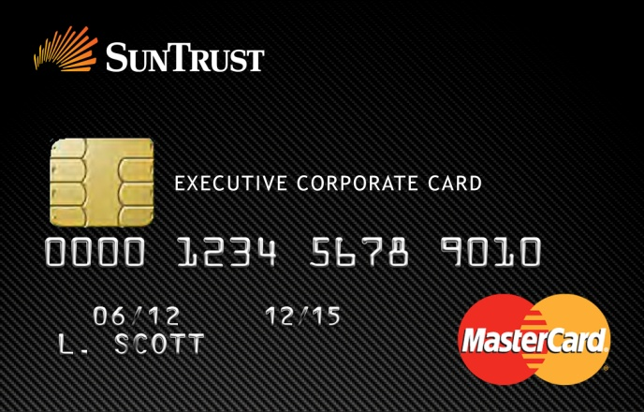
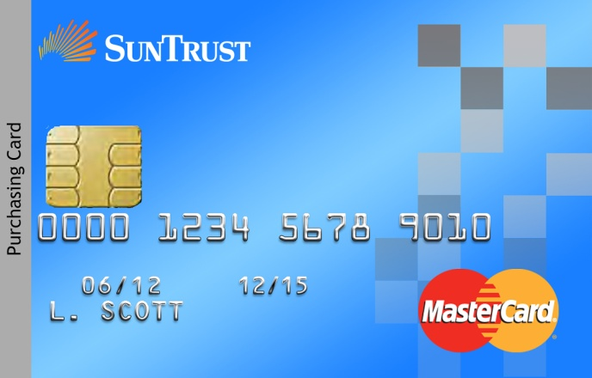
Which Card Products?
SunTrust is installing chip card technology on:
Commercial Card
  Purchasing
  Corporate
  Executive Corporate
Business Credit Card
Consumer Credit Card
Those not in scope include:
Access 3, Gift, Prepaid, and Payroll Cards
Notes:
Enterprise Initiative
Installing this on all cml card products, and business and consumer credit; will apply to ESP and ESP Express clients and to the other clients who are not on either of these platforms

Slide 17
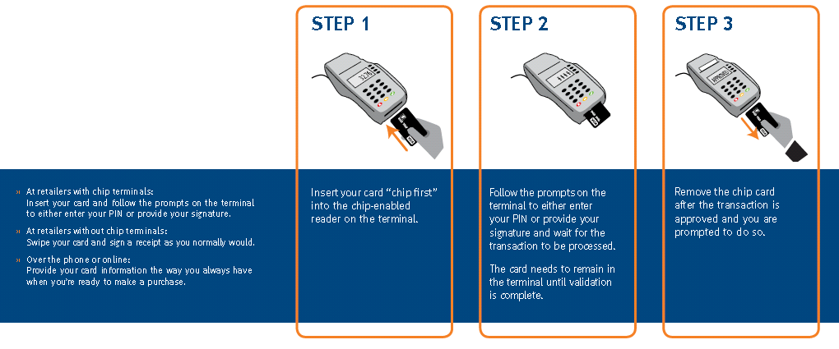
How Do Chip Cards Work?
How will clients use SunTrust chip card technology? It’s as simple as 1, 2, 3…
Insert chip card to start the transaction
Enter PIN* and follow any other terminal prompts
Remove chip card after the transaction is complete
  * Non-chip enabled transactions work just as they do today
Notes:
Mention point of distinction: PINs were only for cash access; going forward, every card will require PIN to authenticate user in almost all cases at POS terminals. Each cardholder will select a PIN when they activate a card
To better protect cards from fraud or misuse, your SunTrust chip enabled card will require a unique PIN to authenticate the identity of the cardholder. Always keep your card and PIN safe and do not share your PIN with anyone. If you are a new SunTrust cardholder, you will be prompted at activation to choose a PIN. Existing cardholders who do not know their PIN will be required to select a new PIN when activating their new chip-enabled card. Your credit card will now utilize a PIN for those merchant terminals that may require it. By entering your PIN, you are validating that you are the authorized user of the card.

Slide 18

Client Conversion
Key Points:
Chip technology offers significant security enhancements, if used as intended
  Card authentication – helps guard against counterfeit plastic
  User authentication and identity protections – individual PIN use helps ensure accountability
Counseling clients on the best configuration and use of their commercial card program becomes even more important than ever
“Card in hand” programs:
Consider issuing a card to any employee who incurs annually at least $500 in business expenses.
Cards should not be shared. Unassigned or “department” cards are a prime source of misuse and fraud and, to optimize accountability and control, companies should avoid using them.
If a company chooses to designate a single card account for all purchases in a department, it is recommended that that card be issued in the name of the primary user, if possible, so that accountability can be maintained. The introduction of PINs for cardholder identity authentication as part of U.S. credit card industry standards makes this even more evident. Real control is impossible, if a single card can be used by multiple people.
Cardholders should never divulge their PIN to anyone, including the program administrator. Chip card technology provides opportunities for enhanced security and accountability, but like any control, they are only effective if not bypassed.
  Program Administrators should be advised that there is no need for bulk activation or ordering PIN mailers. Each cardholder should use the activation telephone number to choose and manage their confidential PIN.
No
Bulk Activation
No
Bulk PIN Settings
No
PIN Mailers
Notes:
The introduction of chip technology makes counseling clients on the best practices of card program configuration even more important than it was previously.
Things have changed in the Chip and PIN world from what you know in the mag stripe world.
We have documented key points for you to help clarify the distinctions between the processes. These will facilitate prepping for client conversations.
The introduction of chip technology makes counseling clients on the best practices of card program configuration even more important than it was previously.

Slide 19
When Will We Get Our New Chip Cards?
Cardholders will receive their new Chip Card when their current card expires
Each month we migrate approximately 50 clients based on when the majority of their cards expire
Can I run a report in Enterprise Spend Platform to see when my company’s employees’ cards expire?
To view a report of expiring cards, follow these steps:
Select the Reports tab from the top navigation.
Click Account Search from the left navigation under the Company Administration heading. The Account Search window appears.
From the Account Status drop-down menu, select Active.
Check the Account Listing box at the bottom of the window.
In the Additional Fields drop-down menu, check the Expiration Date box.
Click the Search button, the listing of open cards appears.
Click the Expiration Date heading to sort the cards by expiration date.

Slide 20
Commercial Card Client Service
Responsible for the Commercial Card Specialist Team
We provide day to day support for our Program Administrators
TMCardSupport@SunTrust.com
866-829-6396
Monday – Friday: 8am – 6pm ET
Provide after hours support for PAs – Just leave a voicemail and state that you require an immediate callback
Cardholders may call the number on the back of their card 24 hours a day, 7 days a week (800-836-8562)

Slide 21
THANK YOU!

