Slide 1
Fraud in today’s world
September 18, 2015

Slide 2
60
82
23
What do these numbers represent?
1

Slide 3
60
82
23
Fraud statistics
60% of organizations were exposed to actual or attempted
payments fraud in 2013
82% of survey respondents report checks were the primary target
for fraud attacks at their organization
$23,100 was the typical financial loss incurred by organizations
due to payments fraud
Source: 2014 AFP Payments Fraud and Control Survey
2

Slide 4
Payment method responsible for largest dollar amount of fraud loss
Source: 2014 AFP Payments Fraud and Control Survey

Slide 5
Types of check fraud
Unauthorized check
Maker forgery
Internal embezzlement
Forged endorsement
Customer victimization
Counterfeit
Altered check

Slide 6
Electronic deposit check fraud
Check 21 opened up a world of possibilities for financial institutions, their customers, and unfortunately, criminals
Risk management has become a key focal point for financial institutions as they offer more opportunities for image-related deposits

Slide 7
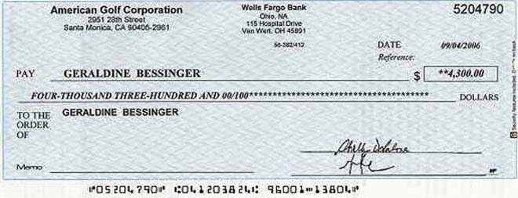
ACH Debit Fraud
Criminals get MICR-line information from a legitimate check
Sell information to fraud rings
Fraud rings originate ACH transactions using legitimate account numbers
05204790 123000999 55555
05204790 123000999 55555

Slide 8

Cyber fraud – three primary methods
Social engineering
Malware
Combination: social engineering used to install malware

Slide 9
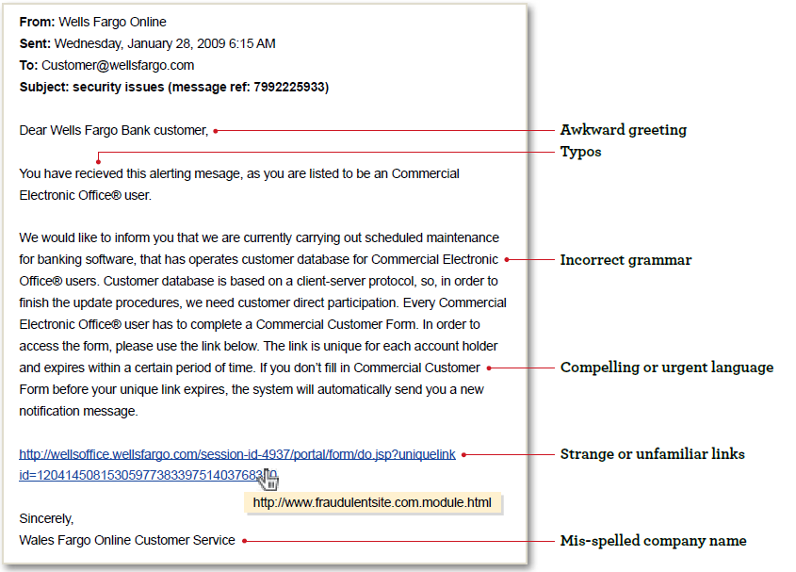
Social engineering via phishing example

Slide 10
Spear phishing
Spear phishers target select groups of people
Information obtained by hacking into a computer network, or by combing through other sites
The messages look more legitimate to the receivers
  Create false sense of security about clicking on the embedded link
  Tone of urgency convinces victims to act quickly, providing information they would not normally disclose
This may allow installation of malicious codes known as “malware”
Malware can be used by criminals to gain unlimited access to data from victims’ computers

Slide 11




Business account takeover
Online banking credentials sent to criminal
Password-stealing Trojan sent as email attachment
Criminal sends sub $10,000 payments to money mules
Criminal logs into victim company’s bank accounts
Mules withdraw cash and forward to criminals overseas

Slide 12
Imposter Fraud
Are you who you say you are?
Do you know whom you are paying?
11

Slide 13
Reduce your risk
Educate your staff
Verify your vendor
Verify your requestor
Watch your wires
Audit your activity
12

Slide 14
What steps can entities take to avoid fraud?
13

Slide 15
Six rules for a strong fraud protection program
Protect access credentials
Increase internal controls
Educate employees
Know your employees
Keep authorizations up to date
Know your vendors
Trust is not an
internal control

Slide 16

Number-one line of protection
Your employees are the front line of defense against online fraud
Entities must ensure they get the training they need and remind them often to stay on their guard against online fraud

Slide 17

Diligent user management
Audit users on a regular basis, especially those with transaction privileges
Review user privileges often to ensure no one has unauthorized or unnecessary access
Limit transaction privileges to an absolute minimum – needs only basis
Apply separation of duties for key money movement activities

Slide 18

Maintain separation of duties
Assign accounts payable functions to more than one person
Rotate personnel in financially sensitive assignments
Limit the number of signers
Require more than one signature on large dollar check amounts

Slide 19
Dual custody – online banking portal
One person initiates and another approves from a different computer
  Online payment transactions
  Self-administration changes
Be aware of collusion risks
  Select approvers that are less likely to collude
    Different locations
    Different functions
Option exists to require multiple approvals

Slide 20

Enforce mandatory vacation policies
One of the most effective ways to avoid internal embezzlement
Also a good way to detect embezzlement if someone is operating a scheme

Slide 21
To avoid phishing attempts
Remember that most companies, banks, etc. will never request personal or sensitive information via email or text
If in doubt, call the company to check, but don’t use the phone number on the email
Don’t reply to a message that asks for personal or financial information
Never follow a link to a secure site from an email, always enter the URL manually
Use a phishing filter; many of the latest web browsers have them built in

Slide 22
Secure passwords are critical
Create different passwords for different purposes
  Social networking
  Major shopping sites
  Financial institutions
  Separate passwords for infrequently visited sites
Use passwords that cannot be easily guessed
  No pet names, family names – they can be found on social media sites
  A recent survey revealed that “password” and “123456” are very popular
  Try using the first letters of a memorable phrase and make it more complex by replacing letters with characters or numbers

Slide 23
Security considerations for mobile banking
Be cautious of unsolicited text messages. Avoid clicking on links contained in text messages.
Don’t store sensitive data on your mobile device.
Install tracking software that allows you to locate, lock or wipe data.

Slide 24
Maintain check security
Require tight security of all check stock
  Destroy obsolete check stock
  Keep check stock in an area that is locked and secure
Purchase check stock from a reputable vendor
  Include safety features in checks
  Require a secure method of delivery for new stock
Inventory check stock at least quarterly
Limit number of individuals who have access to check stock

Slide 25
Reconcile accounts promptly
Required by UCC
Ensures timely identification of errors and/or fraud
Reconcilement duties must be kept separate from check issuing duties

Slide 26
TM services to reduce risk and fraud
Positive Pay with Payee Validation
Payment Authorization
ACH Fraud Filter
Email notification of outgoing wires (event messages)
Account Reconciliation
Dual control
Remote Desktop Deposit
Virtual Vaults
Lockbox
Merchant Services
ACH payments
Prepaid Cards
Unique AP Cards
25

Slide 27
Webinar training sessions
Every week, a 60-minute, instructor-led online training class is offered to all Commercial Electronic Office® (CEO®) portal users.
The training class is called: Reducing Risks: What you need to know about Payment Fraud
During this course, the instructor will review:
Growing fraud threats, including account takeover fraud and impostor fraud
The latest fraud statistics
Tips for how to minimize the risk of fraud
To locate training to go: CEO Homepage>Support Dropdown Menu>Online Training

Slide 28
Thank you

