Slide 1

IT GOVERNANCE
2014 FGFOA ANNUAL CONFERENCE
IT Security Trends
Alex Brown
Plante Moran
216.274.6522
Furney.Brown@plantemoran.com
‘This presentation will discuss current threats faced by public institutions, developing a comprehensive risk assessment framework and discussing the control categories and maturity levels. A risk-based approach to security ensures an efficient and practical approach to managing risks. A risk-based approach is also useful when considering emerging technologies such as Mobile and Cloud Computing.”

Slide 2
Agenda
The Growing World of Information Security Compliance
Control Frameworks
    COBIT
    ISO 27000
    SANS Top 20 Critical Controls
    NIST Cyber Security
  Understanding Threats…. What Can Go Wrong
  Understanding Controls….. Where Are My Controls
  What Are My Next Steps

Slide 3
Understanding of Information Security
Sarbanes Oxley
95/46/EU DPD
The Growing World of Security
HIPAA
GLBA
PCI
FERPA
State Regulation
FISMA
Australia – Federal Privacy Act
Japan - PIP
21 CRF Part 11
Canada - PIPEDA
Are You in Compliance?

Slide 4
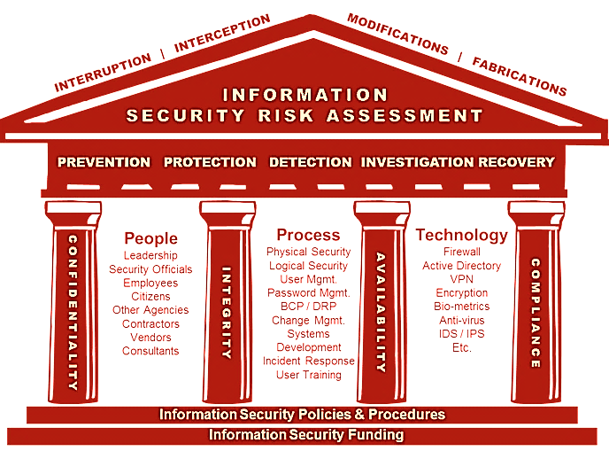
Plante Moran’s
Information Security Governance Model
Different organizations view information security differently. Some of the differences are related to varied risk and threat profiles impacting an organization — based on factors such as industry, location, products/services, etc. Other differences are related to management’s view of security based on its experience with prior security incidents.

Slide 5
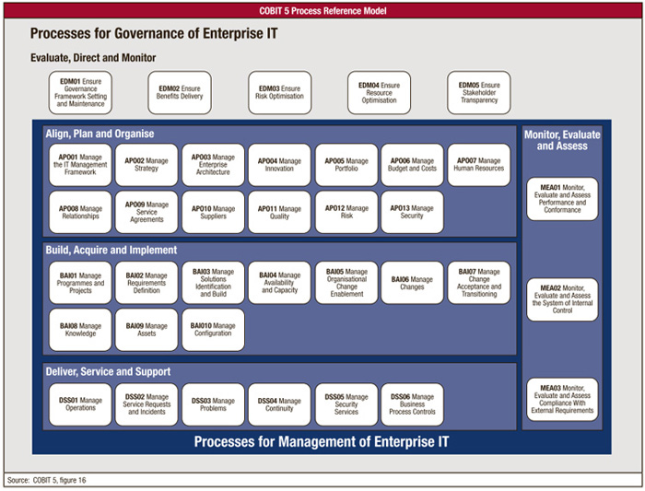
Controls Frameworks – COSO / COBIT
MATURITY LEVELS
0. Ad Hoc
1. Initial
2. Repeatable
3. Defined
4. Managed
5. Optimizing

Slide 6
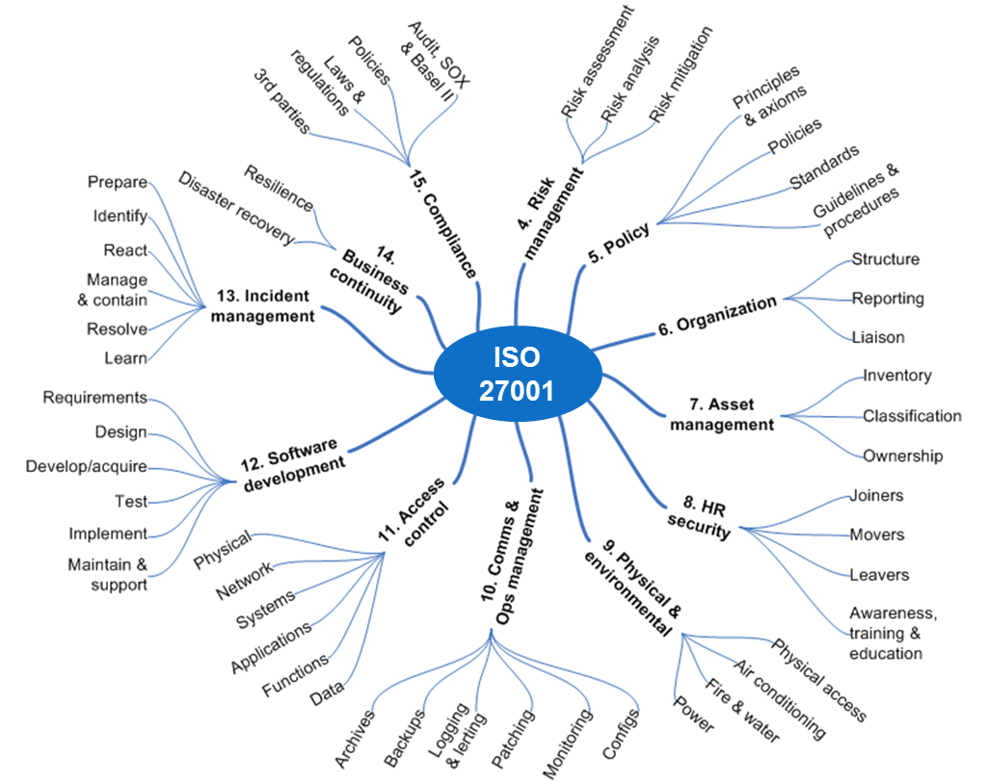
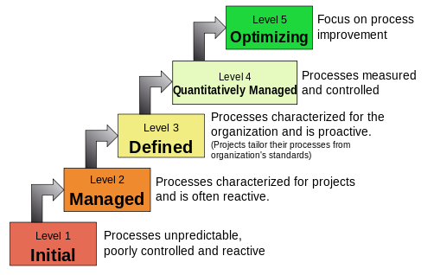
Controls Frameworks – ISO 27001
MATURITY LEVELS

Slide 7
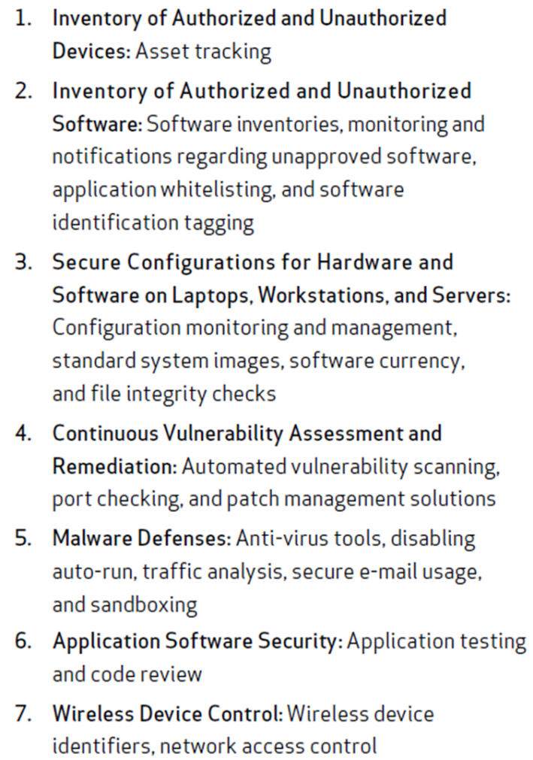
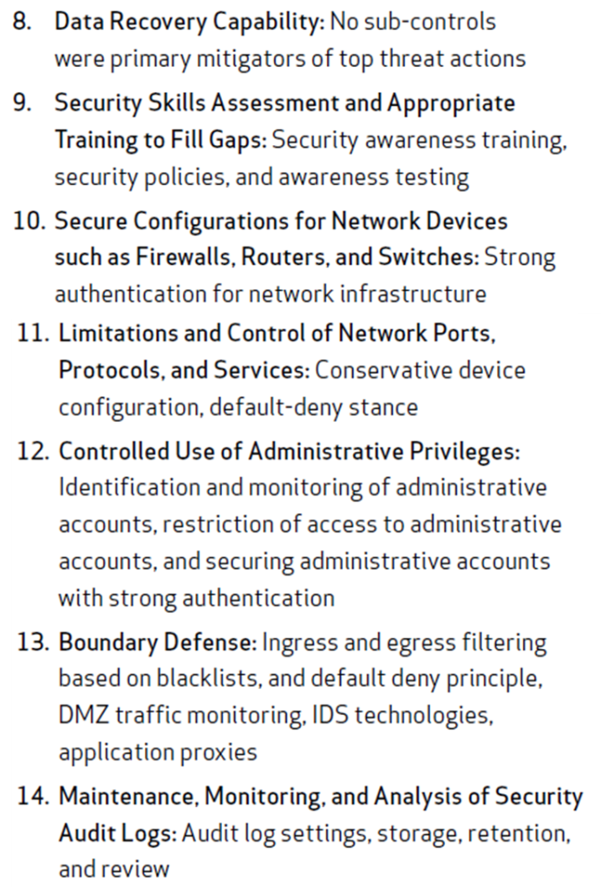
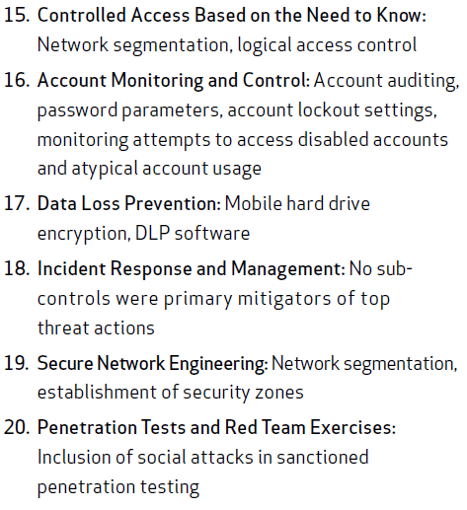
Controls Frameworks – SANS Top 20 CSC

Slide 8
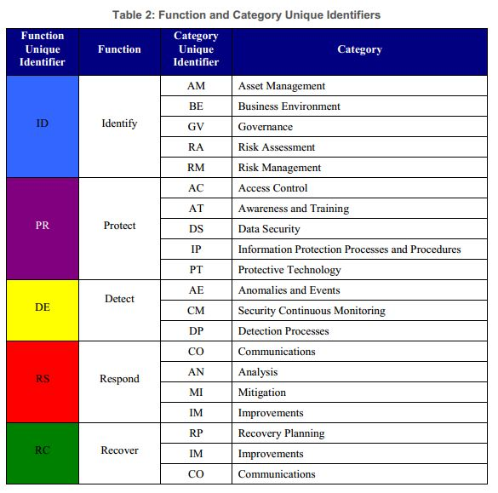
Controls Frameworks - NIST Cyber Security
MATURITY LEVELS
Tier 1 – Partial
Tier 2 – Risk Informed
Tier 3 – Repeatable
Tier 4 – Adaptive

Slide 9
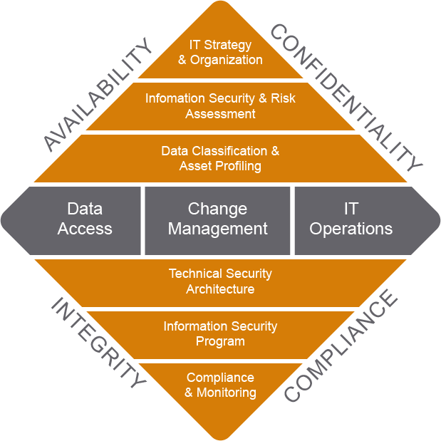
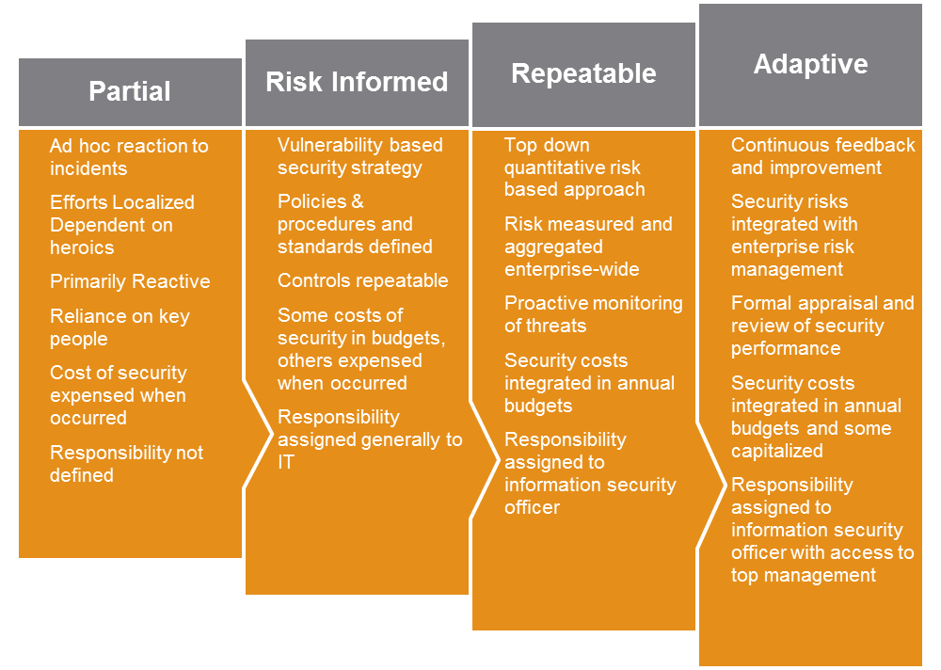
Plante Moran’s
Information Security Control Framework

Slide 10
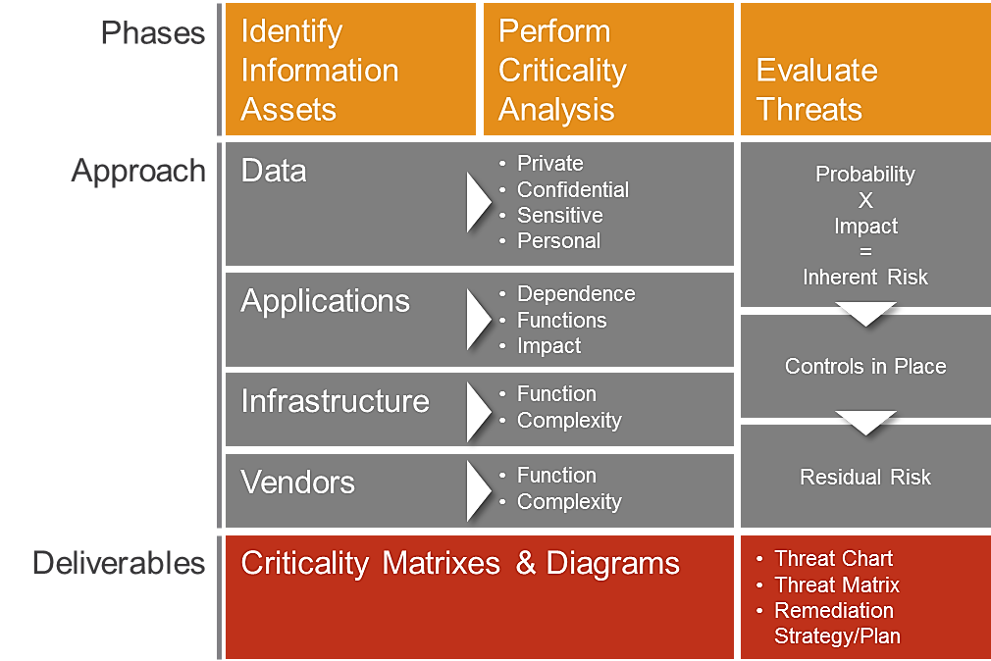
Plante Moran’s
Information Security Risk Assessment Approach

Slide 11


What can go wrong?
Identify threats to your data
Confidentiality
Availability
Integrity

Slide 12
Where is my data?
Identify the types of data you manage
Public
Confidential / Sensitive
Private
Type
Storage
Sharing

Slide 13
Where is my data?
Where is your data?
Potable disk drives
Employee desktops
Network folders
Network Folders / Servers
On-line storage
  Public
  Private
Third-parties
Mobile devices (e.g. iPads)
Don’t know
Type
Storage
Sharing

Slide 14
Where is my data?
Who & how are you sharing your data?
Who
  Employees
  Citizens
  Other Government Agencies
  Other third-parties
How are you sharing data
  E-mail
  On-line portals
  Secure / encrypted media
Type
Storage
Sharing

Slide 15
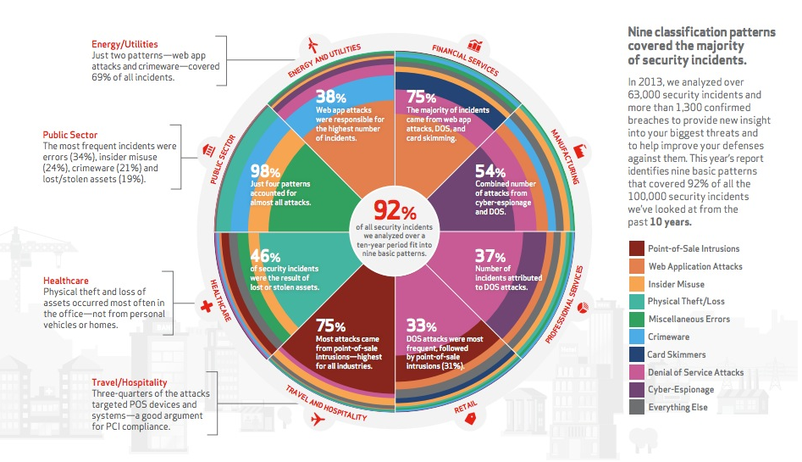
Threats – Information Security
Source: Verizon – 2014 Data Breach Investigations Report

Slide 16
Threats – Top Threats
  Virus & Malware
  Web-based attacks
  Stolen Devices
  Malicious Code
  Malicious Insiders
  Phishing / Social Engineering
  Denial of Service
Source: Ponemon /HP – Cost of Cyber Crime Study

Slide 17
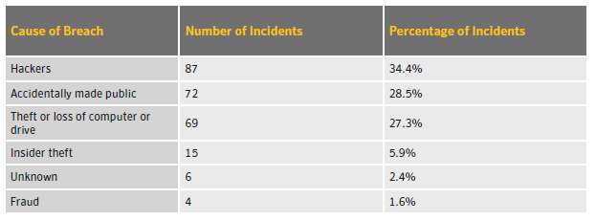
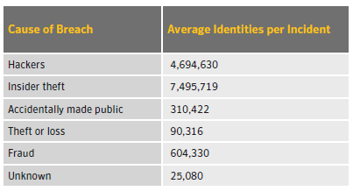
Threats – Data Breach
Source: Norton Cyber-Crime Index

Slide 18
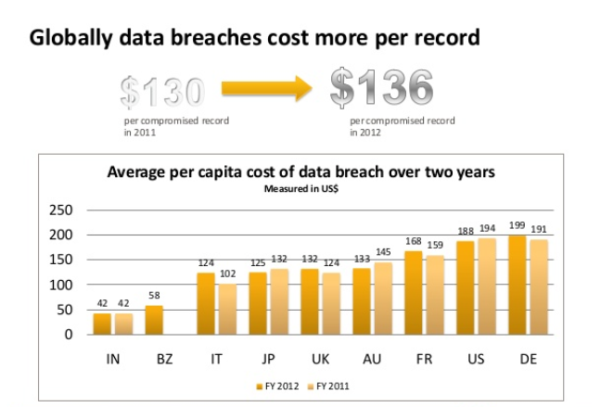

Threats – Cost of Data Breaches
Source: 2012 Verizon Data Breach Investigations Report
So What is the Cost of a Breach?
Symantec Annual Study Global Cost of a Breach – June 5th 2013
Source: Norton Cyber-Crime Index

Slide 19
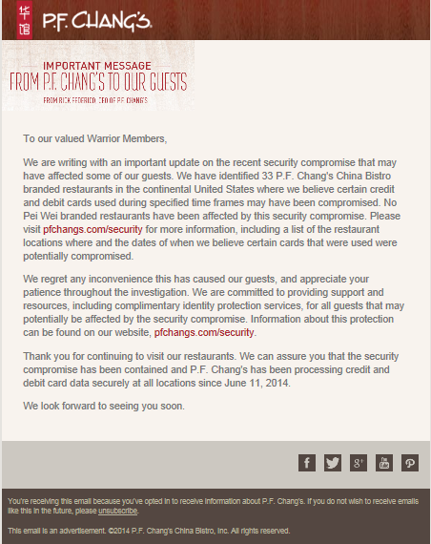
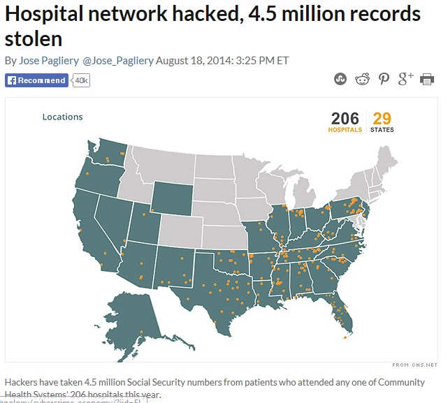
Threats – Recent Data Breach Victims
Community Health Systems Data Loss
P.F. Chang Credit Card Loss

Slide 20
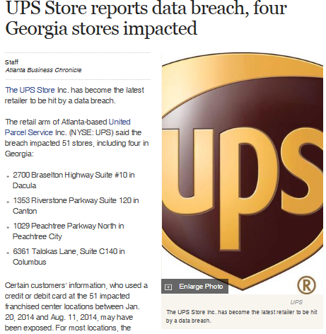
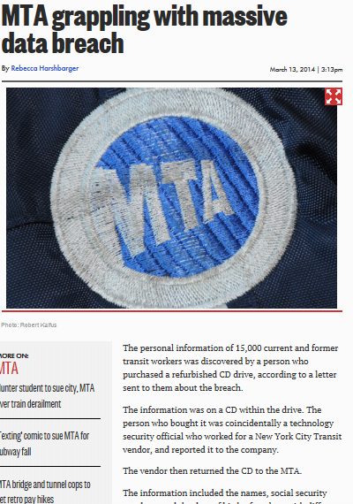
Threats – Recent Data Breach Victims
15000 MTA Data Records Lost
Credit Card Exposure at UPS Stores

Slide 21
Threats – Recent Municipal Data Breaches
City | Agency or division | No. of records breached | Date made public | Type of breach*
Providence, RI | City of Providence | 3,000 | March 21, 2012 | DISC
Springfield, Missouri | City of Springfield | 6,071 | February 28, 2012 | HACK
Provo, Utah | Provo School District | 3,200 | December 23, 2011 | HACK
San Francisco, Calif. | Human Services Agency of San Francisco | 2,400 | February 5, 2011 | INSD
Hingham, Mass. | Hingham City Government | 1,300 | August 4, 2010 | DISC
Charlotte, NC | City of Charlotte | 5,220 | May 25, 2010 | PHYS
Atlanta, Georgia | Atlanta Firefighters | 1,000 | April 13, 2010 | DISC
Detroit, Mich. | Detroit Health Department | 5,000 | December 15, 2009 | PORT
Indianapolis, Indiana | Indianapolis Department of Workforce Development | 4,500 | May 23, 2009 | DISC
Culpeper, Va. | City of Culpeper | 7,845 | April 6, 2009 | DISC
New York, NY | New York City Police Department | 80,000 | March 4, 2009 | INSD
Source: Privacy Rights Clearinghouse.
DISC = unintended disclosure of data;
HACK = hacking or malware;
INSD = insider malfeasance;
PHYS = lost, discarded, or stolen non-electronic records (as in paper documents);
PORT = lost, discarded, or stolen portable electronic devices (laptops, smartphones, etc.);
STAT = lost, discarded, or stolen stationary electronic devices (servers, computers, etc.).
Source: Norton Cyber-Crime Index

Slide 22
Threats – Recent Municipal Data Breaches
City | Agency or division | No. of records breached | Date made public | Type of breach*
Muskogee, Okla. | City of Muskogee | 4,500 | March 1, 2009 | PORT
Charleston, W.Va. | Kanawha-Charleston Health Department | 11,000 | January 20, 2009
Charlottesville, NC | City of Charlottesville | 25,000 | November 9, 2008 | PORT
Indianapolis, Indiana | City of Indianapolis | 3,300 | October 15, 2008 | DISC
Chicago, Ill. | Village of Tinley Park | 20,400 | July 24, 2008 | PORT
Baltimore, Md. | Baltimore Highway Administration | 1,800 | April 25, 2008 | DISC
Columbus, Ohio | City of Columbus | 3,500 | September 21, 2007 | STAT
New York, NY | New York City Financial Information Services Agency | 280,000 | August 23, 2007 | PORT
Virginia Beach, Va. | City of Virginia Beach, Flexible Benefits | 2,000 | July 27, 2007 | INSD
Encinitas, Calif. | City of Encinitas | 1,200 | July 13, 2007 | DISC
Lynchburg, Va. | Lynchburg City | 1,200 | June 14, 2007 | DISC
Source: Privacy Rights Clearinghouse.
DISC = unintended disclosure of data;
HACK = hacking or malware;
INSD = insider malfeasance;
PHYS = lost, discarded, or stolen non-electronic records (as in paper documents);
PORT = lost, discarded, or stolen portable electronic devices (laptops, smartphones, etc.);
STAT = lost, discarded, or stolen stationary electronic devices (servers, computers, etc.).
Source: Norton Cyber-Crime Index

Slide 23
Threats – Recent Municipal Data Breaches
City | Agency or division | No. of records breached | Date made public | Type of breach*
Chicago, Ill. | Chicago Board of Election | 1.3 million | January 22, 2007 | PORT
New York, NY | New York City Human Resources Administration, Brooklyn, NY | 7,800 | December 21, 2006 | PORT
Lubbock, Texas | City of Lubbock | 5,800 | November 7, 2006 | HACK
Chicago, Ill. | Chicago Voter Database | 1.35 million | October 23, 2006 | DISC
Savannah, Georgia | City of Savannah | 8,800 | September 20, 2006 | DISC
Chicago, Ill. | City of Chicago via contractor Nationwide Retirement Solutions Inc. | 38,443 | September 1, 2006 | PORT
New York, NY | New York City Department of Homeless Services | 8,400 | July 24, 2006 | DISC
Hampton, Va. | Hampton Circuit Court Clerk, Treasurer's computer | Over 100,000 | July 14, 2006 | DISC
Source: Privacy Rights Clearinghouse.
DISC = unintended disclosure of data;
HACK = hacking or malware;
INSD = insider malfeasance;
PHYS = lost, discarded, or stolen non-electronic records (as in paper documents);
PORT = lost, discarded, or stolen portable electronic devices (laptops, smartphones, etc.);
STAT = lost, discarded, or stolen stationary electronic devices (servers, computers, etc.).
Source: Norton Cyber-Crime Index

Slide 24
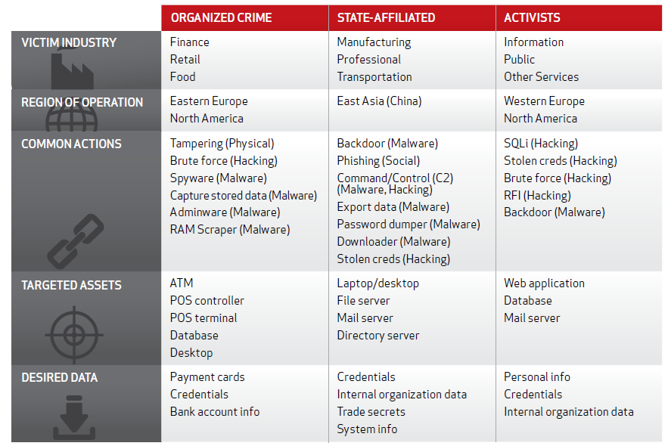
External Threats Profile

Slide 25
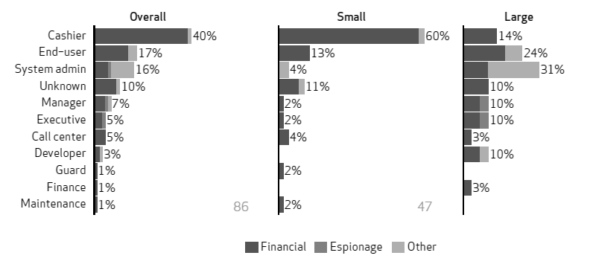
Internal Threats Profile
For smaller organizations, employees directly handling cash/payments (cashiers, waiters, and tellers, etc.) are often more responsible for breaches.
In larger organizations, it is the administrators that take the lead.

Slide 26
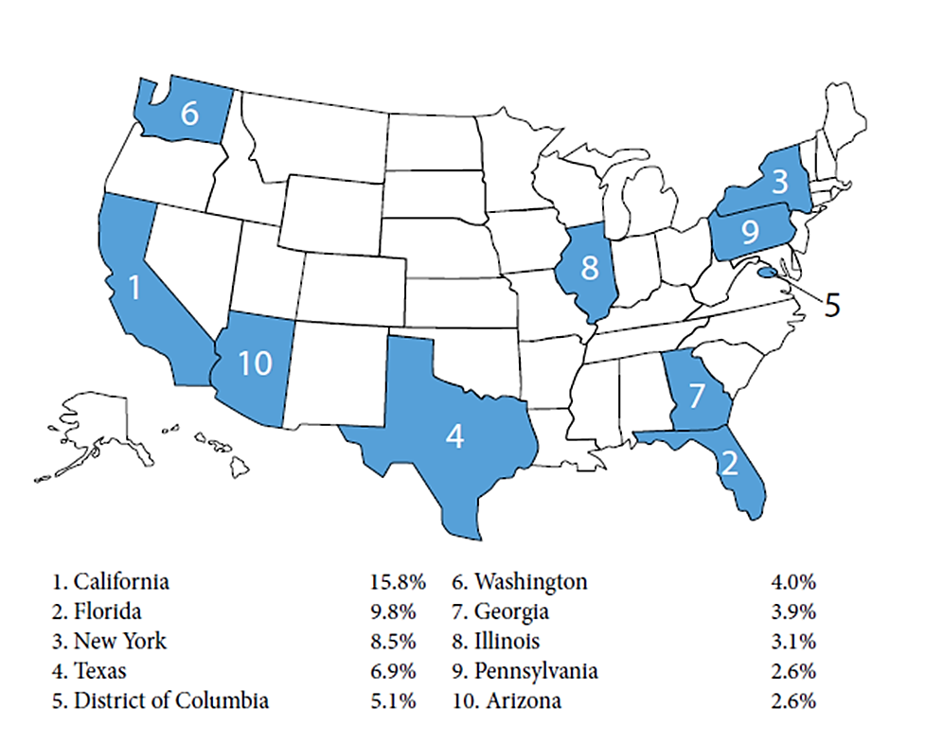
Cyber Crime – State Statistics

Slide 27
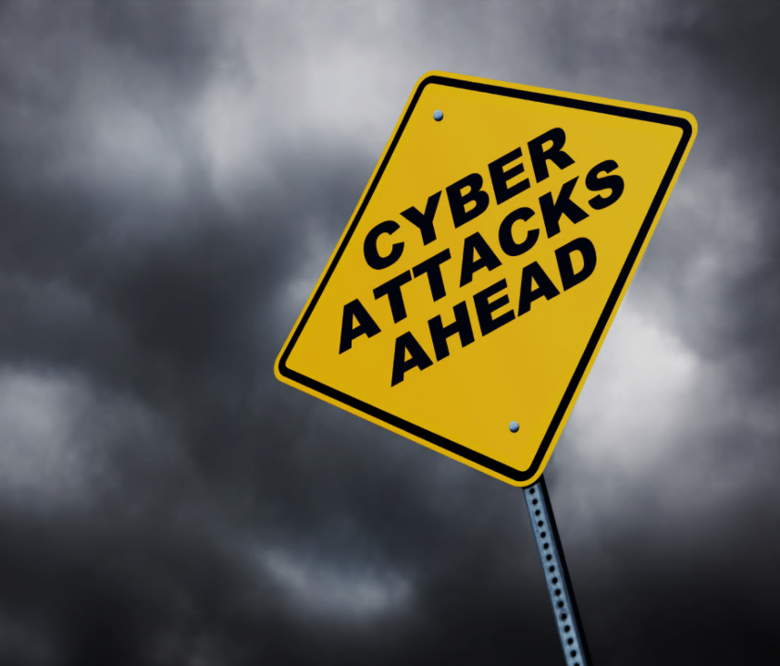
97% of Breaches Were Avoidable
Most victims aren’t overpowered by unknowable and unstoppable attacks. For the most part, we know them well enough and we also know how to stop them.
Verizon Data Breach Investigations Report
Weak Infrastructure
  Weak design (firewalls, wireless routers)
  Weak user authentication (users, passwords)
  Encryption (VPN, secure portals)
  Out-dated (patch management/anti-virus)
  Lack of periodic testing
User Ignorance
  Weak user passwords
  Poor judgment
  Social media
  Phishing attacks
Third-Party Vendors
  Weak due diligence
  Breach notification
  Annual breach confirmation
Technology Advances
  Mobile devices
  Cloud computing/public portals
27

Slide 28
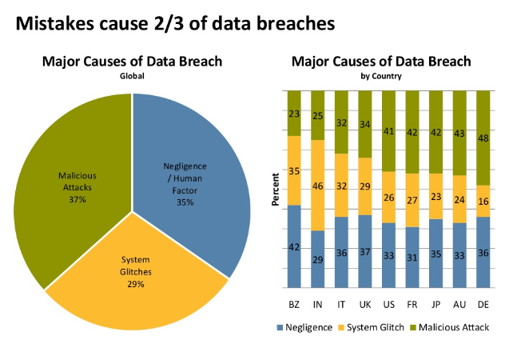

97% of Breaches Were Avoidable
Source: 2012 Verizon Data Breach Investigations Report
Symantec Annual Study Global Cost of a Breach – June 5th 2013

Slide 29
Where Are My Controls?
What would you perceive as your weakest link in cyber security?
IT Infrastructure
End Users
Third-party Vendors
Emerging Technologies

Slide 30
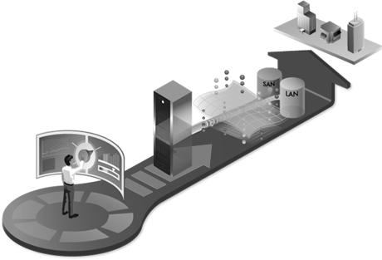
Secure Network Infrastructure
Layer Your Network – Public, Sensitive, Confidential, Private
Perimeter Security – Firewalls, IDS/IPS
Wireless Security – SSID, Encryption, Default Password
Authentication – Users & Passwords
Encryption – Connectivity & Storage
Anti-virus
Patch Management
Remote Access
Network Monitoring
Annual Testing – External Penetration & Internal Security Assessment

Slide 31
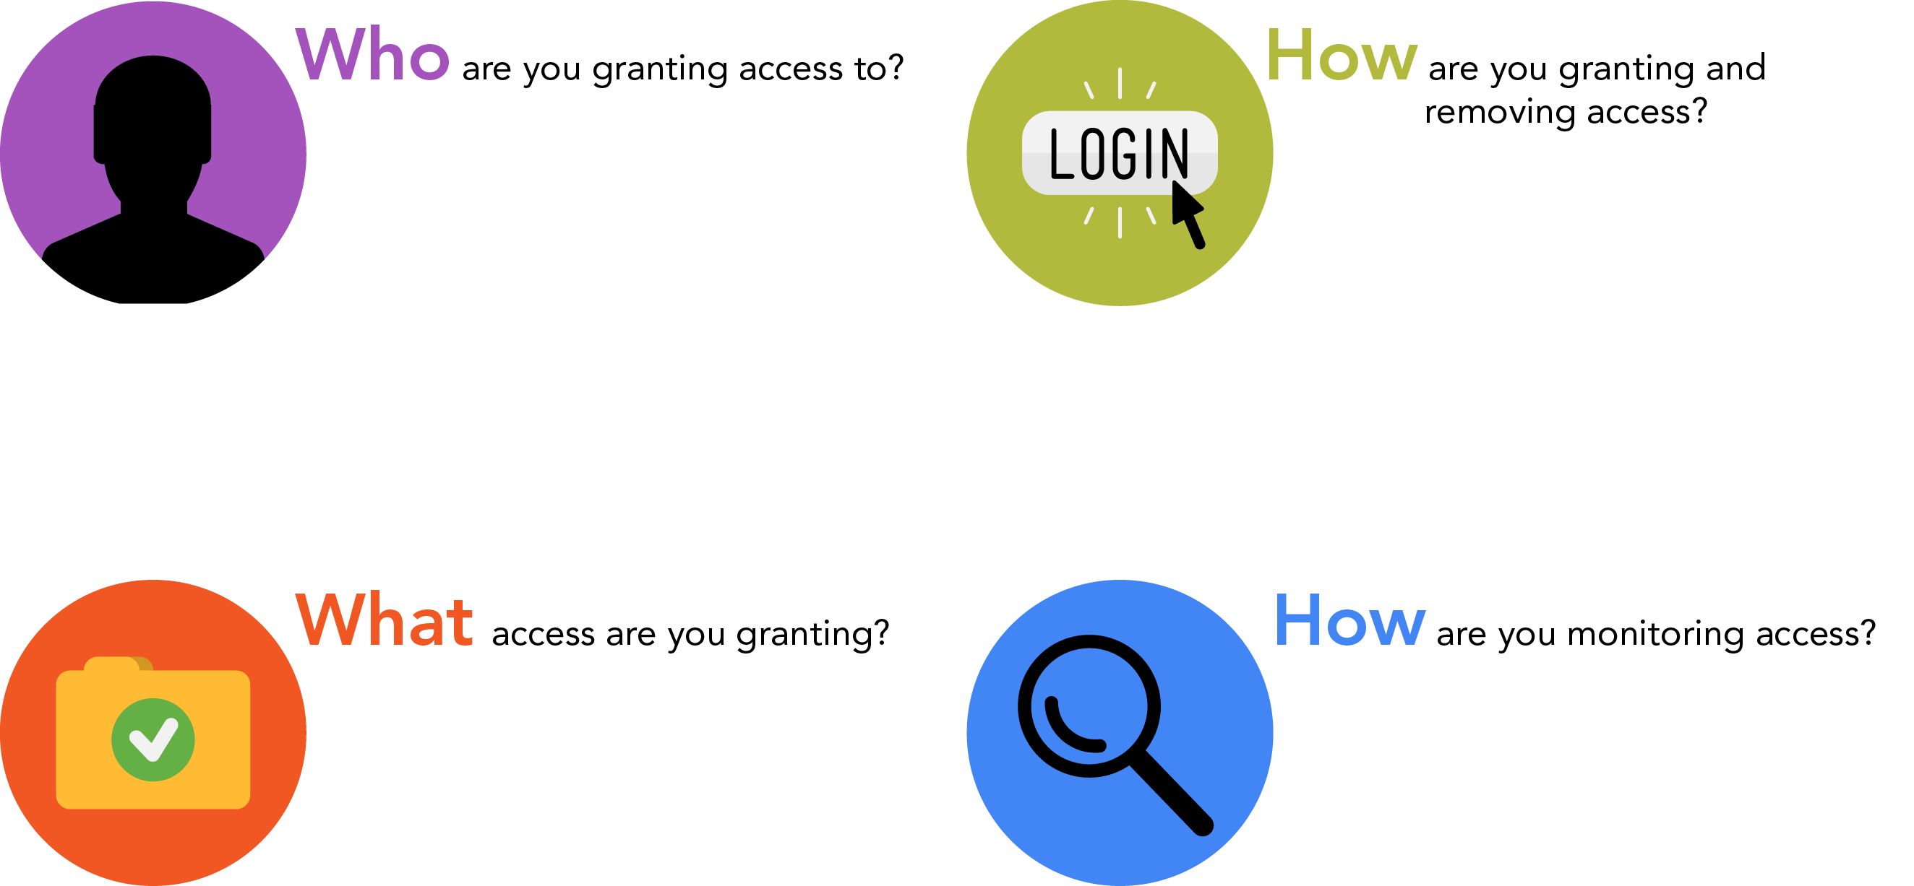
User Access Management
    Full-time employees
    Part-time employees and contractors
    Consultants and vendors
    Customers
    Visitors
    Ad hoc vs. formal repeatable process
    Single sign-on
    User IDs/passwords
    Use of technology (tokens, firewalls, access points, encryption, etc.)
    Need to know basis/able to perform job responsibilities
    Segregation of duties
    Administrative access
    Super-user access
    Internet vs. corporate system access
    Only when an issue is noted
    User access logs
    Annual review of access
    Proactive review of user activity
    Real-time monitoring of unauthorized access or use of information systems

Slide 32

User Security Awareness
I’m flattered, really I am. But you probably shouldn’t use my name as your password.
Strong password practices
Device security
Accessing from public places
Sharing data with outside parties
Loss of hardware
Disposal of devices
Use of mobile technology
Use of online portals
1-800 DATA BREACH

Slide 33
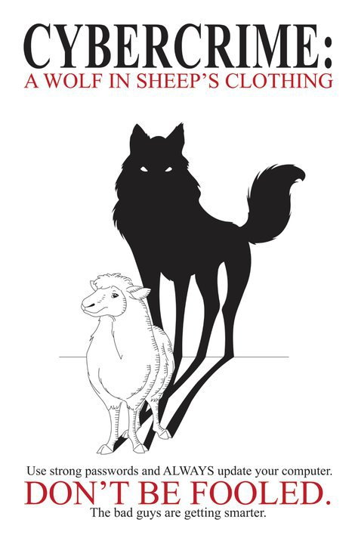
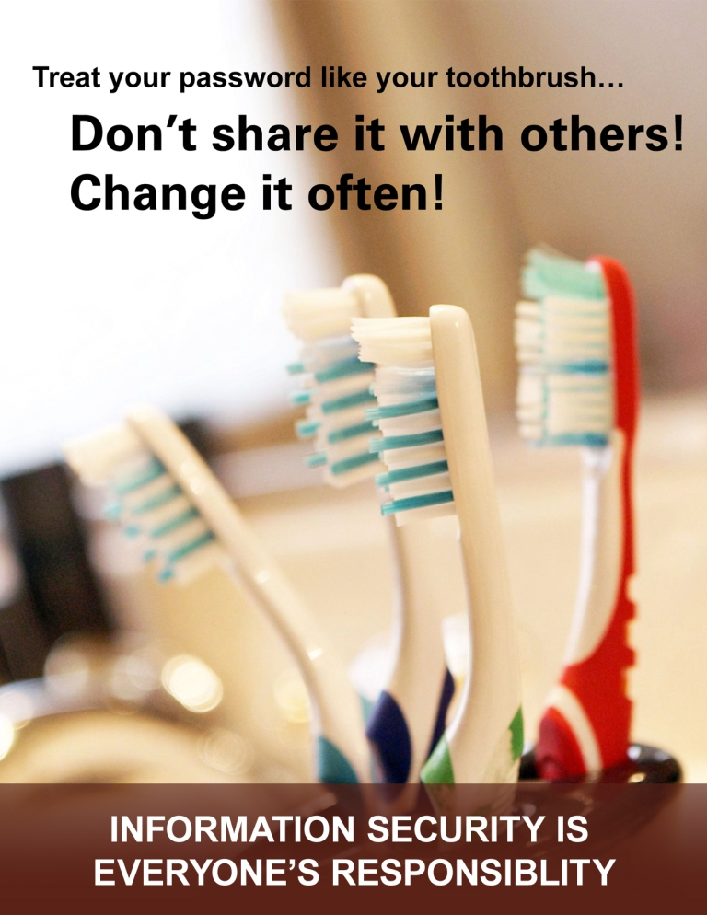
Security Awareness Posters

Slide 34
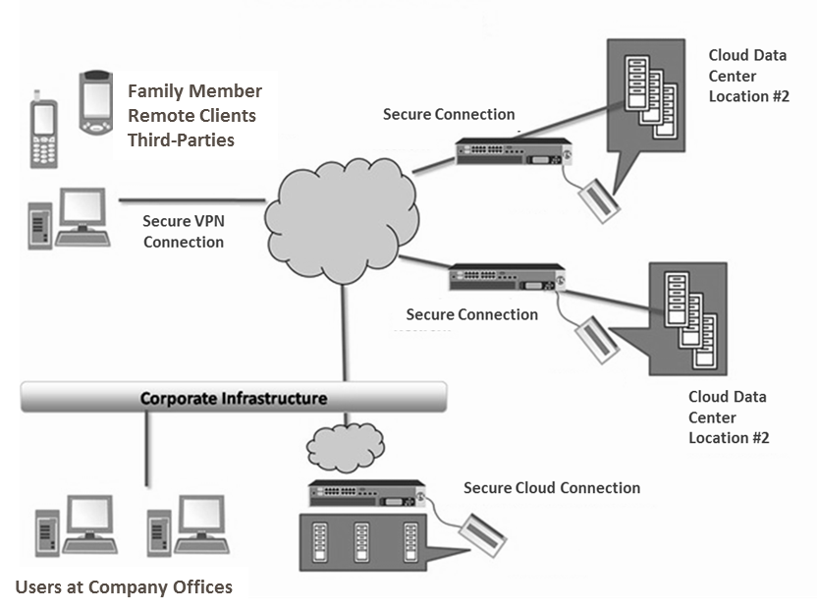
Cloud Computing
Choosing a Cloud Vendor
  Internal controls at cloud provider
  Secure connections/encryption
  User account management
  Shared servers vs. dedicated servers
  Locations of your data
  Data ownership
  Cost of switch vendors
  Other third-parties involved
  Service Organization Controls (SOC) reports
  Independent network security/ penetration testing (ask for summary report)
  Web application testing (if applicable)

Slide 35
Cloud Computing - Vendor Due Diligence
  Due Diligence
  Existence and corporate history, strategy, and reputation
  References, qualifications, backgrounds, and reputations of company principals, including criminal background checks
  Financial status, including reviews of audited financial statements
  Internal controls environment, security history, and audit coverage (SOC Reports)
  Policies vs. procedures
  Legal complaints, litigation, or regulatory actions
  Insurance coverage
  Ability to meet disaster recovery and business continuity requirements
Breach Notification
  Contract language should include breach notification requirement
  Annual confirmation of breaches by CEO or other C-level executive at the vendor

Slide 36

Cloud Computing - Vendor Due Diligence
Security Concerns
Security and Privacy
Expectations
To gain the trust of organizations, cloud-based services must deliver security and privacy expectations that meet or exceed what is available in traditional IT environments.
Traditional IT
In the Cloud
LOSS OF GOVERNANCE: Customer relinquishes some control over the infrastructure. TRUST in the provider is paramount.
COMPLIANCE RISKS: The providers operational characteristics directly affect the ability for a customer to achieve compliance with appropriate regulations and industry standards.
  DATA PROTECTION: The customer relinquishes control over their data to the provider. The provider must give demonstrable assurances to the customer that their data is maintained securely from other tenants of the cloud.
Where
How

Slide 37
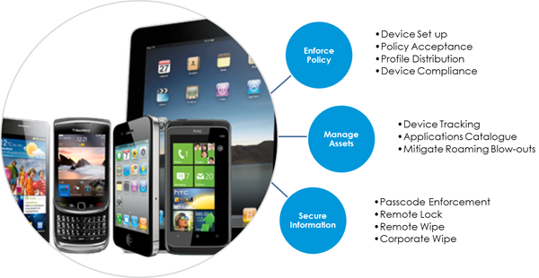
Mobile Devices
Device Security
  Physical security of device
  Passwords not pins
  Enable auto lock
  Secure e-mail/calendar (including sync)
  Keep Bluetooth devices to “non-discoverable” (will not impact authenticated connections)
  Remote wipe
  Failed attempts lock/wipe
  Secure backup data on mobile device
  Keep all system/applications patches up-to-date
  Keep “apps” version current
Encryption
  Passwords enable native encryption
  Encrypted transmission
  Memory encryption
Mobile Device Management
  Great way to manage company owned devices

Slide 38
Mobile Devices
Mobile Device Considerations
Who has access & how is it controlled? | Apps can send data in the clear – unencrypted -- without user knowledge. Many apps connect to several third-party sites without user knowledge. Unencrypted connections potentially expose sensitive and embarrassing data to everyone on a network.
Segregation of personal & bank data | 72% of apps present medium (32%) to high (40%) risk regarding personal privacy. ¹
Lost device & remote wipe management | Only 55% of those allowing personal mobiles in the work place have password policies in place.¹
1- net-security.org

Slide 39
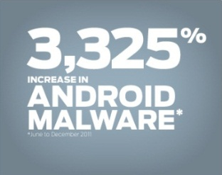
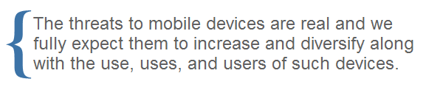
Mobile Devices
In the mobile world, control over customer data is dependent upon:
  Device Physical Security
  Device Logical Security
  App Security
Each of which overwhelmingly rely upon an educated end user to be effective

Slide 40
So What Do We Do?
How can I reduce my risk?
Information Security Program
Risk Assessment
User Awareness
Vendor Management

Slide 41
Information Security Process
Risk-Based Information Security Process
Perform an Information Security Risk Assessment
Designate security program responsibility
Develop an Information Security Program
Implement information security controls
Implement employee awareness and training
Regularly test or monitor effectiveness of controls
Prepare an effective Incident Response Procedure
Manage vendor relationships
Periodically evaluate and adjust the Information Security Program
4
4

Slide 42
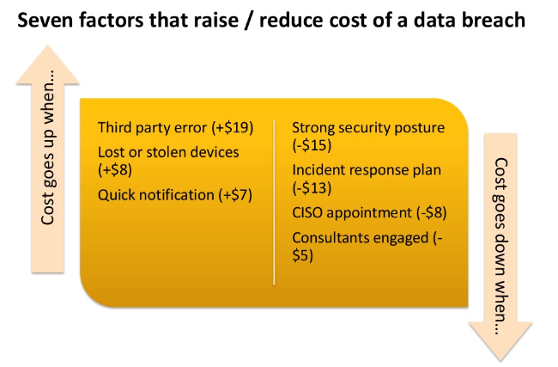
Information Security Process
4
4

Slide 43
Information Security Process
97% of breaches were avoidable - Most victims aren’t overpowered by unknowable and unstoppable attacks. For the most part, we know them well enough and we also know how to stop them.
    Information Security Program
    Annual Risk Assessments
    Strong IT Policies
    Educate Employees
    Patch Management Program
    Deploy Encryption and Strong
    Authentication Solutions
I’m flattered, I really am. But you probably shouldn’t use my name as your password
4
4

Slide 44
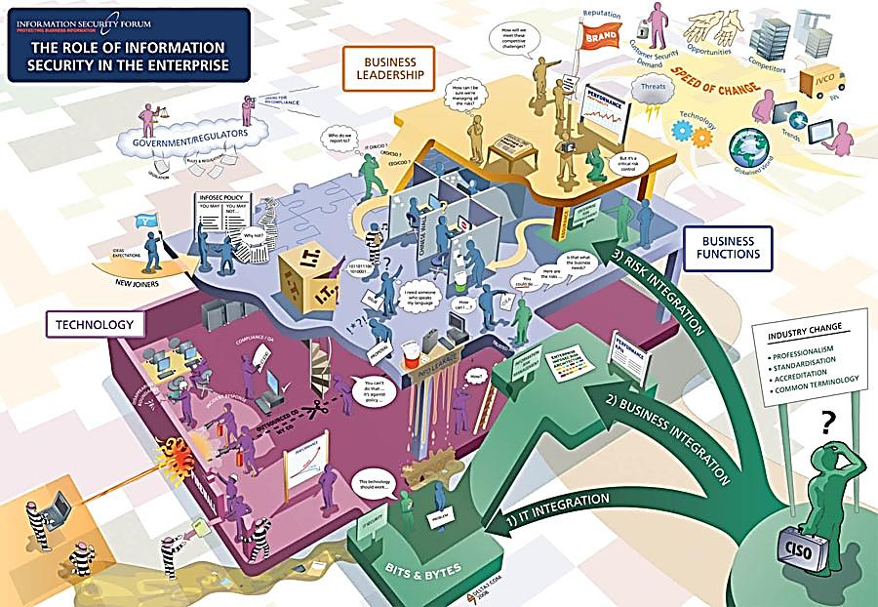
In summary … it’s complicated

Slide 45
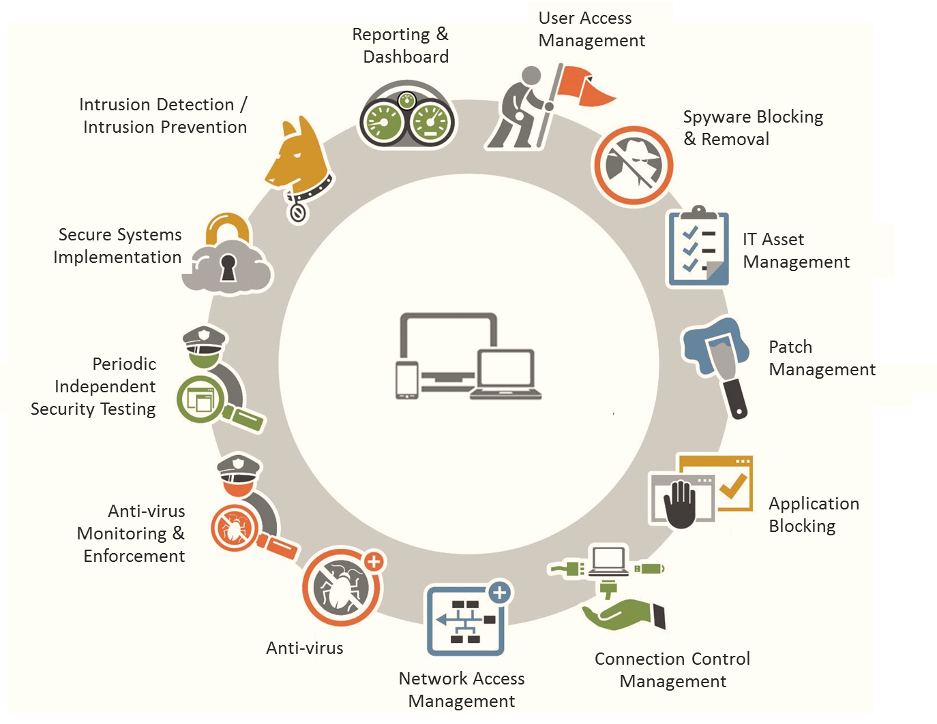
In summary … now simplified

Slide 46

THANK YOU
Alex Brown| Senior Manager | IT CONSULTING
216.274.6522| Furney.Brown@plantemoran.com

