Slide 1
Paul M. Perry, FHMFA, CITP, CPA
paul.perry@warrenaverett.com
(205) 769-3251
INTERNAL CONTROLS FROM A to Z and
HOW to WHY
FGFOA Webinar
July 20, 2016

Slide 3
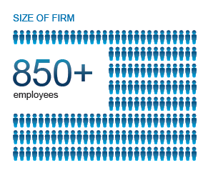
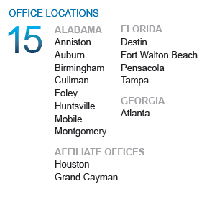
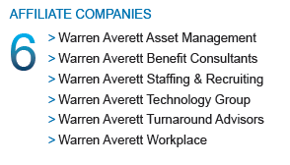
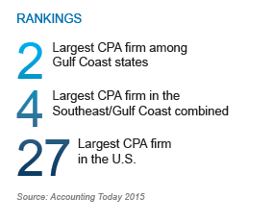
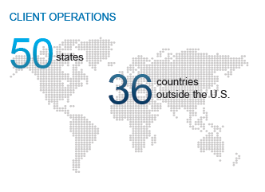
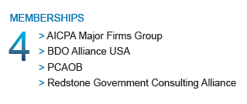
Warren Averett – Firm Facts

Slide 4

Presenter – Paul Perry, FHFMA, CITP, CPA
Paul Perry has been with Warren Averett since 2004 and is a Senior Manager in the Firm’s Consulting Division and Director of Security Services for the Technology Group – focusing on internal control and information technology related projects.
Paul is also a member of the Firm’s Data Analysis Group, a team of individuals within the Firm who provide data analysis solutions to both internal and external clients. For more than 11 years, he has specialized in accounting advisory and review assurance services, as well as external and employee benefit plan audits.
Paul has extensive experience serving clients in the nonprofit, governmental, financial, insurance and healthcare facilities/hospital industries.

Slide 5
Internal Controls - Objectives
Overview of Internal Controls – A to Z
The Why’s to Internal Control
  Risk Management
  Fraud Discussion
  COSO Model Discussion
The How’s to Internal Controls
  Entity Level Controls
  Documentation
  Key and Non-Key Controls
  Types of Controls
  Activity Level Controls
  IT General Controls
  Data Analysis Techniques

Slide 6
The Alphabet of Internal Controls
Everyone
Vulnerability
Documentation
Uncertainty
Year-end Review
P-D-C
Communication
RISK
eXamination
Bus
pHysical safeguards
FRAUD
Key
Non-key
Weight
Zero tolerance
Everyday
Governance
Monitoring
Segregation of duties
Integrity
Opportunity
Quality Control
Tone at the top
Justification
Limitations
Analytics

Slide 7
The Alphabet of Internal Controls

Slide 8
The Alphabet of Internal Controls

Slide 9
The Alphabet of Internal Controls

Slide 10
The Alphabet of Internal Controls

Slide 11
The Alphabet of Internal Controls – Why?
Key Risk Areas
Financial
Operations
Information Systems
Sample Risk Assessment Types
Financial Risk Assessment
Compliance Risk Assessment
Fraud Risk Assessment
Customer and Credit Risk Assessment
Supply Chain Risk Assessment
Cyber Risk Assessment
Product Risk Assessment
Strategic Risk Assessment

Slide 12
The Alphabet of Internal Controls – WHY?
Why Risk Management?
Risk management protects the long-term viability of a business.
Just thinking about risk improves decision-making and business effectiveness.
Good risk management allows companies to anticipate problems and minimize the impact of catastrophic events.
Risk management ensures an optimal allocation of resources and capital.
Risk management can significantly improve strategic planning and opportunity prioritization.

Slide 13
Financial Risk
Cyber Security Risk
Regulatory & Compliance Risk
Credit Risk
Legal Risk
Market Risk
All of these can put Companies Out of Business!
Competitive Risk
Changing Technology Risk
Liquidity Risk
Business Interruption Risk
Human Capital Risk

Slide 14
The Alphabet of Internal Controls – WHY?
FRAUD TRIANGLE
FRAUD SCHEMES
Revenue & Cash Receipts Schemes
Purchasing & Disbursement Schemes
Payroll & Expense Reporting
Other Asset Misappropriation & Misuse
PRESSURE
(Weight of the World)
OPPORTUNITY
RATIONALIZATION
(Justification)

Slide 15

The Alphabet of Internal Controls – WHY?
Red Flags for Fraud
  An employee with disbursement processing responsibilities who refuses to take more than a couple days vacation at a time.
  Control Issues – An employee who is over-controlling or overprotective of responsibilities.
  Behavioral changes indicating possible drug, alcohol, gambling addiction.
  Employee lifestyle changes: financial or significant debt issues, divorce, expensive cars/homes, etc.
  High employee turnover, especially in areas vulnerable to fraud.
  Wheeler/Dealer Type Attitude.
  Suspicious or defensive behavior.

Slide 16
The Alphabet of Internal Controls
Common Internal Control Limitations
Human error
Fatigue
Distractions
Misunderstandings
Carelessness
Collusion
Change
Judgment

Slide 17
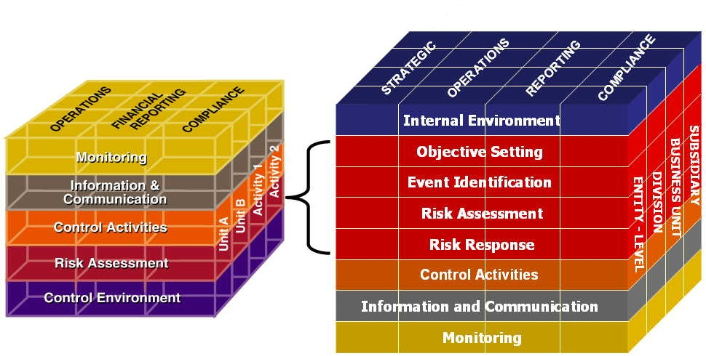
The Alphabet of Internal Controls
COSO Model of Controls

Slide 18
The Alphabet of Internal Controls
2013 COSO Model – Explicity Articulates 17 principles related to components
Control Environment
  1. Demonstrates commitment to integrity and ethical values.
  2. Exercises oversight responsibility.
  3. Establishes structure, authority, and responsibility.
  4. Demonstrates a commitment to competence.
  5. Enforces accountability.
Risk Assessment
  6. Specifies suitable objectives.
  7. Identifies and analyzes risk.
  8. Assesses fraud risk.
  9. Identifies and analyzes significant change.

Slide 19
The Alphabet of Internal Controls
Control Activities
  10. Selects and develops control activities that contribute to the
  mitigation of risks.
  11. Selects and develops general controls over technology.
  12. Deploys control activities through policies and procedures.
Information and Communication
  13. Uses relevant, quality information.
  14. Communicates internally.
  15. Communicates externally.
Monitoring
  16. Conducts ongoing and/or separate evaluations.
  17. Evaluates and communicates deficiencies.

Slide 20
The Alphabet of Internal Controls
Entity Level Controls

Slide 21
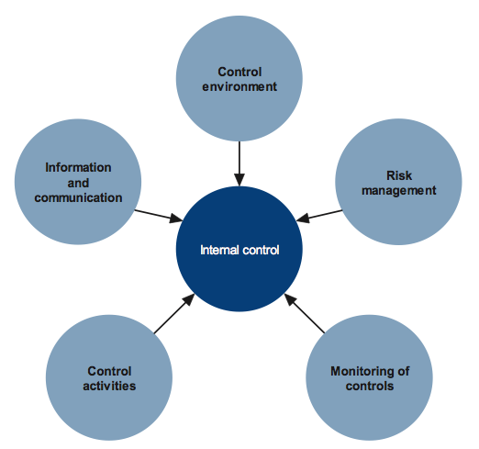
The Alphabet of Internal Controls
Control Environment
The control environment is the attitude toward internal control and control consciousness established and maintained by the management’s philosophy, style and supportive attitude, as well as the competence, ethical values, integrity, and morale of the organization’s people. Elements include:
Ethical Values and Integrity
Management’s Operating Style and Philosophy
Competence
Morale
Supportive Attitude
Mission
Structure
Control Environment
Source: Purchase College – State University of New York

Slide 22
The Alphabet of Internal Controls
Risk Management
Risks are events that threaten the accomplishment of objectives. They ultimately impact an organization’s ability to accomplish its mission. Some questions to ask when assessing risks:
What keeps you awake at night?
What obstacles could stand in the way of achieving your objective?
What can go wrong?
What is the worst thing that could happen?
Are there new processes?
Are there processes that have changed?
Are there new goals and legislation?
Are there staffing changes?
Risk Management
Source: Purchase College – State University of New York

Slide 23
The Alphabet of Internal Controls
Monitoring of Controls
Monitoring is the review of an organization’s activities and transactions over time to determine whether controls are effective. When monitoring is designed and implemented effectively, companies are more likely to:
Identify and correct internal control problems on a timely basis.
Produce more accurate and reliable information for use in decision-making.
Prepare accurate and timely financial statements.
Be in a position to provide periodic certifications or assertions on the effectiveness of internal control.
Monitoring of controls
Source: Purchase College – State University of New York

Slide 24
The Alphabet of Internal Controls
Control Activities
Control activities are tools – both manual and automated – that help prevent or reduce the risks that can impede accomplishment of the organization’s objectives and mission. Examples of control activities include:
Documentation
Approval and Authorization
Verification
Supervision
Separation of Duties
Safeguarding Assets
Reporting
Computer Systems Controls (i.e., backup and disaster recovery, input controls, output controls)
Control Activities
Source: Purchase College – State University of New York

Slide 25
The Alphabet of Internal Controls
Information & Communication
Information & Communication is the exchange of useful information between and among people and organizations to support decisions and coordinate activities. Within an organization, information should be communicated to management and other employees in a timely manner to help them carry out their responsibilities. Elements of communication include:
Timeliness
Sufficient but not excessive detail
Appropriate to user
Clear and open horizontal and vertical
Information & Communication
Source: Purchase College – State University of New York

Slide 26

The Alphabet of Internal Controls
DOCUMENTATION
“If you walk out of here and get hit by a bus…” all auditors everywhere

Slide 27
The Alphabet of Internal Controls
DOCUMENTATION - Continued
“If it is not documented, you did not do it”
Who performs what?
In what order are controls performed?
How often are they performed?
Titles and not specific personnel. Personnel change.
Key and Non-Key Controls
Need a good mix of both
Non-key – process controls (how something is done and documented)
Key – review controls (who reviews what others have done or major controls – without this, something cannot be done)
Can be manual or automated

Slide 28
The Alphabet of Internal Controls
Preventive – Detective – Corrective
Preventive – prevent problems from occurring (Proactive)
Segregation of Duties
Monitoring
Adequate Documentation
pHysical safeguards
Detective – identify problems after occurrence (Reactive)
Data Analytics
Reviews
Reconciliations
Corrective – prevent recurrence of problems
Begin risk assessment process
Submit corrective journal entries after discovering an error.
Back-up data so it can be restored in the event of a crash or improper transaction.

Slide 29
The Alphabet of Internal Controls
Activity Level Controls

Slide 30
Cash RECEIPTS
Internal Controls - Examples
*Management reviews the entity’s financial statements on a periodic basis and investigates significant variances from budgets and expected results.
Cash receipts are reconciled to general ledger postings daily.
There is adequate segregation of duties among those who:
  Open the mail or copy checks received.
  Prepare deposits.
  Deposit cash receipts.
  Reconcile bank accounts.
  Investigate discrepancies or issues related to cash.
  Maintain the cash receipts journal.
  Post journal entries to the general ledger.

Slide 31
Cash RECEIPTS (Cont.)
Internal Controls - Examples
Delinquent accounts receivable are reviewed.
Lockbox receipts are compared to customer remittances.
Bank reconciliations are prepared and reviewed in a timely fashion.
Cash receipts are deposited intact promptly or stored in a secure location.
Adjustments of cash accounts are approved and documented by the appropriate level of management or another appropriate person.

Slide 32
Cash disbursements
Internal Controls - Examples
System rejects duplicate entry of an invoice from a vendor.
Purchase order, receiving report, and invoice are matched and cancelled prior to payment.
Dual signatures required for amounts over a certain limit.
The check signer reviews all supporting documentation prior to signing check.
Checks are pre-numbered, the sequence is accounted for regularly, and unissued checks are controlled and kept in a secure location.
Passwords are established and used for individuals authorized to make wire transfers, and bank callback verifications are in place for telephone transfers exceeding a predetermined dollar amount.
Bank reconciliations are prepared and reviewed in a timely fashion.

Slide 33
Cash disbursements (Cont.)
Internal Controls - Examples
Adequate segregation of duties among those who:
  Review, authorize, or sign checks.
  Initiate checks for expenditures.
  Prepare checks.
  Mail checks.
  Edit the vendor master file.
  Investigate discrepancies or issues involving expenditures.
  Open the mail or copy checks received.
  Reconcile bank accounts.

Slide 34
Investments
Internal Controls - Examples
Interest and dividend income calculations and accruals are reviewed.
Third-party statements are reconciled to sub ledger and general ledger account(s).
Management or the governing body approves investment and derivative instruments transactions to ensure that they are valid and in compliance with the entity’s policies and procedures.
Investment activity must be consistent with a written plan adopted by that governing body – managing risk of the overall investments
  Authorization (who can approve what transactions)
  Concentration limits (what is the makeup of the investment portfolio – are they consistently followed and in agreement with laws and regulations)
  Maturity Structures and Credit Ratings

Slide 35
Investments (Cont.)
Internal Controls - Examples
Periodically, an investment committee, appropriate member of management, or another appropriate person reviews investments and investment return for accuracy and compliance with restrictions or limitations imposed by laws, funding sources, or the governing body.
Accounting policies and procedures specify the correct treatment for valuing investments and derivative instruments and calculating asset impairment, including those requiring management’s estimates and judgments.
Gains and losses for complex investments (e.g., repurchase agreements, reverse repurchase agreements, and securities lending transactions) are calculated by an automated system or third party.

Slide 36
IT General computer controls
Internal Controls - Examples
A management steering committee is responsible for reviewing and approving IT plans and priorities.
Application data and file server backups are performed to minimize the risk of lost or corrupted data. Backup tapes or other media are secure (accessible only by authorized personnel).
A process exists to ensure that systems incidents, problems, and errors are reported, analyzed, and resolved in a timely manner.
User access rights are removed or suspended in a timely manner when employees are terminated. Standards exist to define timeliness requirements for various situations (i.e., voluntary or involuntary termination).
User access rights (network, application, and database) are granted on a need-to-know, need-to-do basis that considers appropriate segregation of duties.
Notes:
The following are examples of controls for different subject areas. These are not an exhaustive lists of controls, but merely examples of possible controls to consider in the control environment.

Slide 37
ITGC (Cont.)
Internal Controls - Examples
There is adequate segregation of duties among those who:
  Administer IT security.
  Make changes to programs or systems.
  Perform transaction and accounting duties.
Application, database, and operating system changes are appropriately approved and tracked in a centralized change tracking database or system.
A test plan is developed and followed for all major implementation projects, including data conversion testing as appropriate.
User acceptance testing is performed on all user-requested projects. Tests are completed and documented prior to the move into production.

Slide 38
DATA ANALYTICS
The Alphabet of Internal Controls
“Data analytics is the science of reviewing raw data for the purpose of drawing conclusions from that data.”
Data Analysis Techniques as Controls
Benford’s Law
Relative Size Factor

Slide 39
Benford’s Law - First Digit law
The Alphabet of Internal Controls
Refers to the frequency distribution of digits in many (but not all) real-life sources (i.e. naturally-occurring) data. In this distribution, 1 occurs as the leading digit about 30% of the time, while larger digits occur in that position less frequently: 9 as the first digit less than 5% of the time.
Benford's law also concerns the expected distribution for digits beyond the first:
First two digits – most commonly used – more granular
Second digit
Last digit

Slide 40
Benford’s Law - CONTINUED
The Alphabet of Internal Controls
1938
Frank Benford – Physicist
surface areas of 335 rivers,
the sizes of 3259 US populations,
1800 molecular weights,
5000 entries from a mathematical handbook,
308 numbers contained in an issue of Reader's Digest,
the street addresses of the first 342 persons listed in American Men of Science
The total number of observations used - 20,229.

Slide 41
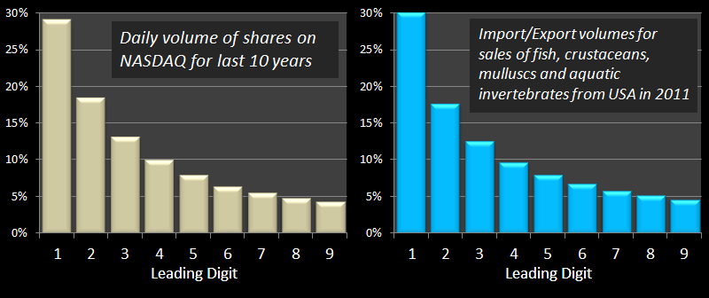
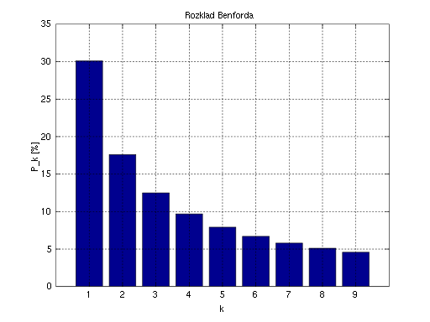
Benford’s Law - Continued
Examples

Slide 42
Benford’s Law – CASE STUDY
The Alphabet of Internal Controls
In 1993, in State of Arizona v. Wayne James Nelson (CV92-18841), the accused was found guilty of trying to defraud the state of nearly $2 million, by diverting funds to a bogus vendor.
The perpetrator selected payments with the intention of making them appear random:
No duplicated check amounts
No round-numbers - all the values included dollars and cents amounts.
He did not realize that his seemingly random looking selections were far from random. And the chart of amounts to the fictitious vendor looked like….

Slide 43
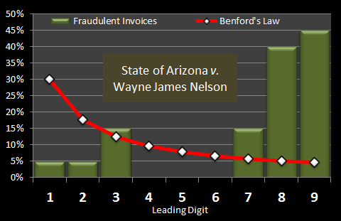

Slide 44
DATA ANALYSIS TECHNIQUE
The Alphabet of Internal Controls
Relative Size Factor
- is to identify anomalies where the largest amount for subsets (vendor, customer) in a given data set is outside the norm for those subsets. This test compares the top two amounts for each subset and calculates the RSF for each.
Examples
Vendor A – $5,000 and $4,000 = RSF is 1.25
Vendor B – $200,000 and $20,000 = RSF is 10.00
Question - Which is consistent with your organization?

Slide 45
Questions?
The Alphabet of Internal Controls
Paul M. Perry, FHMFA, CITP, CPA
paul.perry@warrenaverett.com
(205) 769-3251

Slide 46
CPAs AND ADVISORS
LET’S THRIVE TOGETHER

