Slide 1
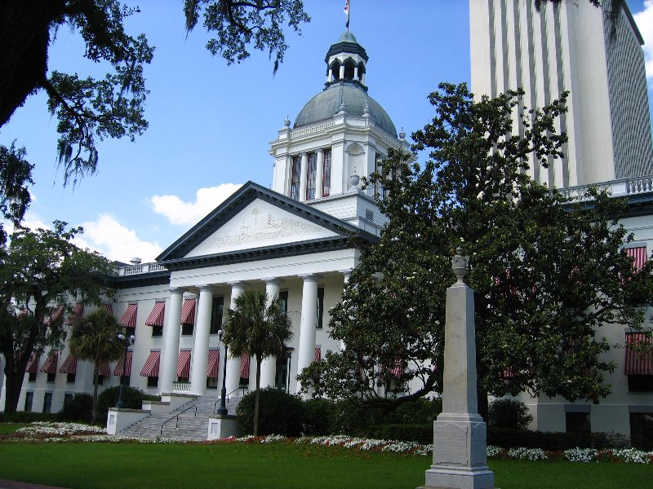
Constitution Revision Commission (CRC)
David J. Cruz
Assistant General Counsel
Florida League of Cities

Slide 2
Constitution of Florida
The Constitution of the State of Florida is the document that establishes and describes the duties, powers, structure and function of the government of the state.
Florida has 5 ways to amend the constitution:
The Florida Legislature
The Constitution Revision Commission (CRC)
The “people” through the initiative process
Constitutional convention
The Taxation and Budget Commission

Slide 3
What is the CRC?
The CRC is a group of 37 people who will review and recommend changes to Florida’s constitution.
Article XI, Section 2
Meets every 20 years
Puts amendments directly on ballot (requires 60% voter approval to pass)
CRC amendments are not bound by single subject requirements
37 members will be appointed as early as February, 2017
This will be the third CRC in state’s history

Slide 4
Who serves on the CRC?
15 Appointed by the Governor
9 Appointed by the Speaker of the House
9 Appointed by the President of the Senate
3 Appointed by the Chief Justice of the Florida Supreme Court
The Attorney General of Florida

Slide 5
What will the CRC do?
Adopt rules of procedure
Examine the constitution of the state
Hold public hearings
Make recommendations for revisions to go on the 2018 general election ballot

Slide 6
Notes:
1997-1998 CRC Process

Slide 7
Previous CRCs
1977-1978 CRC
Eight proposals
None adopted on ballot
1997-1998 CRC
Nine proposals
Eight were successful

Slide 8
When will the CRC process begin?
30 days before the start of the 2017 Legislative Session
Organizational meeting (June 2017)
Likely public hearings (Summer 2017)
Final CRC proposals submitted to Sec. of State (May 2018)
Voters vote on proposals (November 2018)

Slide 9
Florida League of Cities CRC Contacts
David Cruz
Assistant General Counsel
Dcruz@flcities.com
850-701-3676 (Office)
305-322-3643 (Mobile)
Scott Dudley
Legislative Director
Sdudley@flcities.com
850-701-3656 (Office)
850-570-7296 (Mobile)

