Slide 1





Florida agencies moving to the cloud:
Trends, risks and impacts
JOHN CHRISTLY, CHIEF INFORMATION SECURITY OFFICER
NETSURION AND EVENTTRACKER
Twitter: @Christly Email: jchristly@netsurion.com

Slide 2




Growing expectations for
governments
Moving to the cloud: Trends, Risks, Impacts and Best Practices
Security and compliance: Security breach impacts and remediation
Mobile:
Benefits and Disadvantages

Slide 3






Trends in cloud adoption
Tech-savvy businesses outperform their peers in the marketplace
December
A growing number of state CIOs have implemented cloud-first policies of their own:
of all Federal
IT spending went to the cloud in FY16, according to IDC government insights.
The City of Miami
The State of Illinois
The State of Alabama
Florida Dept. of Education
The “cloud first” policy: no new federal IT project of any significance was to move forward without

Slide 4
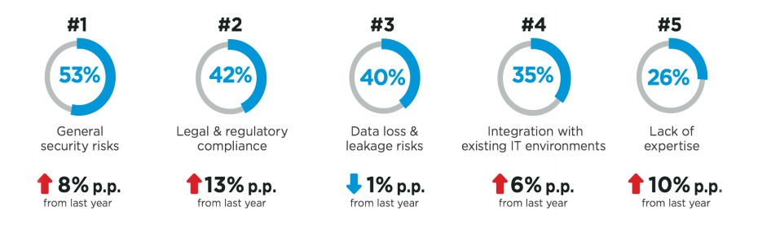
Risks and concerns
www.crowdresearchpartners.com

Slide 5











Leap ahead in the cloud

Slide 6
Question #1
A questions to ask a cloud /SaaS provider is:
a) What is your Cloud provider’s disaster recovery plan?
b) Will my organization have to encrypt their own files?
c) What files can be saved in the cloud?

Slide 7

Cloud: know what you are doing
and do it right
SIEM/MDR, FIM,
IDS/IPS, and more
Monitors systems, applications, firewalls, servers, etc.
Helps maintain confident
compliance
FedRAMP approved
Offers 24/7 monitoring
Manages installation and configuration

Slide 8













Benefits

Slide 9
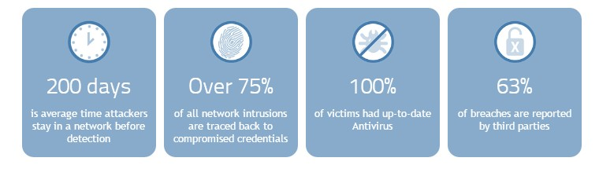
Data breach statistics
60% of attackers are able to gain access immediately

Slide 10
Question #2
The benefits of utilizing the cloud/SaaS include:
a) Weaker security
b) Access to updated technology
c) Increased staff work/time

Slide 11






Impacts of a breach

Slide 12




Breach Remediation
Have a data breach policy
Educate employees
Have tools that prevent and immediately detect a breach

Slide 13



Mobile devices support government priorities:
Cost savings
Increased productivity
Citizen service
Public safety

Slide 14
Complete Managed Security
Managed Firewall and Next Generation Anti-Virus
SIEM and Log Management
Threat Detection and Response
Vulnerability Assessment
Behavior Analysis
Compliance Management
SIEM and event correlation
Actionable threat intelligence analyzed by SOC
Unlimited log management
Honeynet deception as a service
Alert turning and automated response rules
Endpoint USB Monitoring
Vulnerability assessment
Network vulnerability scanning
Network intrusion detection
Monitors user activity and alerts on anomalous activity
Reveals system misuse or compromise
Ensures audit trails for compliance
File integrity monitoring
Automated log review
FISMA, PCI DSS, HIPAA, NIST, GPG13 and more

Slide 15
Question #3
A completely managed security will provide:
a) Threat detection and response
b) Antivirus updates
c) Lack of log management
d) No audit trails

Slide 16

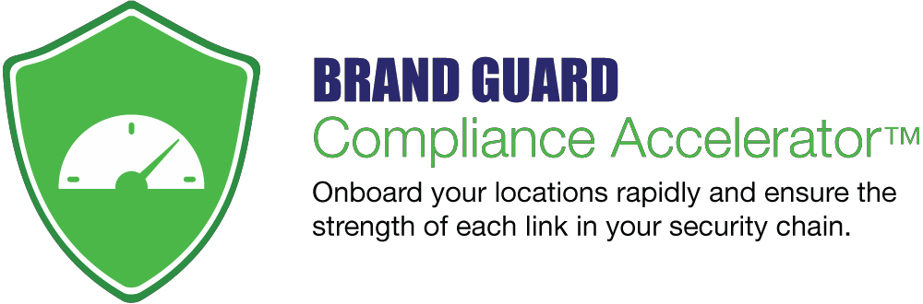
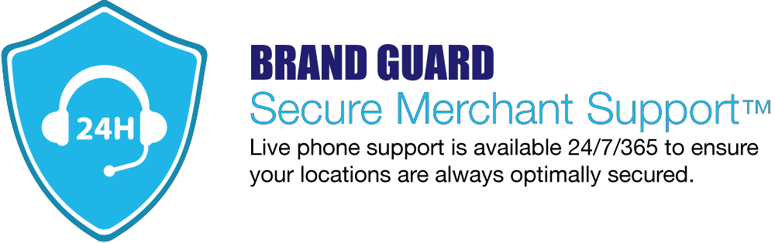

Security Adoption for all locations
Professional solutions tailored to ensure a successful security rollout
BrandGuard
Trust in your brand starts with security.
Strategic security initiative roll-out program
Communication and change
management expertise
Educate and encourage adoption
Generate awareness and support

Slide 17
“The ease of having someone manage your
network is probably the biggest benefit. Other than that, it’s knowing my network is safe.”
Harsh Ghai
Owner, Burger King Franchisee

Slide 18
Thank you.
We will now take questions
JOHN CHRISTLY
CHIEF INFORMATION SECURITY OFFICER
NETSURION AND EVENTTRACKER
Twitter: @Christly Email: jchristly@netsurion.com

Slide 19
The Cloud, Risks and Internal Controls
Presented By
William Blend, CPA, CFE

Slide 20
AGENDA
Cloud Basics
Risks Related Cloud Use
GOA on Service Level Agreements
COSO ERM Internal Control Model

Slide 21
Cloud Basics

Slide 22
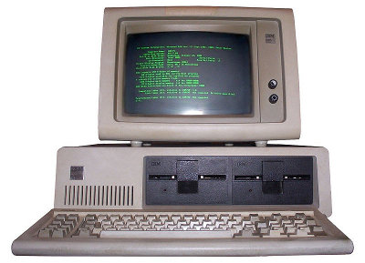
Evolution

Slide 23
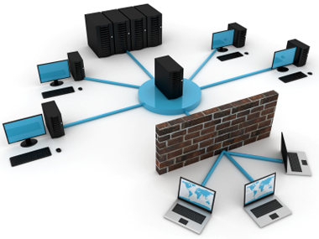
Evolution

Slide 24



Slide 25
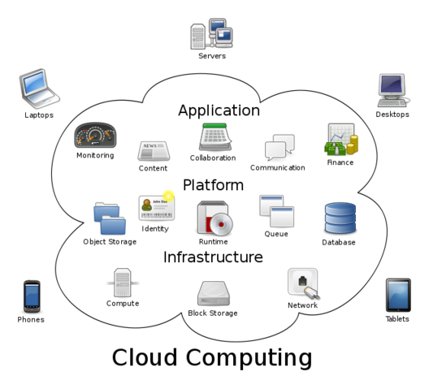

Slide 26
Cloud Computing Characteristics
On-demand self service – Cloud Service Provider (CSP) has ability to utilize computing capabilities without requiring human interaction with customers.
Broad network access – Cloud network is accessible from anywhere by almost any device (phone, laptop, tablet, etc.).
Resource pooling – CSP resources are pooled to serve multiple entities using a multitenant model. Customers generally do not have control or knowledge of exact location of CSP resources (storage, processing, memory, network, bandwidth and virtual machines).

Slide 27
Cloud Computing Characteristics
Rapid elasticity – CSP can rapidly allocate resources for customers to accommodate needs. To customers this appears seamless and they can be charged only for what they use.
Measured service – CSP systems automatically control and optimize resource usage. Resource usage can be monitored, controlled and reported, providing transparency for both the CSP and the customer.
Multi-tenancy of data – Sharing of an application by multiple customers.

Slide 28
Cloud Delivery Models
Infrastructure as a Service (IaaS) – Provides online processing or data storage capacity. This service is ideal for entities considering very large, one-time processing projects or infrequent, extremely large data storage, networks and other computing resources.
Platform as a Service (PaaS) – Provides resources for application development. Entities essentially rent resources in the cloud for development and testing various applications.
Software as a Service (SaaS) – Provides business application usage by many individual users and entities concurrently. Applications are accessible from various client devices through a thin client interface such as a web browser.

Slide 29
Question #4
Cloud delivery models include:
a) SIEM, FISMA and PCI compliance
b) Premise based systems
c) SaaS, PaaS and IaaS

Slide 30
Cloud Deployment Models
Private Cloud – One entity user. Often employ virtualization within an entity’s existing computer servers to improve computer utilization. This model is closely related to the existing IT outsourcing models.
Public Cloud – Offered by one CSP to many entities who share the cloud processing power concurrently. Entities share applications, processing power and data storage space. Entity data is commingled, but segregation is provided through the use of metatags.

Slide 31
Cloud Deployment Models
Community Cloud – Private-public cloud with users having a common connection or affiliation, such as a trade association, the same industry or a common locality. The business model allows CSP to provide cloud tools and applications to specific needs of the community.
Hybrid Cloud – A combination of tow or more of the other cloud deployment models. Hybrid cloud leverages the advantage of the other models in an attempt to provide a more optimal user experience.

Slide 32
Risks related to cloud use

Slide 33
COSO Inherent Risk - Cloud Delivery and Deployment

Slide 34
Cloud Risks
Security Responsibility – Who will be responsible for data security the CSP or the Government? What is the extent of responsibility for each party?
Authentication and Authorization – responsibility and controls over user authentication and authorization including any third parties and maintenance of these rights.
Isolation Failure – Muti-tenancy creates risk to ensure government specific data is properly segregated, stored and access limited to authorized users.

Slide 35

Compliance and Legal – What data for how long and in what form.
Security Incidents – Detection, reporting and subsequent notification and remediation.
Management Interface Vulnerability – Interfaces to access cloud resources allow access to larger sets of resources this increases risk when combined with remote access and web browser vulnerabilities.
Application Protection – With infrastructure security delegated to the CSP governments need to re-evaluate perimeter security at the network level including applying more controls at the user and application data level.

Slide 36
Data Protection – Exposure to release sensitive data as well as the loss or unavailability of data. Governments will find it harder to effectively evaluate and check on the CSP data handling practices. This issue becomes more complicated where the CSP utilizes sub-contractors.
Malicious Behavior of Employees – Governments risk is compounded to not only its own employees but those of the CSP.
CSP Business Failure – CSP business failure could result in data and applications essential to the Governments operations and financial reporting to become unavailable over an extended period of time.

Slide 37
Service Unavailability/ Reliability and Performance Issues – Could be caused by hardware, software, communication network failures, or hacks.
Vendor Lock-in – Lack of portability of applications and data across provider presents the risk of data and service unavailability in case of a change in providers.
Insecure or Incomplete Data Deletion – Termination of CSP may not result in deletion of the Governments data. This could be the result of the CSP back up process where data is co-mingled with other CSP customers making specific data deletion difficult.

Slide 38
Lack of Transparency – CSP may be unlikely to provide information about its processes, operations, controls, and methodologies
High-value cyber-attack targets – CSP’s may become a more attractive target of cyber attacks because of the ability to disrupt many entities by attacking one CSP
IT Organizational Changes – While using a CSP may reduce the size or need for internal IT departments. This may also result in a negative impact on remaining IT personnel and or reduction in the qualifications of IT personnel

Slide 39
GAO on Service Level Agreements

Slide 40
Properly Prepare Your Service Level Agreements with CSP
The GAO Recommends Key Practices for CSP Agreements Broken Into Four Categories:
    Roles and Responsibilities (RR)
    Performance Measures (PM)
    Security (S)
    Consequences (C)

Slide 41
Properly Prepare Your Service Level Agreements with CSP
THE GAO Recommends the following Key Practices for CSP Agreements:
    RR - Specify roles and responsibilities of all parties
    RR - Define key terms, such as dates and performance measures
    PM – Define who is responsible for measuring performance (level of service, duration, capacity/number of users, response times for processing addressing outages, etc.)
    PM - How and when government has access to its own data networks. Including how networks will be managed during the agreement period
    PM - How data networks will be transitioned back to government upon termination

Slide 42
Properly Prepare Your Service Level Agreements with CSP
THE GAO Recommends the following Key Practices for CSP Agreements:
    PM - How the CSP monitor performance and report results to the government
    PM - When and how the government, via an audit, will evaluate/confirm performance of the CSP
    PM – CSP should provide disaster recovery and continuity of operations planning and testing
    PM - CSP reporting responsibilities for outages and other service failures or data base breaches
    PM - Remediation of outages, service failures and breaches including what steps the CSP will take to mitigate re-occurrence

Slide 43
Properly Prepare Your Service Level Agreements with CSP
THE GAO Recommends the following Key Practices for CSP Agreements:
    PM – Identify PM exceptions when CSP performance measures do not apply (ex. During scheduled maintenance)
    S – Specify metrics the CSP must meet to show compliance with the governments performance requirements for protecting data. Clearly identify who has access to data and the protections in place to protect the governments data.
    S – Specify performance requirements and attributes defining how and when the CSP is to notify the agency when security requirements are not being met (when a data breach occurs)
    C – Specify a range of enforceable consequences, such as penalties for non-compliance with CSP agreement performance measures

Slide 45
Question #5
The GAO recommended practices for CSP agreements are broken into X categories:
a) 4
b) 6
c) 3

Slide 46
COSO ERM IC Model

Slide 47
COSO ERM CUBE

Slide 48
COSO ERM - Framework
Internal Environment – The internal environment component serves as the foundation for and defines the organization’s risk appetite in terms of how risks and controls are viewed. For instance, if management has a policy of not outsourcing any of its operations (i.e., there is a culture of risk avoidance), this policy will limit the viable options for cloud deployment and service delivery models so that private cloud solutions might be the only acceptable alternative.

Slide 49
COSO ERM - Framework
Objective Setting – Management needs to evaluate how cloud computing aligns with the organization’s objectives. Depending on the circumstances, cloud computing might present an opportunity for the organization to enhance its ability to achieve existing objectives, or it might present an opportunity to gain a competitive advantage, which would require new objectives to be defined.

Slide 50
COSO ERM - Framework
Event Identification – Management is responsible for identifying the events (either opportunities or risks) that can affect the achievement of objectives. The complexity of event identification and risk assessment processes increases when an organization engages cloud service providers.
Management needs to consider external environmental factors (e.g., regulatory, economic, natural, political, social, and technological), as well as the organization’s internal factors (e.g., culture, personnel, and financial health), as part of the process when identifying and assessing risk events.

Slide 51
COSO ERM - Framework
Risk Assessment – Management should evaluate the risk events associated with its cloud strategy to determine the potential impact of the risks associated with each cloud computing option. Ideally, risk assessments should be completed before an organization moves to a cloud solution.

Slide 52
COSO ERM - Framework
Risk Assessment (cont.) – Cloud computing can affect the following critical focal points of a risk assessment:
Risk profile – An organization’s risk profile encompasses the entire population of risks it must manage.
Inherent and residual risk – An organization must assess the inherent risks of the events and then develop risk responses and determine the residual risk.
Likelihood and impact – The likelihood of certain events and the related potential impact change in many cases when cloud solutions are adopted.

Slide 53
COSO ERM - Framework
Risk Response – Once risks have been identified and assessed in the context of organizational objectives relative to cloud computing, management needs to determine its risk response.

Slide 54
COSO ERM - Framework
Risk Response (cont.) – There are four types of risk responses:
Avoidance – Exiting the activities giving rise to risk (i.e., not moving to the cloud or considering only private cloud types of solutions as viable options).
Reduction – Implementing control activities and taking actions to reduce risk likelihood, risk impact, or both.
Sharing – Reducing risk likelihood or risk impact by transferring or otherwise sharing a portion of the risk (e.g., buying insurance).
Acceptance – Taking no action to affect risk likelihood or impact. For example, when an organization does not have direct ability to manage the controls of its CSP, the organization is accepting an increased level of inherent risk.

Slide 55
COSO ERM - Framework
Control Activities – The traditional types of controls (preventive, detective, manual, automated, and entity-level) apply to cloud computing as well.
The difference introduced by cloud computing is that some control responsibilities might remain with the organization while certain control responsibilities will be transferred to the CSP

Slide 56
COSO ERM - Framework
Control Activities (cont.) – If the quality of an organization’s existing control activities is moderate or poor, going to a cloud solution could exacerbate internal control weaknesses.
  For example, if an organization with poor password controls or data security practices migrates its computing environment to a public or hybrid cloud solution, the possibility of an external security breach is likely to increase significantly due to the fact that access to the organization’s technology base is now through the public Internet.

Slide 57
COSO ERM - Framework
Information and Communication – To effectively operate its business and manage the related risks, management relies on timely and accurate information and communications from various sources regarding external and internal events.
With cloud computing, information received from a CSP might not be as timely or of the same quality as information from an internal IT function. As a result, fulfilling management’s information and communications requirements might require additional or different information processes and sources.

Slide 58
COSO ERM - Framework
Information and Communication (cont.) – Management should also monitor external information related to its CSP (e.g., financial reports, public disclosures, regulatory filings, industry periodicals, and announcements by fellow cloud tenants), since certain events impacting the CSP or fellow cloud tenants might also have an impact on the organization.

Slide 59
COSO ERM - Framework
Monitoring – Management must monitor the effectiveness of its ERM program to verify that the program adequately addresses the relevant risks and facilitates achieving the organization’s objectives. Effective ERM programs are evolving and dynamic in nature and must be increasingly so given the pace of cloud computing’s evolution in terms of solution offerings, competitors’ adopting the cloud, and changing laws.
Given cloud computing’s potential and actual impact, senior management personnel across the entity (not just the chief information officer) need to be assigned responsibilities to achieve cloud computing governance.

Slide 60
Question #6
The COSO ERM framework includes:
a) Internal environment
b) Monitoring
c) Risk Response
d) All of the above

Slide 61
Cloud Computing Resources
GAO Report - http://www.gao.gov/products/GAO-16-325
Cloud Standards Customer Council - http://www.cloud-council.org/deliverables/CSCC-Security-for-Cloud-Computing-10-Steps-to-Ensure-Success.pdf
COSO Thought Paper - http://www.coso.org/documents/Cloud%20Computing%20Thought%20Paper.pdf
ISACA IT Control Objectives - http://www.isaca.org/chapters2/kampala/newsandannouncements/Documents/IT%20contro%20objectives%20for%20Cloud%20computing.pdf

