Slide 1
Understanding the Status of ACA and Cost Mitigation Practices
Clay Austin
Florida League of Cities
This is only a brief summary that reflects our current understanding of select provisions of the law, often in the absence of regulations. All of the interpretations contained herein are subject to change as the appropriate agencies publish additional guidance.

Slide 2
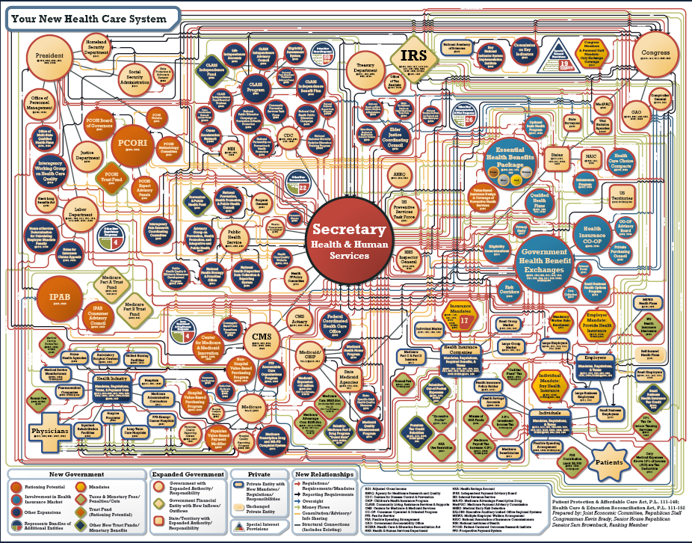

Slide 3
Understanding the Current State of the ACA

Slide 4
Trump executive order on the ACA
January 20 order seeks to reduce “burdens” pending repeal
Additional notes
Seeks “to minimize the unwarranted economic and regulatory burdens” of the ACA pending the law’s repeal
Directs agencies to waive, defer, grant exemptions or delay provisions imposing cost, fee, penalty or regulatory burdens on individuals, families, providers, insurers, patients, recipients of health care services, purchases of insurance, medical device and pharmaceutical manufacturers, to extent permitted by current law
Scope and implications TBD based on agency implementation of the executive order
Agencies must make decisions about relief that will be granted; such decisions could be delayed pending approval of political appointees
Executive order does not specifically refer to employer-sponsored plans
May grant administration flexibility to address issues Congress does not (or cannot) include in legislation repealing or replacing the ACA

Slide 5
Health Care Reform Considerations Under New Administration
Employer-sponsored Plans
Medicare
Potential elimination of employer mandate (and reporting rules)
Health care benefit taxation (excise tax vs. exclusion cap)
Cost management
Prescription drug pricing
Provider/health system impact
Carrier implications
Conflicting rules on health status incentives (ACA and EEOC)
Expanded role for HSAs
Combine Parts A and B; add out-of-pocket maximum
Part D coverage
Medicare Advantage funding
Medicare supplement plan design
Uncompensated care
Expansion of means testing
Higher eligibility age
Premium support (privatization)

Slide 6
Three potential directions
Lower Tax Rates
Less Regulation
Health Care Changes
Accelerate pension plan contributions
Monitor capital market reactions
Review pension asset strategy/mix
Plan for the possibility of increased retirements
Shift nonqualified pension liability to qualified plan and fund
Fund retiree welfare liabilities via a qualified trust (VEBA), in a pension plan (401(h) account) or settle via a tax effective annuity
Fund incurred but not reported (IBNR) claims for the active medical plan in a qualified trust (VEBA) in 2016 to ensure larger tax deduction
Maintain status quo through relative pay mix
Stay the course relating to Dodd-Frank until there is more clarity
Continue efforts on calculating your CEO Pay Ratio
Do not expect significant movement on “pay gap” rulings
Keep and broaden your clawback provisions
Prepare for the fiduciary rule to be delayed, perhaps indefinitely
Review and confirm existing human capital policies and procedures
Continue to comply with current rules and regulations
Anticipate change and prepare for a range of potential actions; think through a few scenarios
Update strategy and objectives in sponsoring group health care benefits
Review plan design + delivery (cost management, employee engagement…)
Consider potential impact on employees and retirees including future retirees
Communicate with employees re: concerns and overall benefits value

Slide 7
Employer confidence in offering health care continues to grow
How confident are you that your organization will continue to sponsor health care benefits to active employees in five years and in ten years, either via a self-managed plan or use of a private exchange?
+10

Slide 8
Health care cost trend remains at historically low levels
Health care cost trends after plan changes are well above the rate of inflation. Employers under 1,000 lives appear more likely to make plan changes to address trend closer to 8%.

Slide 9
Cost Mitigation and the ACA

Slide 10
What’s driving variability in health care costs?
Vendor Partner Strategy
Determine entities best positioned to help you deliver on your strategy
Employee and dependent participation
Single most significant predictor of per employee health costs
Health Care Delivery
Maximize purchasing value of health care services
Participation
Efficiency
Workforce Health
Identify and effectively manage population health risks
Engagement and Consumerism
Increase participant engagement through shared accountability
Pharmacy
Manage specialty drug costs and leverage cost-effective options
Program design value and subsidy level
Define financial commitments based on overall program value
Subsidization

Slide 11
Managing costs - Public Sector & Education
#1 Priority is to evaluate health and pharmacy plan design strategy
92%
Plan to change health and pharmacy plan design as most important priority in the next 3 years
Anticipate adopting spousal surcharge by 2018, compared to 3% today
Structure employee contributions based on employees taking specific actions, which could reach 50% in two years
Currently use defined contribution strategies, expected to increase to 47% by 2018
28%
19%
22%

Slide 12
Employers embrace telemedicine – Public Sector & Education
Offer telemedicine for professional consultations
31%
Of employers offer tele behavioral health or tele-psychiatry currently, expected another 44% by 2018

Slide 13
Low program participation lead companies to revisit their incentive strategy
25%
67%
$927
Of companies plan to increase their use of incentives over the next three years. Two-thirds plan to maintain current levels, while 10% plan to decrease or completely eliminate their use.
Use financial rewards for individuals who participate in health management programs/activities, which dropped from 77% in 2015
Maximum incentive opportunity continues to rise but the pace slows. Are we approaching a plateau?

Slide 14
Use of incentives is changing – Public Sector & Education
TOBACCO SURCHARGE: Reward (or penalize) based on smoker, tobacco-use status (tobacco surcharge)
BIOMETRIC OUTCOMES: Reward (or penalize) based on biometric outcomes other than smoker, tobacco-use status
$435
Median tobacco surcharge

Slide 15
Nearly two thirds consider health and well-being a core part of employee value proposition
To what extent do you agree with the following statements about your organization’s approach to health and well-being?
 | Employee value proposition Health and well-being is a core part of our organization’s employee value proposition
 | Effective communication Our organization has a health and well-being strategy that is effectively communicated to employees and deliver on its promises
 | Effectively improve Our health and well-being program has effectively improved employee health behaviors (e.g., program participation, health risk reduction)
 | Customized and differentiated Our health and well-being program is customized for critical workforce segments and used to differentiate from other organizations with which we compete for talent

Slide 16
Conclusions: What can we learn from best performers?
Employers take action to curb the cost of specialty pharmacy, focusing on price, utilization and delivery/site of care
Examine health care benefits in a total rewards context with changes to plan design and account contributions that consider affordability for low-wage employees
Understanding your population health is critical in selecting programs. Greater opportunities to broaden measurement to include non-financial metrics
Lack of employee engagement warrants a review of program structure, vendor partners, and incentive strategy
Consider care extenders, such as telemedicine and onsite/near site clinics, to enhance employee access, productivity, and convenience in a cost effective manner
Greater emphasis on value-based arrangements through plan designs that encourage employees to utilize high-value services (quality and cost effectiveness) to maximize the value they receive from their health care benefit
Put employees at the center of the health care strategy
Enhance the member experience through more choice with decision support
Expand well-being programs to address financial issues alongside physical, emotional and social
Adapt the workplace environment to encourage good health habits

Slide 17
NEXT STEPS?
This is only a brief summary that reflects our current understanding of select provisions of the law, often in the absence of regulations. All of the interpretations contained herein are subject to change as the appropriate agencies publish additional guidance.

