Slide 1
Florida Government Finance Officers Association
Budgeting Basics
February 19, 2015
Michael D. Perry, CGFO
Budget Officer
City of Tampa

Slide 2
Agenda
The Budget Office
Budget Cycle
  Planning for the Next Budget Cycle
  Monitoring Current Year Activities
  Budget Instructions
  Department Budget Preparation
  Budget Department’s Review of Submitted Budget

Slide 3
Agenda
  Capital Improvement Budget
  Publishing the Budget Document
  Presentations to Legislative Body
  Truth in Millage Process
  Non-Ad Valorem Hearing Process
  After Action Review
Budget Book versus CAFR
Odds & Ends

Slide 4
The Budget Office
Each governmental agency has established and organized their budget office to meet their needs
Vary in size and composition
  Centralized budget office with all of the organization’s analysts assigned
  Central core budget office with departmental analysts
  Budget function integrated within the finance department/office

Slide 5
The Budget Office
Budgeting is a management function
Budget Office’s function:
  Analyze historical trends to better forecast current and future financial outlook
  Ensure the organization’s long-term financial health
  Prepare reports and review financial transactions
  Ensure compliance with GAAP and GASB

Slide 6
Planning for the Next Budget Cycle
Preparing the budgeting system
  Technology department should be involved
  Format/prepare template for new budget year
  Prior years financial data
  Adopted/current budget
  Capital improvement budget
Personnel data
  Validating data
  Current information correct (pay grade, salary, salary date, step, name, benefit information)

Slide 7
Planning for the Next Budget Cycle
Revenue projections
  State revenue estimating conferences –edr.state.fl.us
  Local Government Financial Information Handbook
  Trend analysis

Slide 8
Planning for the Next Budget Cycle
Major events/leading indicators that will affect the upcoming budget
  Property taxes
  Legislation
  Health-care/pension costs
  Retirements/DROP
  Collective bargaining agreements/compensation
Chief executive officer’s guidance

Slide 9
Monitoring Current Year Activities
Report to chief executive officer
High level – major funds and departments
Identify problems and potential solutions
This year’s performance effects next year’s budget
MONTHLY BUDGET ANALYSIS
 |  |  |  |  |  |  |  | General Fund and Utility Tax Fund
CURRENT YEAR (BUDGET VS. PROJECTIONS) |  |  |  |  |  |  |  | For the month ending March 2014
Revenue Drivers:
 |  | 100% | Property Taxes |  |  |  |  |  | 77% | Fines and Forefeits
 |  | 96% | Other Taxes |  |  |  |  |  | 77% | Miscellaneous Income
 |  | 96% | Permits |  |  |  |  |  | 95% | Utility Tax - Electric
 |  | 100% | Intergovernmental |  |  |  |  |  | 98% | Utility Tax - Communication Svs
 |  | 99% | Charges for Services |  |  |  |  |  | 100% | Utility Tax - Water
 | Thresholds
 |  | Rev | Exp |  |  | Rev/Exp |  |  | Rev | Exp
 |  | >100% | <90% |  |  | 90% - 100% |  |  | < 90% | > 100%
CURRENT YEAR (BUDGET VS. PROJECTIONS)
Expense Drivers:
 |  | 98% | Salaries |  |  |  |  |  | 93% | General Employees Pension
 |  | 111% | Overtime |  |  |  |  |  | 94% | Electric
 |  | 111% | Other Pay |  |  |  |  |  | 94% | Fuel
 |  | 97% | Other Benefits |  |  |  |  |  | 97% | Other Operating
 |  | 99% | Fire & Police Pension
 | Thresholds
 |  | Rev | Exp |  |  | Rev/Exp |  |  | Rev | Exp
 |  | >100% | <90% |  |  | 90% - 100% |  |  | < 90% | > 100%

Slide 10
Monitoring Current Year Activities
Reports to departments
  Current year budget and actuals
  Budget analyst’s year-end projections
  Easy to read and understand
  Discuss/identifies variances, issues to watch
MONTHLY BUDGET ANALYSIS
 |  |  |  |  |  |  |  |  |  |  |  | Water Department
CURRENT YEAR (Budget VS. Projections)
 |  |  |  |  |  |  |  |  |  |  |  | For the month ending March 2014
Revenue Drivers:
 |  | 98% | Total Revenues |  |  |  |  | Total revenues are currently anticipated to be under the budgeted amount by approximately 2% due to combined effects of three month watering restrictions that ended in March 2014 and higher than normal rainfall reducing water demand.
Expenditure Drivers:
 |  | 100% | Total Personnel Costs |  |  |  |  | Personnel costs are currently anticipated to remain within budget. Actual expenses are 49% of the annual budgeted amount.
 |  | 95% | Total Operating Costs |  |  |  |  | Operating costs are projected at approximately 95% of budget with anticipated savings in Tampa Bay Water contractual services and chemical usage due to low water demand through March.
 |  | 100% | Total Capital Outlay Costs |  |  |  |  | Total expenses are currently anticipated to remain within budget. Actual expenses are 38% of the annual budgeted amount.
 | Thresholds
 |  | Rev | Exp |  |  | Rev/Exp |  |  | Rev | Exp
 |  | >100% | <90% |  |  | 90% - 100% |  |  | < 90% | > 100%
Plan: |  |  | The Water Department and Budget Office will continue to monitor revenues and expenses throughout FY2014 with specific focus on water sales, personnel, Tampa Bay Water contract, electricity, repairs and maintenance, and chemicals.
Department: |  |  | The department is in agreement.

Slide 11
Monitoring Current Year Activities

Slide 12
Monitoring Current Year Activities

Slide 13
Monitoring Current Year Activities
Category | Account | Account Description | Budget | Encumbrance | Actual | Balance | Burn Rate. | Projected | Projected %.
Charges for Services | 343301 | Water Sales--Wcrwsa--N Blvd | (1,275,000) | - | (529,414) | (745,586) | 41.52% | (1,433,000) | 112.39%
 | 343302 | Water Sales | (90,650,000) | - | (37,669,947) | (52,980,053) | 41.56% | (88,975,220) | 98.15%
 | 343303 | Hydrant Rental-City | (425,000) | - | - | (425,000) | 0.00% | (425,000) | 100.00%
 | 343304 | Sale of Water Fr Hydrants | (100,000) | - | (55,224) | (44,776) | 55.22% | (102,000) | 102.00%
 | 343305 | Hydrants and Fire Line-Billing | (550,000) | - | (339,398) | (210,602) | 61.71% | (630,000) | 114.55%
 | 343306 | Rental of Meters | (55,000) | - | (32,552) | (22,448) | 59.19% | (56,000) | 101.82%
 | 343307 | Water Meter Test | - | - | - | - |  | (100)
 | 343308 | TBW Pass Through | (1,820,000) | - | 30,356 | (1,850,356) | -1.67% | (1,044,800) | 57.41%
 | 343309 | Other Water Services | - | - | - | - |  | -
 | 343310 | Bad Debt Collections-Water | (185,000) | - | (95,511) | (89,489) | 51.63% | (193,000) | 104.32%
 | 343311 | Mdse Jobbing & Contracting | (36,000) | - | (6,300) | (29,700) | 17.50% | (15,450) | 42.92%
 | 343312 | Connection Fees-Meters | (1,120,000) | - | (471,215) | (648,785) | 42.07% | (1,010,000) | 90.18%
 | 343313 | Installation Charges-Meters | (650,000) | - | (264,161) | (385,839) | 40.64% | (586,000) | 90.15%
 | 343315 | Connection Fees-Fire Lines | (345,000) | - | (237,487) | (107,513) | 68.84% | (479,000) | 138.84%
 | 343316 | Installation Charges-Fire Lines | (10,000) | - | (12,568) | 2,568 | 125.68% | (10,000) | 100.00%
 | 343318 | Water Application Fees | (70,000) | - | (31,921) | (38,079) | 45.60% | (69,000) | 98.57%
 | 343319 | Inspection Fees-Fire Lines | (40,000) | - | (27,149) | (12,851) | 67.87% | (60,000) | 150.00%
 | 343320 | Inspection Fees-Main Extension | (10,000) | - | (8,709) | (1,291) | 87.09% | (7,000) | 70.00%
 | 343321 | Application Fee-Der Permit | (7,000) | - | (1,921) | (5,079) | 27.44% | (1,500) | 21.43%
 | 343322 | Charges From Wastewater For Meter Srvc | (400,000) | - | - | (400,000) | 0.00% | (400,000) | 100.00%
 | 343324 | Reclaimed Water Water Usage | (1,700,000) | - | (708,424) | (991,576) | 41.67% | (1,565,000) | 92.06%
 | 343325 | Reclaimed Water Meter Install Fee | (35,000) | - | (9,769) | (25,231) | 27.91% | (19,000) | 54.29%
 | 343326 | Reclaimed Water Connection Fee | (2,000) | - | - | (2,000) | 0.00% | (2,000) | 100.00%
 | 343327 | Reclaimed Water Relocation Fee | (500) | - | (510) | 10 | 102.00% | (1,000) | 200.00%
 | 343328 | Reclaimed Water Water Application Fees | (500) | - | (229) | (271) | 45.80% | (300) | 60.00%
 | 343329 | Reclaimed Water Inspection Fee | (500) | - | - | (500) | 0.00% | (500) | 100.00%
Charges for Services Total |  |  | (99,486,500) | - | (40,472,054) | (59,014,446) | 40.68% | (97,084,870) | 97.59%

Slide 14
Monitoring Current Year Activities
Category | Account | Account Description | Budget | Encumbrance | Actual | Balance | Burn Rate. | Projected | Projected %.
Personnel | 512000 | Regular Salaries and Wages | 10,519,210 | - | 5,061,888 | 5,457,322 | 48.12% | 10,363,342 | 98.52%
 | 512002 | Terminal Leave | 82,300 | - | 43,452 | 38,848 | 52.80% | 82,300 | 100.00%
 | 512003 | Longevity Awards | 189,787 | - | 34,896 | 154,891 | 18.39% | 189,787 | 100.00%
 | 512006 | Floating Holiday | 45,005 | - | 11,736 | 33,269 | 26.08% | 32,037 | 71.19%
 | 514000 | Overtime | 781,000 | - | 418,185 | 362,815 | 53.54% | 745,000 | 95.39%
 | 515003 | Sick & Annual Leave Accrual | - | - | - | - |  | -
 | 516000 | Compensated Annual Leave | 694,775 | - | 352,858 | 341,917 | 50.79% | 574,572 | 82.70%
 | 517000 | Compensated Sick Leave | 416,862 | - | 265,143 | 151,719 | 63.60% | 576,632 | 138.33%
 | 521000 | Fica Taxes | 696,918 | - | 346,198 | 350,720 | 49.68% | 696,612 | 99.96%
 | 521001 | 1.45% Medicare Match | 163,643 | - | 81,234 | 82,409 | 49.64% | 163,192 | 99.72%
 | 522000 | Retirement Contributions | 1,966,062 | - | 995,136 | 970,926 | 50.62% | 1,976,892 | 100.55%
 | 523000 | Life Insurance | 34,118 | - | 14,361 | 19,757 | 42.09% | 28,892 | 84.68%
 | 523001 | Accidental D&D Insurance | 6,611 | - | 3,419 | 3,192 | 51.72% | 6,879 | 104.05%
 | 523002 | Employee Health Insurance | 1,802,498 | - | 863,456 | 939,042 | 47.90% | 1,751,940 | 97.20%
 | 523003 | Long-Term Disability Insurance | 10,490 | - | 5,313 | 5,177 | 50.65% | 10,810 | 103.05%
 | 524000 | Workers? Compensation | 800,803 | - | 400,402 | 400,401 | 50.00% | 800,803 | 100.00%
 | 525000 | Unemployment Compensation | 39,884 | - | 13,599 | 26,285 | 34.10% | 17,207 | 43.14%
 | 529999 | Personnel Services and Benefits Budget Reserve | (149,000) | - | (17,966) | (131,034) | 12.06% | - | 0.00%
Personnel Total |  |  | 18,100,966 | - | 8,893,310 | 9,207,656 | 49.13% | 18,016,897 | 99.54%

Slide 15
Budget Instructions
Budget calendar
Management instructions for preparation and submission of budget requests
  Target budgets
  Budget reduction scenarios
  Requested budget increases
Technical instructions
Frequently Asked Questions – why do we prepare the budget a certain way

Slide 16
Departmental Budget Preparation
Departmental narrative information
Vision
Mission
Goals & Objectives
Additional initiatives and information
Department Name: Wastewater
DEPARTMENT WEBSITE: http://www.tampagov.net/dept_wastewater/
VISION AND MISSION:
The Wastewater Department's vision is to become a world-class utility while protecting the environment. We will operate in a cost-effective manner and continually improve our work practices. The mission is to provide outstanding wastewater services to our customers while protecting public health and the environment.
GOALS AND OBJECTIVES:
The Wastewater Department's goal is to provide complete and cost-effective service and to respond rapidly to expanding service requirements. To achieve its goal, the Department's primary objectives include:
• Development, tracking, and reporting of specific, measurable, and relevant performance metrics;
• Implementation of an effective and efficient asset management program;
• Expansion of cross-training efforts amongst multi-skilled workforce technicians;
• Improving internal and external communication through the use of modern technologies; and
• Rehabilitation and/or replacement of facilities as necessary to maximize reliability and minimize operating costs.
CURRENT OPERATIONS AND INITIATIVES:
In FY2015, the Department will continue with the following initiatives in support of its primary objectives:
Complete design, award contracts, and complete construction for rehabilitation of the Krause and Louisiana Pump Stations;
Design and award additional construction contracts to continue with Department's collection system renewal and replacement program to repair and replace deteriorated force mains and gravity sewers located throughout the collection system; and
Complete the construction for the replacement of the Orient Road force main.

Slide 17
Departmental Budget Preparation
Link performance measures to strategic outcomes
Comprehensive plan
Neighborhood plans
Developer initiatives
Other opportunities
City of Tampa Strategic outcomes:
  Changing Economic DNA
  Strong Neighborhoods
  Safe Streets
  Efficient Government
Neighborhood Plans
  InVision Center City Plan
  West River Area Plan

Slide 18
Departmental Budget Preparation
Performance Measures
Linked to organization’s strategic plans
Measures effectiveness, efficiency, and quantity
CITY STRATEGIC PRIORITY:
􅎖Changing Tampa's Economic DNA 􀜆Keeping our Streets Safe
􀜈Strengthen our Neighborhoods 􀜈Effective & Efficient Government
Performance Measures | Actual FY2013 | Projected FY2014 | Estimated FY2015
Non-Revenue Producing Water (%) | 9.6 | 9.5 | 9.5
Reclaimed Water Demand (mgd) | 3.31 | 3.21 | 3.4
Call Center - Average Call Wait Time (minute:seconds) | 1:51 | 1:50 | 1:45
Call Center - Calls Abandoned (%) | 10.4 | 9.0 | 8.0
Meter Reading Accuracy (%) | 99.7 | 99.8 | 99.8
Hydrants Inspected (%) | 100 | 100 | 100

Slide 19
Departmental Budget Preparation
Outcomes versus inputs
Presents case for budget request
  To administrators and chief executive officer
  Tie to performance outcomes
  Detailed information at the account level to support revenue estimates and expenditure requests
Non-Department Budget
Debt Service Budget

Slide 20
Departmental Budget Preparation
Inputs
Reduction in parking fund
Outcomes
Time to empty garage following performance arts center program – 90 minutes
Increase staff for project management office
Increase in the number and scope of city’s capital improvement program

Slide 21
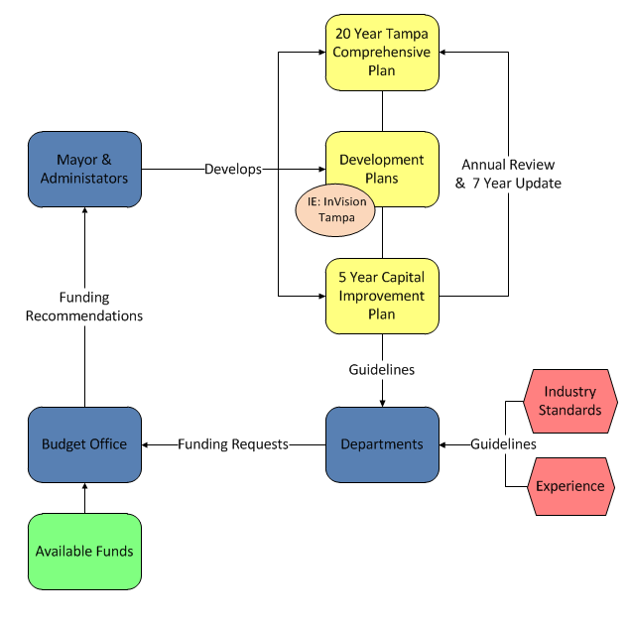
Capital Improvement Program
CIP is part of the long- range planning system
Guided by comprehensive plan and development plans
Available funding

Slide 22
Capital Improvement Program
Usually five years in scope
Incorporate the needs/goals of long-range plans
  Comprehensive plan/Comprehensive Improvement Element (CIE)
  Neighborhood plans/initiatives
  Replacing older infrastructure or expand for growth

Slide 23
Capital Improvement Program
Understand limitations and restrictions of funding sources
Local Government Financial Information Handbook
  Communications Services Tax
  Local Business Tax
  Local Government Infrastructure Surtax
  Fuel Taxes
  Local Revenues
  Impact Fees
  Water/Wastewater/Parking/Solid Waste rates
  Tourist Development Tax
  Grants
  Debt Proceeds

Slide 24

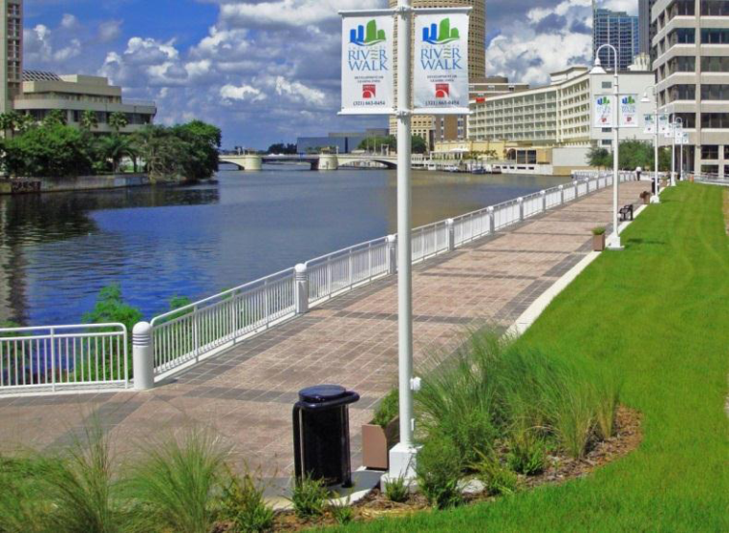
Capital Improvement Program
Changing the Community
Changes the community’s fabric
Understand how projects are constructed – site visits

Slide 25
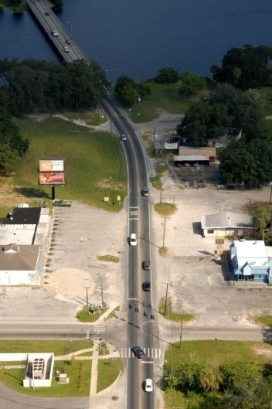
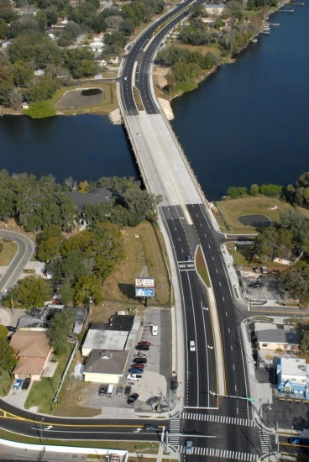
Capital Improvement Program
Changing the Community
Before
After
40th Street Segment Before Construction
40th Street Segment After Construction

Slide 26
Capital Improvement Program
Capital Cash Flow Model
Ensure that each revenue source is balanced for each year of the CIP

Slide 27
Capital Improvement Program
Capital Cash Flow Model

Slide 28
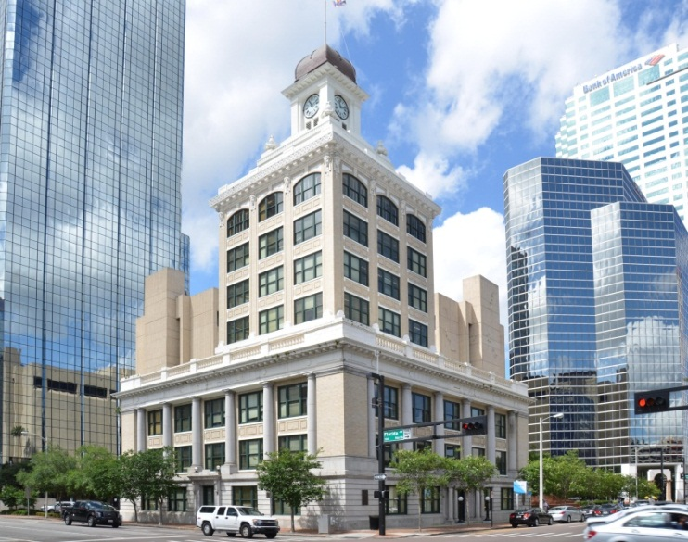
Capital Improvement Program
Capital Cash Flow Model

Slide 29
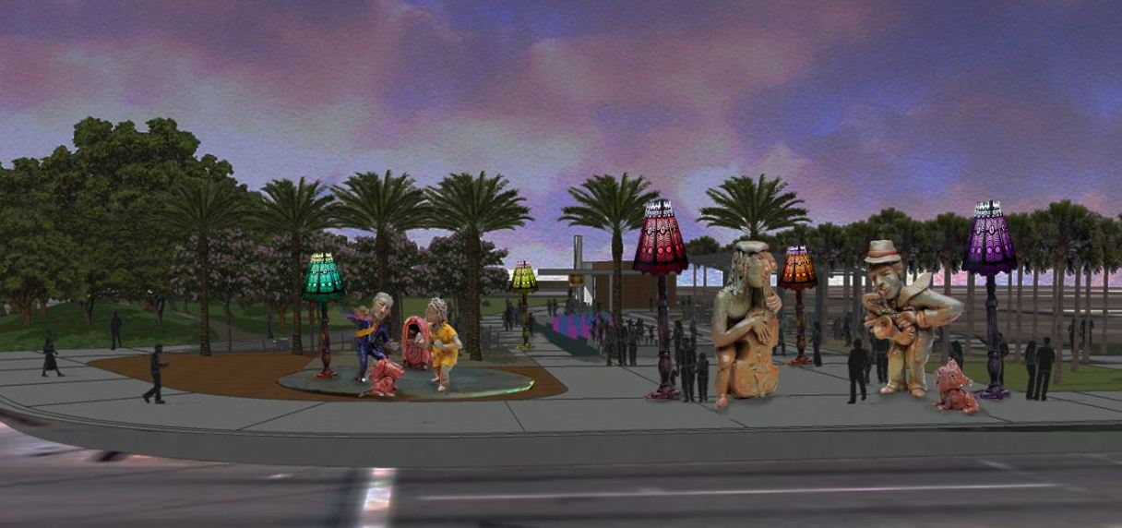
Capital Improvement Program
Sources and Use Statement
Project specific
One page briefing tool that summarizes all revenues and project funding requirements

Slide 30
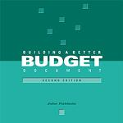
Publishing the Budget Document
Presentation matters
Follow the guidelines, but it is your document
GFOA Distinguished Budget Award Program
  Policy document
  Financial plan
  Operations guide
  Communications device
  Reviewed by a three person panel of volunteers with government budgeting experience
Building a Better Budget Document, John Fishbein

Slide 31
Publishing the Budget Document
Primary users of the budget document
  Elected officials
  Supervisors
  Public
  Rating agencies

Slide 32
Presentation to Legislative Bodies
How and when you present to the legislative bodies is a local practice
Workshops allows for exchange of information
Allows legislative bodies to ask questions and provide guidance
Chief executive officer’s budget presentation
TRIM required public hearings

Slide 33
Truth in Millage Process
Most important process of the budget!!!!
E-Trim

Slide 34
What is TRIM?
Purpose is to provide taxpayers transparency in how local taxing authorities propose and approve millage rates as part of the taxing authorities’ budget adoption process.
Determine whether there is a tax increase proposed (calculate the rolled-back rate)

Slide 35
TRIM Key Processes
June 1- Estimate; July 1 – Preliminary Tax Roll
TRIM Notice (forms DR-420, DR-420MM-P, DR-420TIF forms)
Budget Ordinance & Resolutions
Proper Notices and Advertisements
Public Hearings
DR-422 (before/after Value Adjustment Board)
TRIM Compliance Package

Slide 36
TRIM Calendar
On or before June 1st - Property Appraiser provides estimated taxable values to local taxing authorities (not technically part of TRIM)
July 1 – 1st day of calendar – Property Appraiser provides the Preliminary Tax Roll to all taxing bodies on Form DR-420

Slide 37
TRIM Calendar (cont.)
By day 35 (August 4), taxing bodies must file with the Property Appraiser (PA) and the tax collector the tentative millage rate on form DR-420 as well as forms DR-420TIF and DR-420MM-P (Also must provide tentative 1st public hearing date on DR-420)
Notice of Proposed Taxes (TRIM notice)is distributed by the Property Appraiser no later than day 55 (August 24)

Slide 38
TRIM Calendar (cont.)
Between day 65 (September 3) and day 80 (September 18), taxing authority must hold its first public hearing
Within 15 days of holding the first public hearing, the taxing authority must publish an advertisement to adopt the final millage and budget

Slide 39
TRIM Calendar (cont.)
Second public hearing must be held between 2 and 5 days after the advertisement has been published
Within 3 days after the second public hearing, taxing authority must file its millage rate ordinance with the property appraiser and the tax collector

Slide 40
TRIM Calendar (cont.)
End of September or early October - Taxing authorities receive extended roll taxable values from PA (DR-422). Taxing authorities have three days to determine if they will adjust their millage rates administratively
Within 30 days after the second public hearing, taxing authority files certification (DR-487) and required documentation with DOR

Slide 41
TRIM Calendar (cont.)
Within 60 days after the second public hearing, the DOR will indicate compliance or non-compliance with the Statute
After completion of Value Adjustment Board hearings, Property Appraiser provides taxing authorities with final taxable values

Slide 42
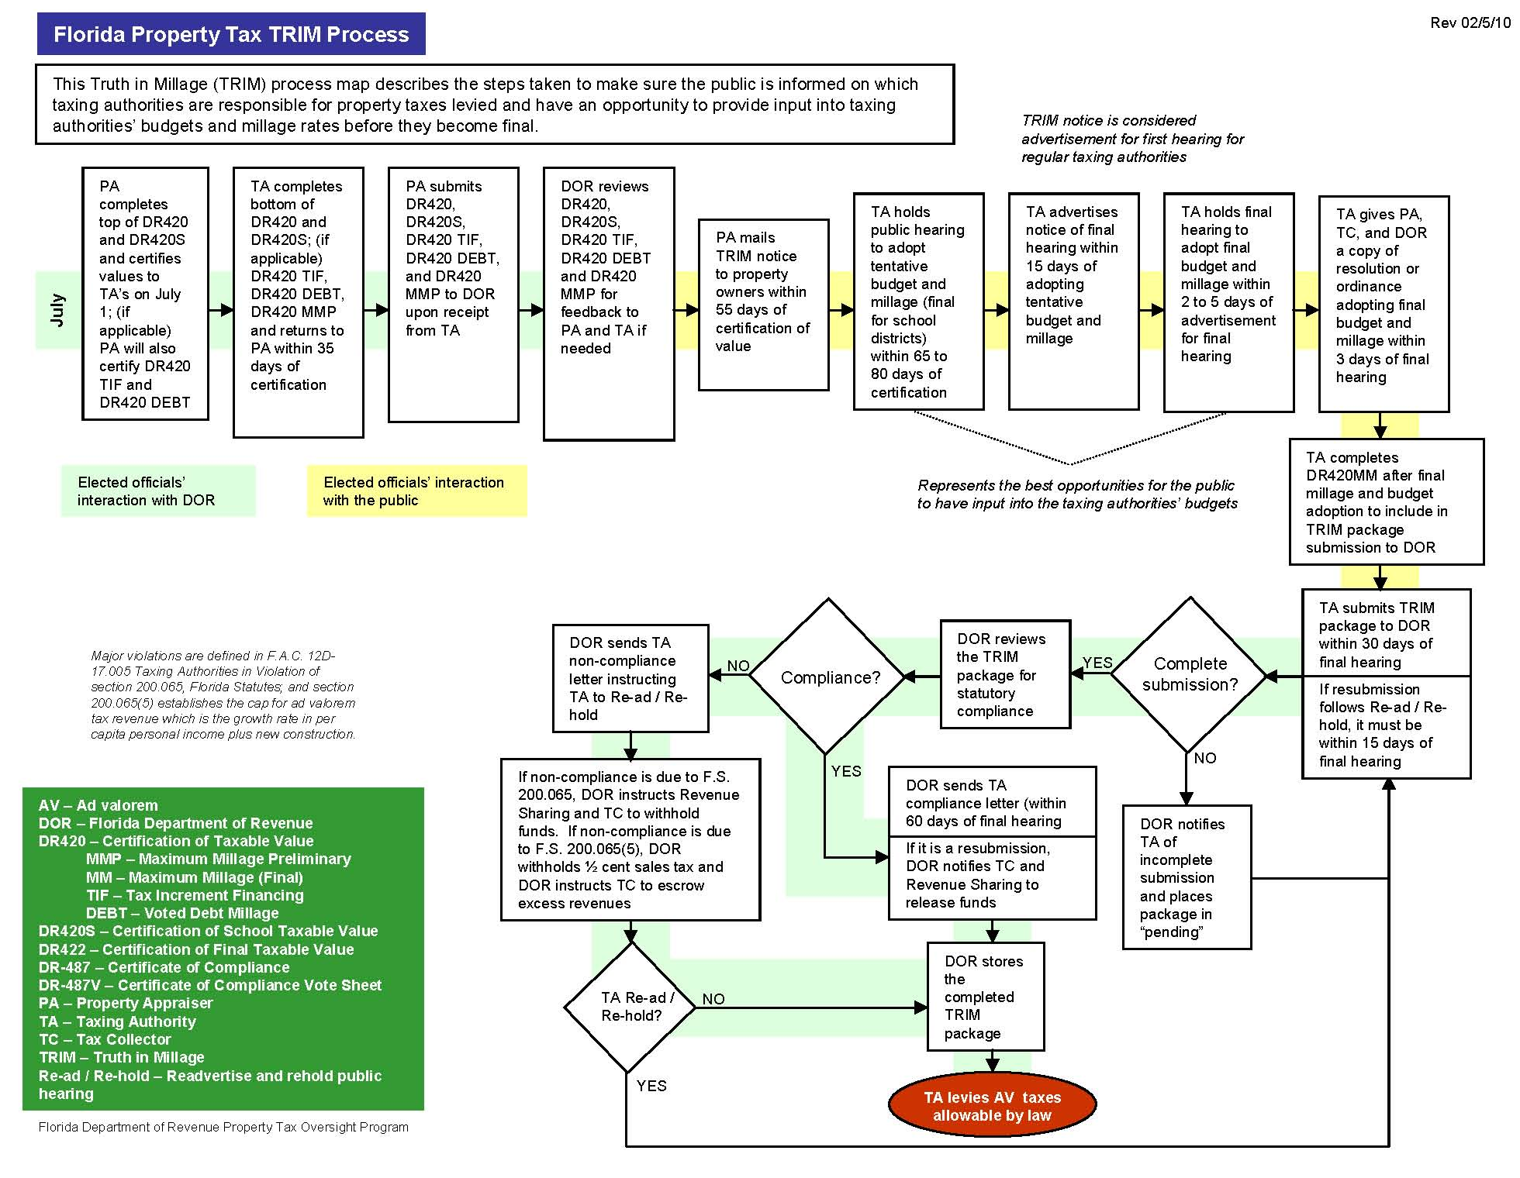
TRIM Calendar - Florida DOR

Slide 43
Budget Hearings
Per F.S. 200.065, School Boards and Counties have priority in selecting public hearing dates
School Boards get first priority, Counties are second
No other taxing authority can hold its hearing on the same date as the School Boards or Counties
Hearings start after 5 p.m. (5:01 p.m. at the earliest)

Slide 44
Budget Hearings (cont.)
At both hearings, millage rate must be discussed first before the Budget; increase over RBR must be announced
At the first public hearing, the millage rate can be increased from the tentatively adopted millage in July; however, would require a first class mailing to all taxpayers

Slide 45
Budget Hearings (cont.)
At the second public hearing, the millage rate cannot be increased from the tentatively adopted millage rate at the first public hearing
The general public is allowed to speak before the governing body can take any action of adoption
The millage must be adopted before the budget can be adopted

Slide 46
Budget Hearings (cont.)
No millage can be levied until the taxing authority adopts a resolution or ordinance
The following must be publicly announced at the hearing before adopting the millage:
  Name of the Taxing Authority
  Rolled-back rate
  Percentage of increase over the rolled-back rate
  Millage to be levied

Slide 47
Budget Hearings (cont.)
“This is the First Public Hearing for the City of Tampa FY2015 Budget. The proposed millage rate is 5.7326 mills, which is 5.16% more than the rolled back millage rate of 5.4514 mills. Property tax funds are used to support the General Fund operating budget of the City. This Fund includes such Departments as Fire Rescue and Police, Human Resources, Parks and Recreation, and Public Works.”

Slide 48
Advertisement Requirements
A Notice of Tax Increase ad is required if the millage rate is greater than the rolled-back rate
A Notice of Budget Hearing ad is required if the millage rate is equal to or less than the rolled-back rate
In either case, a Budget Summary advertisement is required to be published adjacent to the appropriate “Notice” ad

Slide 49
Notice of Proposed Tax Increase Ad
Size requirements for the Notice of Proposed Tax Increase ad
  Full 1/4 page
  Headline type of 18 point or larger
May not be published in legal or classifieds
Do not deviate from specified language (see TRIM Manual on DOR website)

Slide 50
Notice of Proposed Tax Increase Ad

Slide 51
Notice of Budget Hearing Ad
No specific size requirements
May not be published in legal or classifieds
Do not deviate from specified language

Slide 52
Budget Summary Ad
No size requirements
Must be published adjacent to the appropriate “Notice” ad
Basically shows flow of funds including reserves available, revenues and expenditures, transfers, yielding in effect a “Total Available” and a “Total Appropriated”, including reserves

Slide 53
Budget Summary Ad (cont.)
Include all budgeted revenues, expenditures and reserves
  Group by fund type (General, Special Revenue, etc.)
  Group revenues and expenditures by major classification
  Exclude trust, agency, internal service funds, and bond proceeds
Must show ad valorem revenue at a level of 95% or greater of the tax levy amount
See Examples in TRIM Manual

Slide 54
Budget Summary Ad (cont.)

Slide 55
DOR TRIM Violations/Infractions
DOR keeps track of violations or infractions annually
“Minor” infractions are noted with the letter the taxing authority receives if the TRIM package is “in compliance”
Serious violations and how they may be corrected are included in letter of non-compliance

Slide 56
Non-Compliance
If Department of Revenue review indicates non-compliance with maximum rates
  Determination within 30 days of submittal deadline (30 days after adoption)
  Repeat hearing and advertisement process
  Notice includes “Previous Notice . . In Violation of the Law”
  Revised millage adopted recertified with State within 15 days of adoption; not sent to PA or TC

Slide 57
Uniform Method of Collection
(Non-Ad Ad Valorem Assessment)
What is the Uniform Method of Levy, Collection, and Enforcement - Statutory process as provided in Florida Statutes 197.3632 for the levy, collection, and enforcement of Non-Ad Valorem assessments
What is a Non-Ad Valorem Assessment - An assessment, which is not based upon value and can become a lien against a homestead

Slide 58
Uniform Method of Collection
(Non-Ad Ad Valorem Assessment)
What is a special district - A Special District is a unit of special-purpose government operating within a defined geographic boundary for a specific purpose. They have limited and specific powers.

Slide 59
Uniform Method of Collection
(Non-Ad Ad Valorem Assessment)
How is a special district created - A special district can be created by general law, special act, local ordinance, or by rule of the Governor or Cabinet to provide specialized services not provided by units of general-purpose government inclusive of Municipalities and Counties.

Slide 60
Uniform Method of Collection
(Non-Ad Ad Valorem Assessment)
Must hold public hearing to adopt the roll between January 1 and September 15 if:
  Non-ad valorem assessment is levied for the first time
  Non-ad valorem assessment is increased beyond maximum rate authorized
  Local government boundaries have changed
  Purpose of the non-ad valorem assessment has changed

Slide 61
Uniform Method of Collection
(Non-Ad Ad Valorem Assessment)
At least 20 days prior to public hearing, public must be noticed by first-class U.S. mail and by publication in a newspaper of general circulation within each county contained in the boundaries of the local government
By September 15 the chair or designee shall certify a non-ad valorem roll to the tax collector

Slide 62
After the Budget
Assist in the preparation of the year-end financial reports and/or CAFR
  Budget to actuals – explain variances
  Review statements and notes
  Understand what is behind the numbers – ask for the working papers

Slide 63
After Action Review
After Action Review
  Good, bad, and ugly
  Expand on what went right, fix what went wrong
  Do better next year
  Hold management accountable for improvements
Agenda
8:30 am – Opening
8:45 am - 9:30 am Round 1
9:30 am – 9:45 am Break
9:45 am – 10:30 am Round 2
10:30 am – 11:15 am Report out
11:15 am – 11:30 am Final Comments
Round 1 | Round 2
Pre-Budget & Departmental Process *Lead – Pullara Vance, Reed, Lozo, Hobbs, Rice, Certain | Revenue Projections *Lead – Murphy Carballa, Seth, Hobbs, Pullara
Reports and Publishing *Lead – Waitman Stanton, Murphy, Gobble, Herbert | Personnel Budgeting (HCP) *Lead – Vance King, Hardeman, Tran, Reed
Technology & System *Lead – Seth Hardeman, Carballa, Tran, King | CIP Process *Lead – Stanton Gobble, Herbert, Waitman, Lozo, Rice, Certain

Slide 64
Budget Book and the CAFR
Consistent information between documents
Budget books is more narrative in nature
CAFR concentrates on schedules
My preference – don’t use account structure numbers in the documents; use the names

Slide 65
Odds and End
Blue Book (GAAFR)
  Know it, use it
  Separate fact from folklore
Fiscal Transparency - Be aware of requirements
  Posting of budgets on web sites
  Posting of budget amendments on web sites

Slide 66
Odds and End
Budget analyst
  Pursue Certified Government Finance Officer designation
  Be inquisitive
  Know you organization’s account structure
  Master your organization’s systems (financial, purchasing, budget)
  Push the envelope, ask why not

Slide 67
Conclusion
Building a Better Budget Document, John Fishbein - http://gfoa.org/building-better-budget-document-second-edition
Local Government Financial Information Handbook - http://edr.state.fl.us/Content/local-government/reports/index.cfm#local-government
Department of Revenue -http://dor.myflorida.com/dor/property/cofficials/
Any questions?

