Slide 1
BANKING SERVICES
HOW TO MANAGE & MAXIMIZE YOUR LOCAL BANKING RELATIONSHIPS & IMPROVE YOUR INVESTMENT PORTFOLIO
RENE’ O’DAY
Vice President, Sales & Relationship Manager–Florida
FL SAFE | PMA Financial Network, Inc.
Clayton R. Meng, CPA
Finance Director
Clay County Board of County Commissioners
October 23, 2017

Slide 2
Manage and Maximize
An enhanced bank structure is one
key to treasury efficiency
Inefficient bank account structures lead to excess costs, wasted time, errors and more complicated oversight
Unnecessary accounts result in more monthly bank statements to be reconciled and more account analyses to be scrutinized
    Balances accumulating inefficiently
    Bank account administration and control responsibilities expand

Slide 3
Review your banking relationship
Challenging economic environments underscore the importance of your banking relationship
Risk management
    Assure your bank is a QPD and that all funds are properly collateralized in accordance with Chapter 280
    Don’t let the low interest rate environment lure you into undue risk
    Set controls that correspond and are in compliance with your policy
      Internal payment controls (depending upon payment type)
    Limit Counterparties to a specifically stated list and understand how these relationships correspond with your banking institution.

Slide 4
Review your banking relationship
Liquidity
    Timely account reconciliation
    Cash forecasting
    Improve cash flow by speeding the cash conversion cycle
Transaction management
    Fully automated
    Electronic payments may be easier to manage against fraud

Slide 5
Review your banking relationship
    Strong internal and IT controls on all programs, data files and devices related to customers and employees information to ensure privacy and prevent unauthorized use, including network security to protect data files from internal and external threats.
    Strong segregations of duties, including dual control for the establishment of templates and the authorization of transactions, establishment of dollar limits for authorized personnel and the establishment and use of passwords, PINS and secure authentication for authorized personnel to initiate transactions.

Slide 6
MANAGE THE relationship
Manage Your Banking Relationship
Keep current on products, services and exposures with the bank
Create policies and procedures covering all activities or interactions with your bank
Keep current with your analysis fees and accuracy to your usage of the services
    Review current Earnings Credit offerings. As rates increase, ECR and interest income on excess funds may need adjusting.
      A higher ECR may allow for a lower compensating balance. Excess funds can be swept into higher interest earning vehicles that fit into your Investment Policy
      Keep current with the bank’s financial condition and banks’ credit ratings
      Maintain frequent relationship reviews with your Relationship Manager

Slide 7
MANAGE THE relationship
Manage Your Banking Relationship Through Routinely Scheduled Relationship Reviews
The most valued aspect of your banking relationship is to make sure the bank continuously understands your business and operations
Assures your needs are being met by addressing any concerns or issues
Discuss market changes relating to Earnings Credit or account structure changes to better fit your current needs and contain cost

Slide 8
MANAGE THE relationship
Update staff to any Treasury Management product enhancements to better manage the day to day duties and minimize fraud risk
Address any line item pricing concerns or ways to better manage cash flows
Update bank on any staff or board changes
Make sure your Relationship Manager understands your audit reporting needs and their importance

Slide 9
MANAGE THE relationship
The GFOA recommends that state and local governments should perform cost/benefit analysis, implement safeguards and routinely evaluate opportunities to make and receive electronic payments that are suitable for their specific needs for the following:
Disbursements
  Payroll and retirement payments
    Emergency procedures available
  Expense reimbursements
  Vendor payments
  Social benefits and child support payments
  Intergovernmental payments
  Other recurring payments
Collections
  Utility payments
  Tax payments
  License payments
  Grant payments
  Tuition payments
  Traffic tickets
  Other receipts

Slide 10
Maximize your banking relationship
Maximize Through Performance
Evaluate specific analyzed services on a cost/benefit basis
    FDIC Assessment Fees?
    Remote Deposit versus Lockbox?
    Cash Concentration instead of Cash Vault Services?
    Wire bond payments instead of ACH?
    Competitive Earnings Credit?
It is important that you look beyond the standard package offered, choose the right service package for you
    Various service needs can be bundled together, or
    Can be separate with different providers
    Understanding your business, economic and political environment determines the services provided by your banking relationship

Slide 11
Maximize your banking relationship
The Request for Proposal (RFP) helps establish your banking relationship
It is a recommended best practice by the Government Finance Officer’s Association (GFOA)
Provides the basis for the services that will be provided
The RFP will set the stage for your relationship
Understanding your business is as important as understanding the business services the bank will provide you
The banking services contract will establish the banking relationship
Meeting routinely with your relationship manager/banker will keep the lines of communication open and provide opportunities for cost savings through the use of new products

Slide 12
Maximize your banking relationship
Utilize Cash Flow Analysis to Maximize Interest Income
There is more to money management than simply shopping for investments. Cash Flow Analysis should map out such items as payroll and accounts payable dates and amounts, and debt schedules.
An accurate cash flow plan:
    Helps meet all liabilities with a maturity
    Invest longer to take advantage of higher rates
    Plan for cash shortfalls
    Identify long-term investment potential
    Maximize interest income
    An intelligently built investment schedule that seeks to capitalize on the yield curve benefits of longer-term investing

Slide 13
SAMPLE
INVESTMENT Strategy

Slide 14
SAMPLE
INVESTMENT Strategy

Slide 15
Maximize your banking relationship
Historic cash flow data ultimately provides a complete and reliable picture from which investment decisions are based
Review cash-based historical monthly data by fund
    Determining trends
    Isolating anomalies
    Incorporating specific information (e.g., A/P cycle, payroll cycle, summer payroll, debt schedules, calendar, etc.) to ensure the plan is as accurate as possible

Slide 16
Maximize your banking relationship
Maximizing return on investment starts with reviewing and managing core operating and banking relationships, touching key aspects such as:
Risk Management
Navigating market changes
Understanding Cash Flows and future needs
Liquidity management
Acting as a Fiduciary

Slide 17


APPENDIX
RENE’ O’DAY | Vice President, Sales and Relationship Manager – Florida
Tel: (407) 797-8228 | Email: roday@pmanetwork.com
  FL SAFE | PMA Financial Network, Inc. | PMA Securities, Inc.
  Rene’ joined the firm in 2015 and is responsible for all sales and marketing efforts of FL SAFE/PMA products and services in Florida for PMA’s participants, prospects and clients. She is a proven Relationship Manager specializing in government banking, finance and investment services.
  During her over 28 years in the Florida market, Rene’ has held various operating leadership positions within the banking industry, working with various sized banking institutions specific to Treasury Management products and services, as well as bank internal operation positions. She is a native Floridian, is active with the Florida Government Finance Officers Association (FGFOA), the Association of Financial Professionals (AFP), Women in Leadership and has a passion for Florida’s Economic Development. Rene’ holds Series 6 and 7 FINRA licenses.

Slide 18
APPENDIX
SAMPLE QPD MATERIAL

Slide 19
Qualified public depository information
In Florida, Banking Services must be with a Qualified Public Depository Bank pursuant F.S. 280.02
What is a Qualified Public Depository:
    Florida Statutes 280
    Collateral backing bank's obligation to pay in addition to bank's own credit standing
    “Joint and Several” support agreement among banks
    State puts responsibility on you to have original collateral
    Letter on file (see Appendix)
    Trust but verify

Slide 20
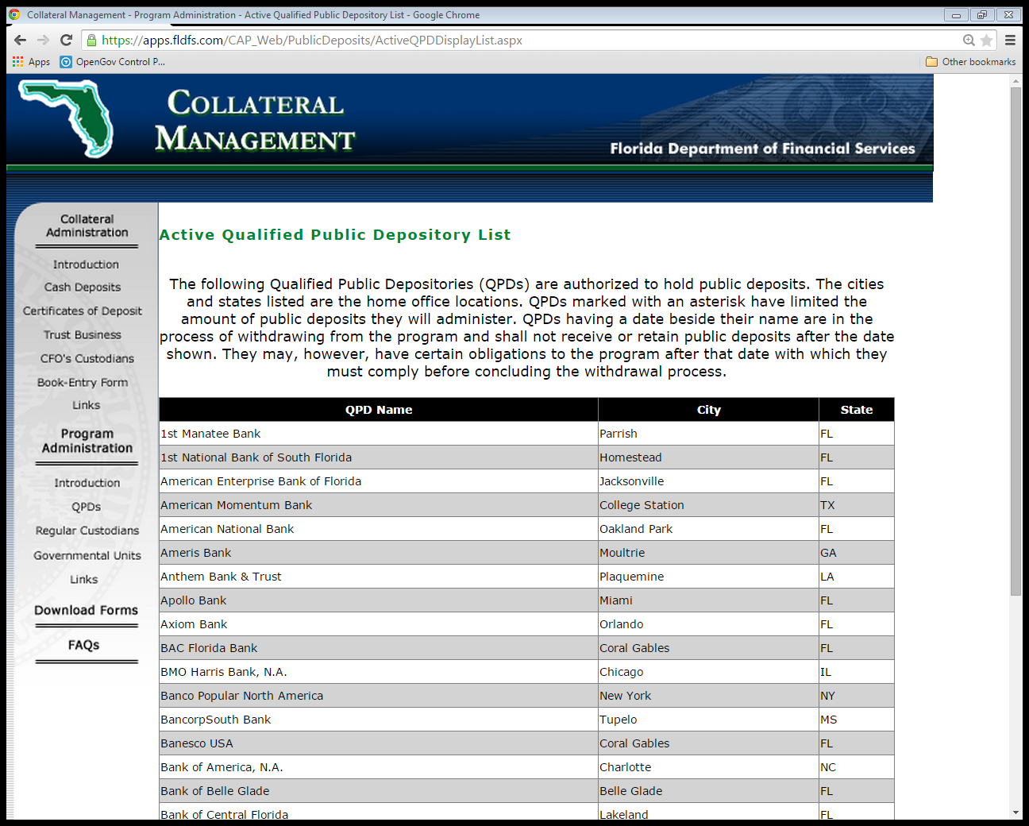
Active qualified public depository

Slide 21
Public identification & acknowledgement form

Slide 22
Public depositor annual report filing

Slide 23
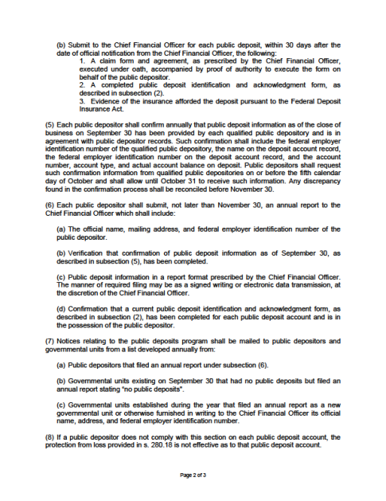
Public depositor annual report filing

Slide 24
Disclaimer
The information contained herein is solely intended to suggest/discuss potentially applicable financing applications and is not intended to be a specific buy/sell recommendation, nor is it an official confirmation of terms. Any terms discussed herein are preliminary until confirmed in a definitive written agreement.
The analysis or information presented herein is based upon hypothetical projections and/or past performance that have certain limitations. No representation is made that it is accurate or complete or that any results indicated will be achieved. In no way is past performance indicative of future results. Changes to any prices, levels, or assumptions contained herein may have a material impact on results. Any estimates or assumptions contained herein represent our best judgment as of the date indicated and are subject to change without notice. Examples are merely representative and are not meant to be all-inclusive.
The information set forth herein was gathered from sources which we believe, but do not guarantee, to be accurate. Neither the information, nor any options expressed, constitute a solicitation by us for purposes of sale or purchase of any securities or commodities. Investment/financing decisions by market participants should not be based on this information.
You should consider certain economic risks (and other legal, tax, and accounting consequences) prior to entering into any type of transaction with Prudent Man Advisors, Inc. Our analyses are not and do not purport to be appraisals of the assets, or business of any entity. PMA makes no representations herein as to the actual value which may be received in connection with a transaction nor the legal, tax, or accounting effects of consummating a transaction. PMA cannot be relied upon to provide legal, tax, or accounting advice. You should seek out independent and qualified legal, tax, and accounting advice from outside sources.
Securities, public finance and institutional brokerage services are offered through PMA Securities, Inc. PMA Securities, Inc. is a broker-dealer and municipal advisor registered with the SEC and MSRB, and is a member of FINRA and SIPC. Prudent Man Advisors, Inc., an SEC registered investment adviser, provides investment advisory services to separately managed accounts and local government investment pools. All other products and services are provided by PMA Financial Network, Inc. PMA Financial Network, Inc., PMA Securities, Inc. and Prudent Man Advisors (collectively "PMA") are under common ownership. Securities and public finance services offered through PMA Securities, Inc. are available in CA, CO, FL, GA, IL, IN, IA, KS, MI, MN, MO, NE, OH, OK, PA, SD, TX and WI. This document is not an offer of services available in any state other than those listed above, has been prepared for informational and educational purposes and does not constitute a solicitation to purchase or sell securities, which may be done only after client suitability is reviewed and determined. For additional information please visit the website at www.pmanetwork.com.
© 2017 PMA Financial Network, Inc., PMA Securities, Inc. and Prudent Man Advisors, Inc., Inc. All rights reserved. For institutional use only.

